Slide 1
Academic style

Slide 2
ACADEMIC WRITING
Written English may be formal and informal
Academic writing is formal in an impersonal or objective style; cautious language is frequently used; vocabulary appropriate for particular academic context is used (specialist or technical vocabulary); the structure varies according to the particular type (genre), for example essay, report, thesis, etc.

Slide 3
Full form of words
contracted forms (e.g. can’t, shouldn’t, won’t, isn’t) are not acceptable in the academic style
full forms should be used instead: cannot, should not, will not

Slide 4
Referencing
Academic writing often contains references to other writers’ publications, sometimes including quotations
The purpose of quotations and references is to demonstrate support for own ideas, points of view and findings, and to show examples or evidence
Quotations should not be overused

Slide 5
Nominalisation
a tendency to describe actions with nouns, rather than verbs and condense the writing
  Germany invaded Poland in 1939. This was the immediate cause of the Second World War breaking out.
  The recession occurred because too many consumer goods were produced.
  Crime is increasing rapidly and causing concern.
Rewrite these sentences using nominal phrases instead of the underlined verbs.

Slide 6
Answer key
  Germany’s invasion of Poland in 1939 was the immediate cause of the outbreak of the Second World War.
  The recession occurred because of an over-production of consumer goods.
  The rapid increase in crime is causing concern.

Slide 7
Formal or informal?
The project will be completed next year.
I showed that his arguments did not hold water.
I wonder why he put up with those terrible conditions for so long.
Five more tests will be necessary before the experiment can be concluded.
It is possible to consider the results from a different viewpoint.
It has been proved that the arguments so far are without foundation.
He’ll have to do another five tests before he can stop the experiment.
It isn’t clear why such terrible conditions were tolerated for so long.

Slide 8
Informal sentences
She said it wasnt’t good enough.
I thought the lecture was terribly difficult to follow.
They’ve got to find out how to carry out a survey of old folks’ opinions of little kids.
The results were a lot better than I expected.
None of our other student friends knew the answer either.
He said: ‘It’s hell being on your own.’
Rewrite the sentences in a formal style!

Slide 9
Answer key
It was said that it was unsatisfactory.
It seemed that the lecture was very difficult to understand.
They need to discover how to conduct a survey of elderly people’s opinions of young children.
The results appeared to be better than expected.
It was reported that the answer was not known by any of the students.
It was said that one man was very unhappy at being alone.

Slide 10
Cautious language
Read the following sentences which contain definite statements:
A survey has shown that lecturers use the terms ‘seminars’ and ‘tutorials’ interchangeably.
The rate of inflation will not increase this year.
Reading is effective when it has a particular purpose.
The answer to problems is found in asking the right questions.
Countries disagree on the interpretation of democracy.
Rewrite the sentences so that the statements are more cautious!

Slide 11
Answer key
A survey has shown that many lecturers seem to use the terms ‘seminars’ and ‘tutorials’ frequently interchangeably.
There is an assumption that the rate of inflation may not increase next year.
It is said that reading is most effective when it has a particular purpose.
Perhaps the answer to problems is to be found in asking the right questions.
Many countries appear to disagree on the interpretation of democracy.

Slide 12
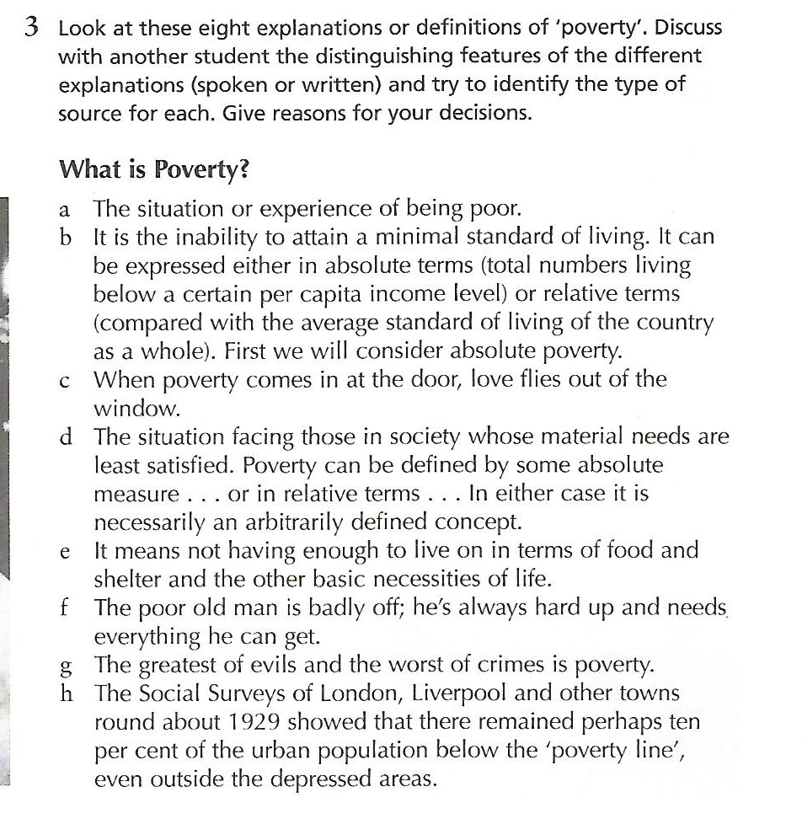
Finding sources

Slide 13
Answer key
a A dictionary definition.
b An explanation by an economist.
c A proverb
d A specialist economics dictionary definition.
e A spoken definition by an educated adult
f Informal statement
g From literature
h From a history text

Slide 14
Inappropriate language
Rewrite the following in an academic style:
Causes of writing errors
Research has shown (James) that learners of English find writing the most difficult thing they’ve got to do. There are 3 main types of error that the learner will make.
The biggest sort of error leads to misunderstanding or a total breakdown in communication. There are lots of causes of this: the biggest is the use of translation from the mother tongue. By translating word for word the student uses the wrong sentence patterns (grammar) and the wrong words (vocabulary). Another cause is choosing to write too long and complicated sentences with far too many supplementary clauses. The longer the sentence the bigger is the chance of making mistakes and failing to communicate the meaning. Therefore, in the early stages of your writing, you shouldn’t write sentences longer than 3 lines.

Slide 15
Sample answer
Causes of writing errors
Some research suggests (James, 1988) that learners of English appear to find that writing is the most difficult thing for them to master. There are three main types of error that learners frequently might make.
The most serious type of error may lead to a misunderstanding or a total breakdown in communication. There are many causes of this: one of the biggest is the use of translation from the mother tongue. By translating word for word the student may employ the wrong sentence patterns and the wrong vocabulary. Another cause is choosing to write long and complicated sentences with an excessive number of subordinate clauses. The longer the sentence, the greater is the likelihood of making mistakes and failing to communicate the meaning. Consequently, in the early stages of their writing, the advice to students is that they should not write sentences which are longer than three lines.

Slide 16
Finding errors
Identify some types of error in the paragraph!

Slide 17
Comments
- a year is needed for the reference
- thing and do are too vague
- contractions are inappropriate
- you should be avoided – it should be impersonal
- small numbers should be put into words
- more formal language is needed
- a number of statements need to be qualified

Slide 18
Informal style
Informal English contains:
Colloquialisms
Hesitation fillers (e.g. well, you know...)
Contractions
Phrasal and prepositional verbs
Euphemisms
All of the above should be avoided in academic writing

Slide 19
Personal pronouns
Personal pronouns (I, you, we) tend not to be used in more formal writing. Instead the style may be more impersonal. An introductory it or there may begin sentences; passive forms may also be used.

Slide 20
Thank you for your attention!

