Slide 1
Nuremberg to Guantanamo: US Military Commissions in Perspective
Howard R. Cabot
March 27, 2014

Slide 2
"Injustice anywhere is a threat to justice everywhere." --- Martin Luther King

Slide 3
Amnesty Int'l USA v. Clapper No. 09-41112, slip at 17 (2d Cir. September 21, 2010
"The Constitution sets limits on the powers even of Congress. It is the glory of our system that even our elected leaders must defend the legality of their conduct when challenged. Short-circuiting that process risks not only that we will be governed by unconstitutional laws, but also that legitimate exercises of the lawmaking power will exist under a cloud, undispelled by the light of objective reasoning." (Lynch,J. Concurring)

Slide 4
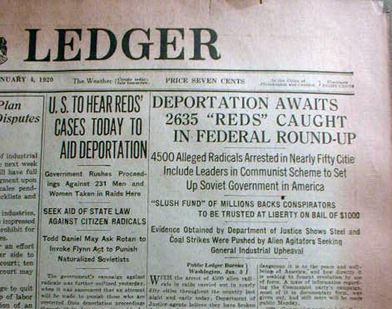
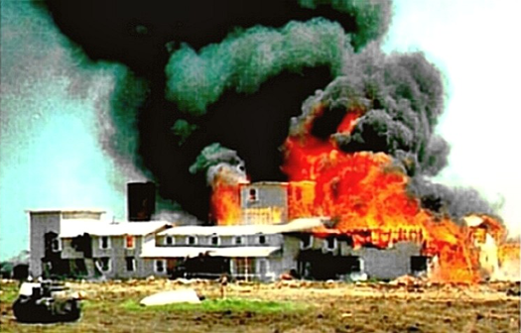
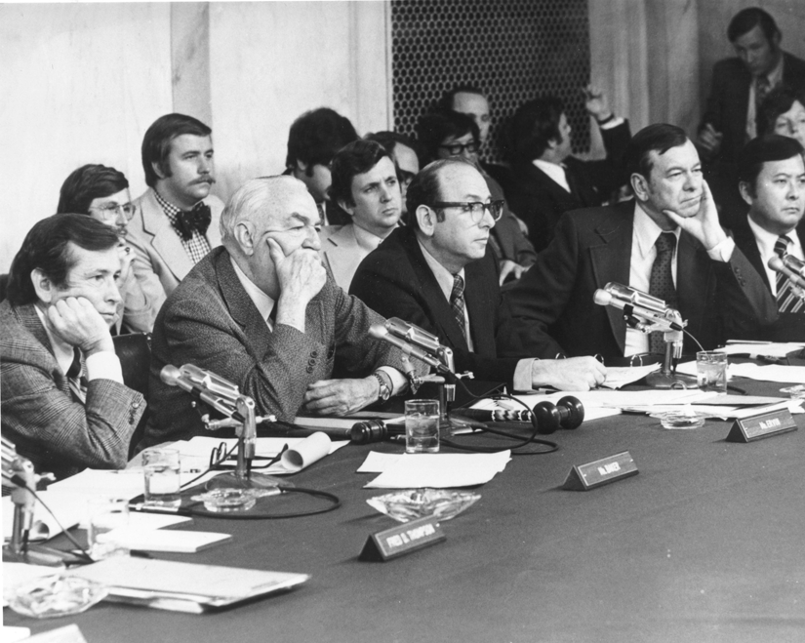
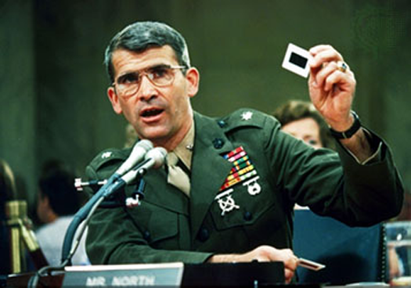
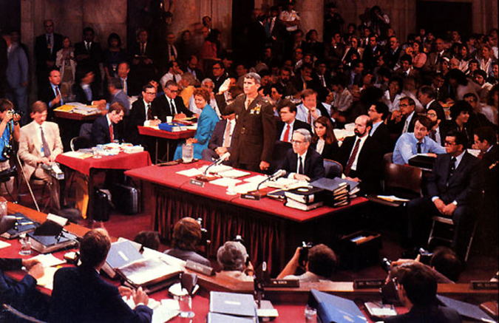
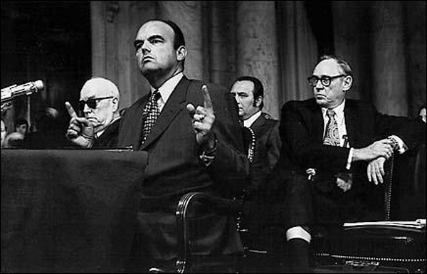
Risks
Waco, Texas
Palmer Raids
Iran-Contra Affair
Watergate

Slide 5
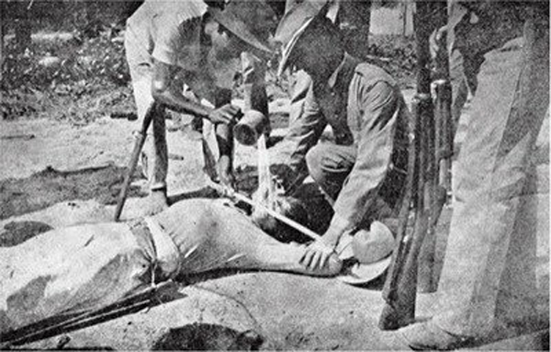
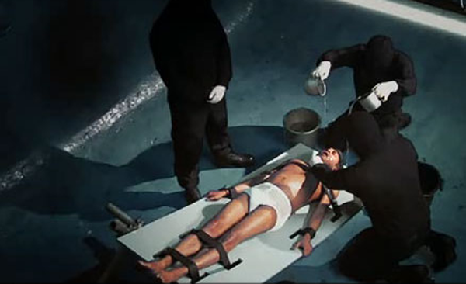
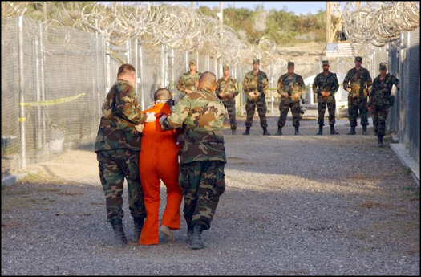
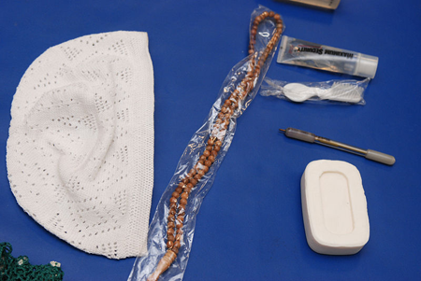
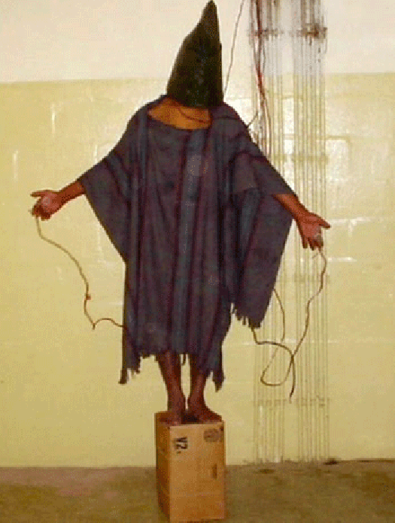
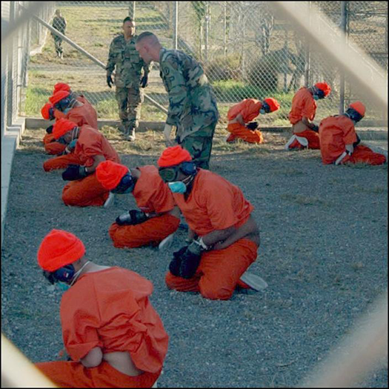
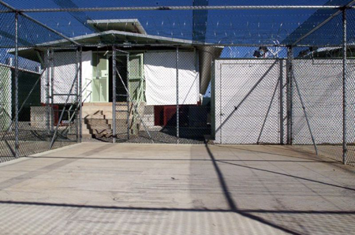
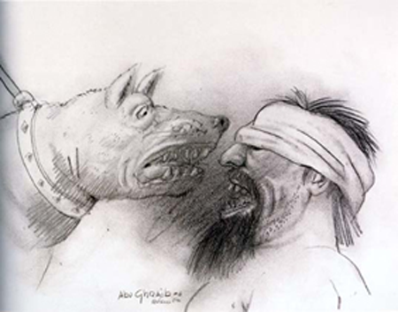
Post 9/11
Waterboarding
GTMO
Abu Ghraib

Slide 6
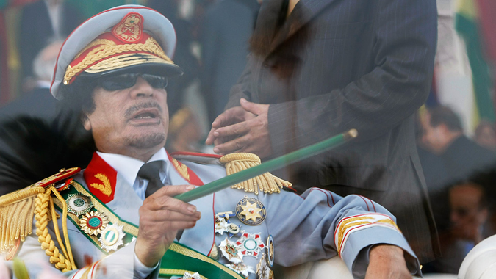
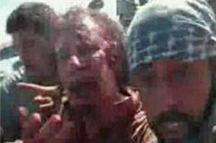
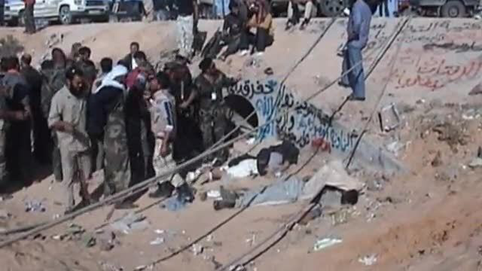
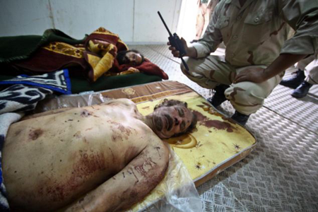
At Stake -- Chaos and Lawlessness
Gaddafi

Slide 7
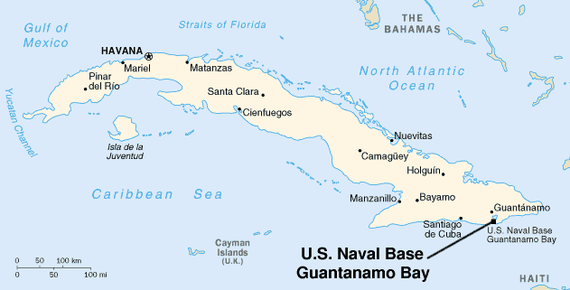
Cuba and Guantanamo Bay
Notes:
Site location re relative to Cuba

Slide 8
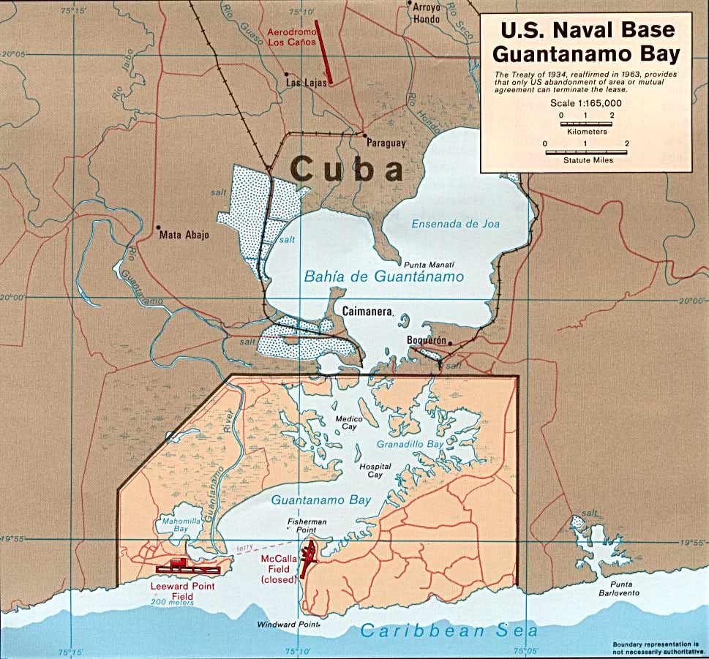
Guantanamo Bay
Notes:
Detail of Naval Base Area
Airstrip and customs
Camp Justice (Commission jurisdiction)
Naval Base (Navy command)
Prison Camp (JTF jurisdiction)

Slide 9
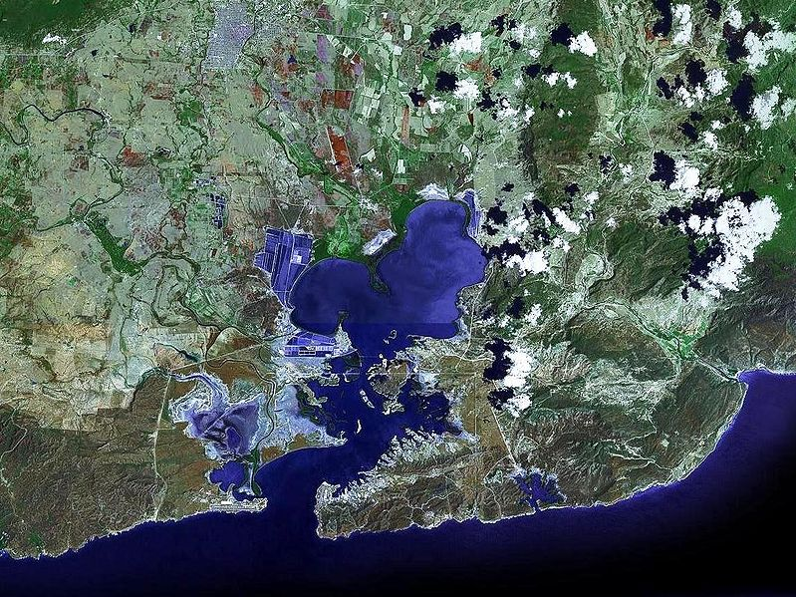
Satellite Image: Guantanamo Bay
Notes:
Satellite Photo

Slide 10
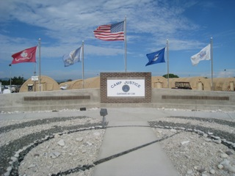
Notes:
Camp Justice

Slide 11
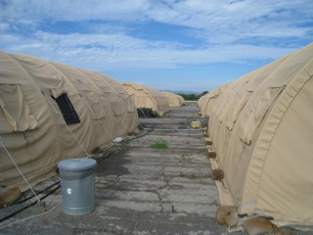

Slide 12
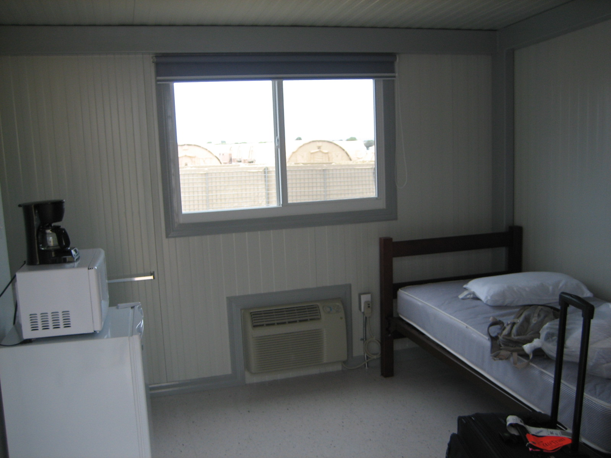

Slide 13
Guantanamo Bay Naval Station
Guantanamo Bay Tower Camp X-ray
Notes:
Prison Camp

Slide 14
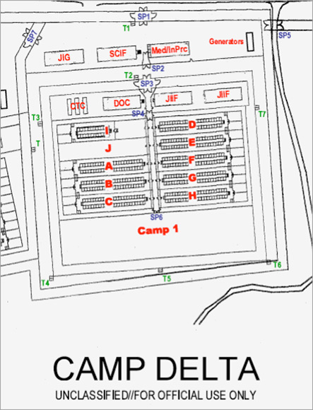
Guantanamo Photos
Recreation Yard, Camp Delta

Slide 15
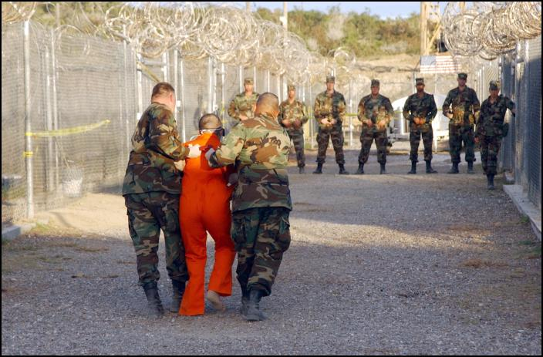
Guantanamo Photos
Escorting Detainees
Addressing Detainees

Slide 16
Guantanamo Bay Naval Station

Slide 17
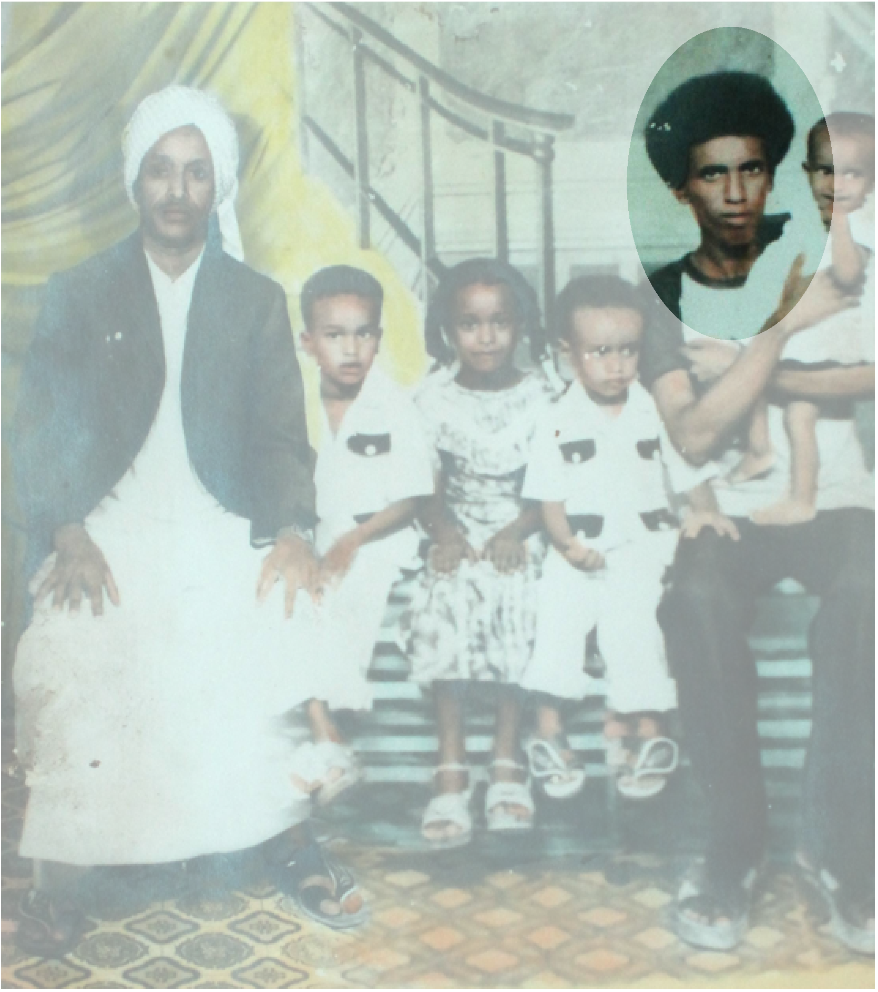
Noor Uthman Muhammed
Sudanese citizen with grade school education
Bought food, ran errands, briefly taught small arms at Khalden 1996-2000
Never took arms against U.S. or civilians
Never member of Al Queda or Taliban
Captured in Afghanistan March 28, 2002
Detained at Guantanamo beginning August 2002

Slide 18
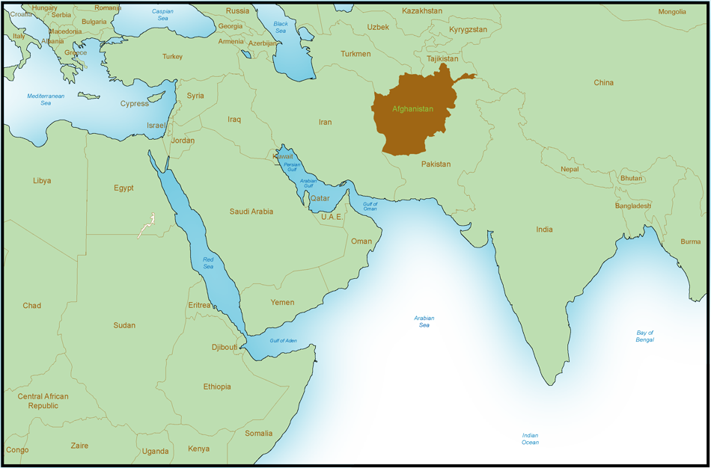
Khalden Camp
(Near Khowst, Afghanistan)
Safe House
(Faisalabad, Pakistan)
Noor's Hometown (Port Sudan, Sudan)

Slide 19
Noor vs. Operational Terrorist
 | Noor | Operational Terrorist
Education | Little schooling | Well-educated or well-trained
Western knowledge | Minimal | Multi-lingual or cultural knowledge
Training | Small arms | Advanced explosives, tactics, planning
Expertise | None | Military, technological, or tactical
Leadership | Based on titles | Policy planning and execution
Safe House | Waited and helped out | Used for training
Attacks | Awareness only | Planned or executed

Slide 20
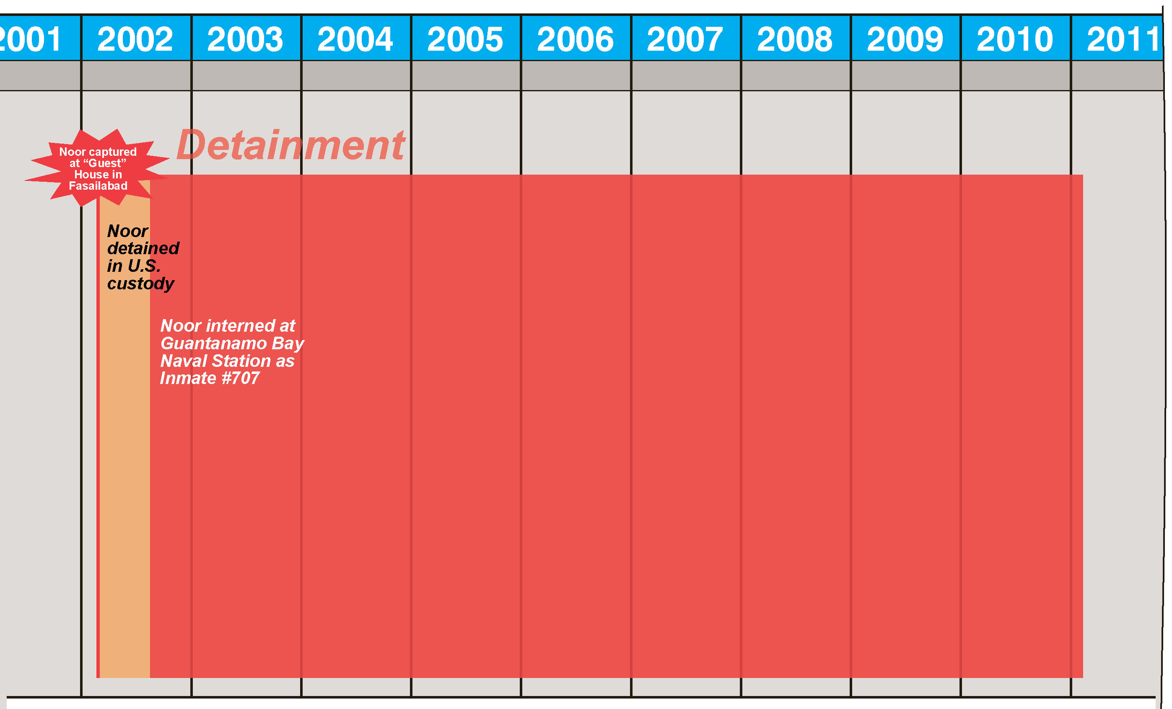
Noor's Confinement to Date

Slide 21
The Constitutional Debate: War Power
“Eternal Vigilance is the price of liberty.”
---Thomas Jefferson

Slide 22
Source of the Debate
U.S. Const. Art. I, sec. 8: "Congress shall have power…to define and punish Piracies and Felonies committed on the high Seas, and Offences against the Law of Nations"
U.S. Const. Art. II, sec. 2: "The President shall be Commander in Chief of the Army and Navy of the United States"

Slide 23
Third Geneva Convention
Common Art. 3: prohibits “violence to life and person,” ”cruel treatment and torture,” “outrages upon human dignity,” and “humiliating and degrading treatment” even to those prisoners who have allegedly violated the laws of war

Slide 24
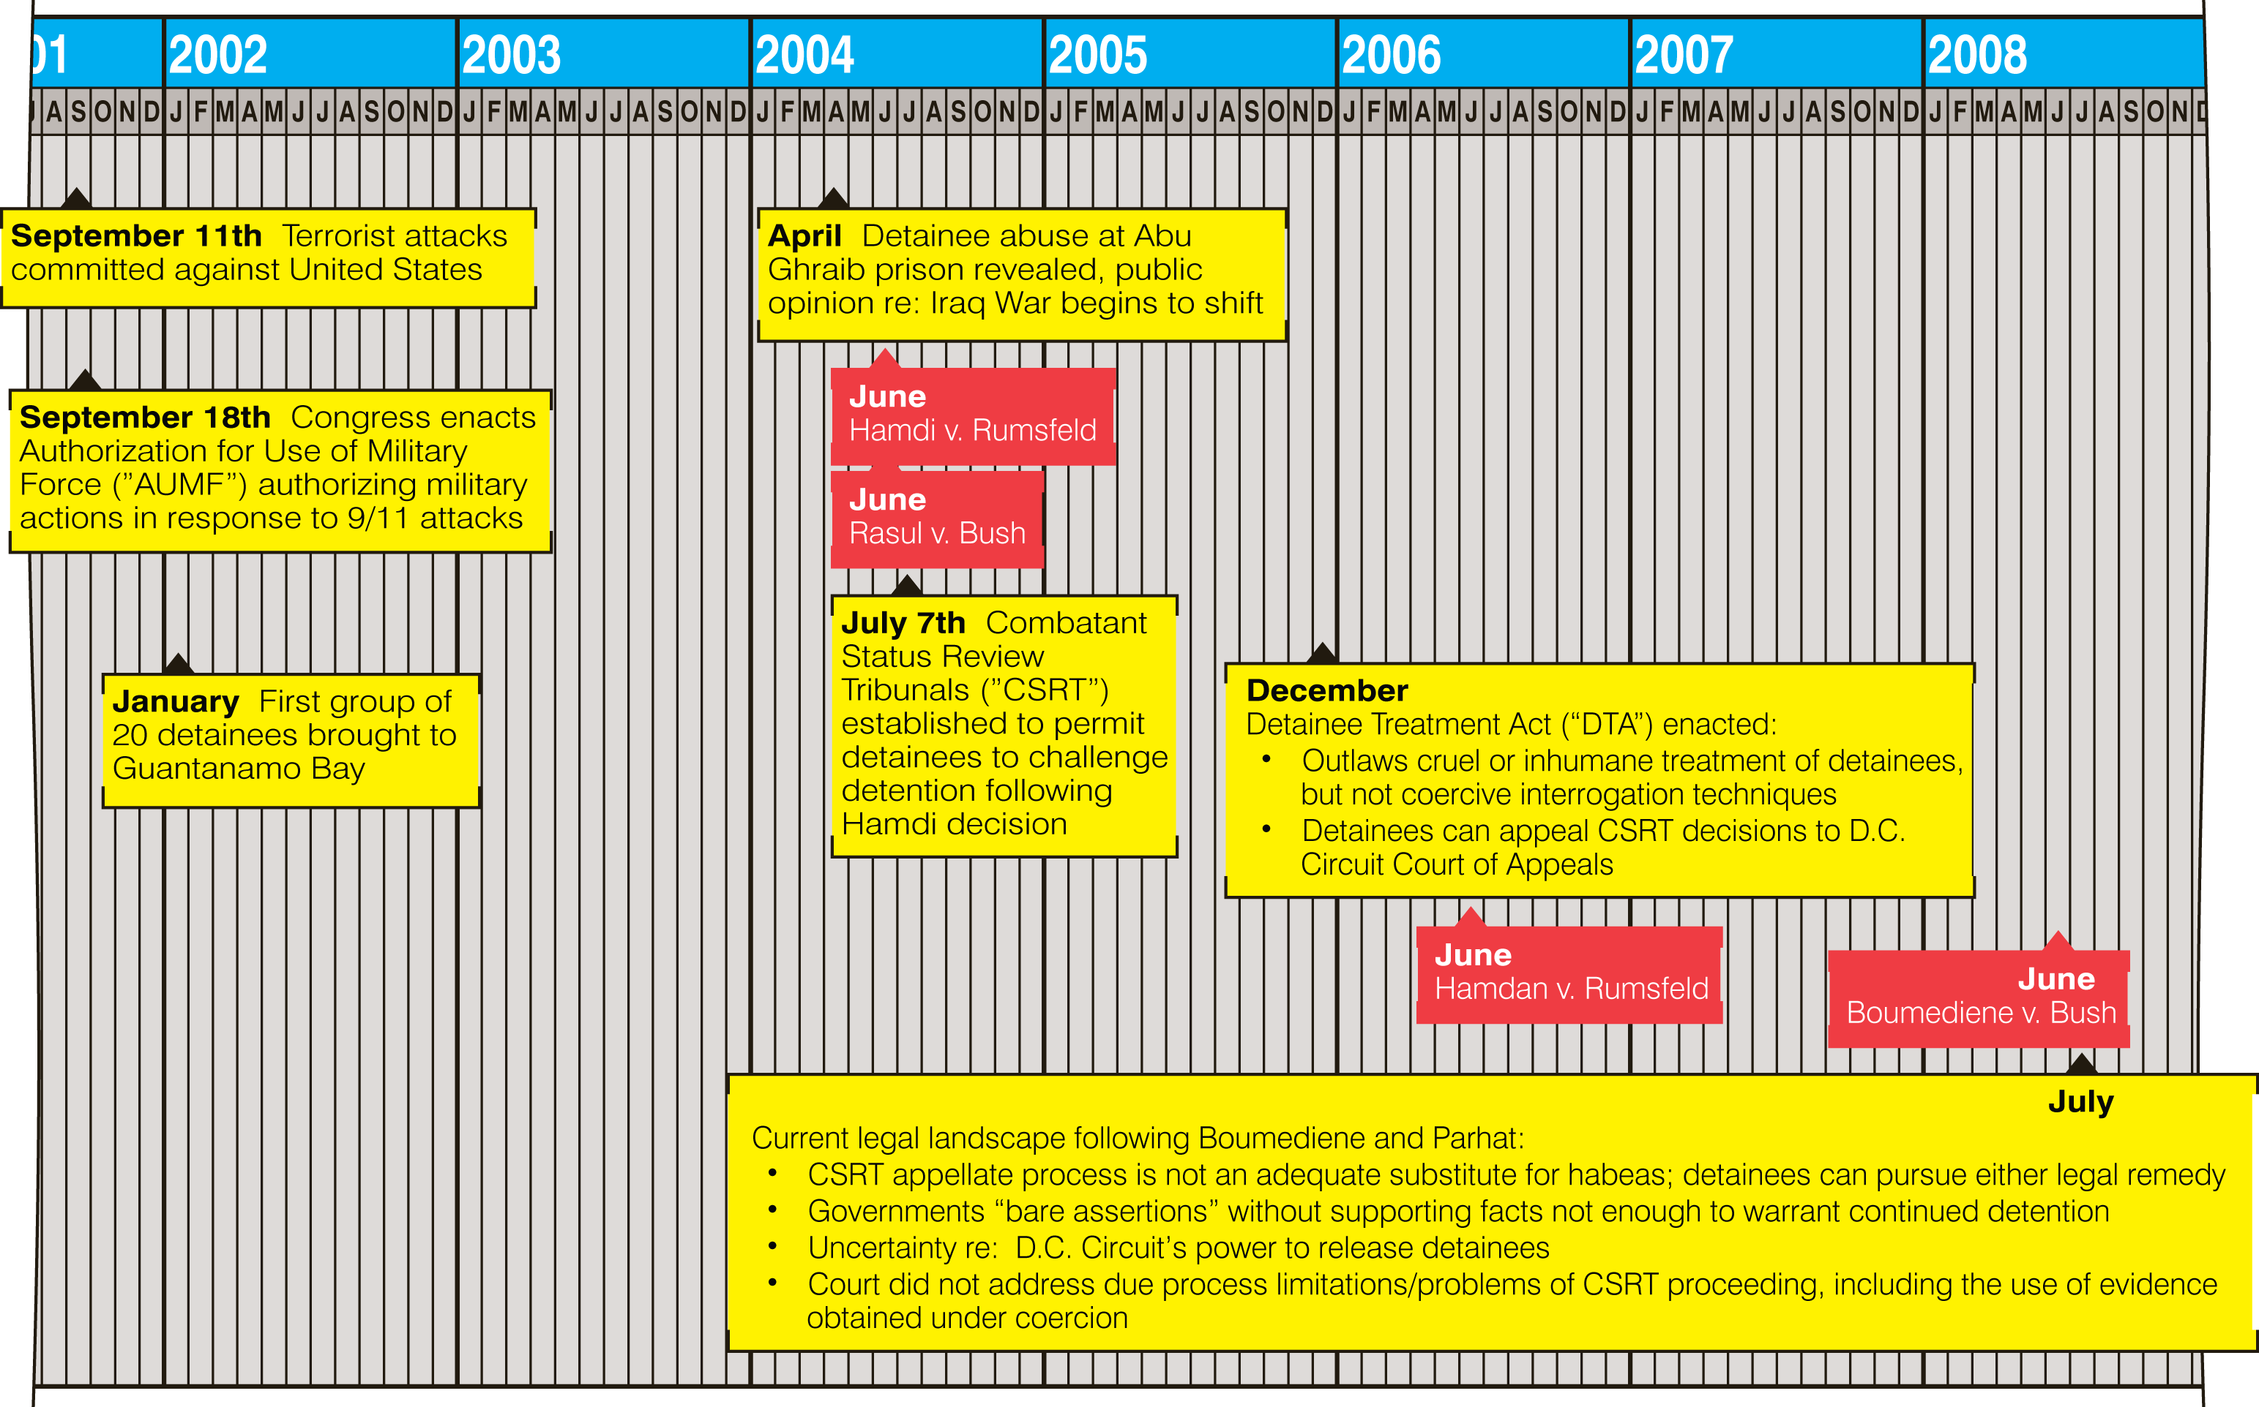
Timeline of Significant Events
Notes:
Timeline stops at 2008
Focus on opening of Gitmo in relation to 9/11, Congress declaration of war, movement of detainees
Red flags refer to seminal court decisions

Slide 25
War Powers Restrained
Hamdi v. Rumsfeld (June 2004) U.S. citizens detained as enemy combatants on American soil must get a “meaningful opportunity” to challenge the factual basis for their detention.
Rasul v. Bush (June 2004) Guantanamo Bay is within U.S. jurisdiction and subject to its laws, meaning detainees are entitled to some sort of due process in American courts.
Hamdan v. Rumsfeld (June 2006) Common Article 3 of the Geneva Conventions applies to all detainees.
Boumediene v. Bush (June, 2008) Detainees at Guantanamo Bay are “entitled to the privilege of habeas corpus to challenge the legality of their detentions.”

Slide 26
Military Commission Proceedings Noor Uthman Muhammed

Slide 27
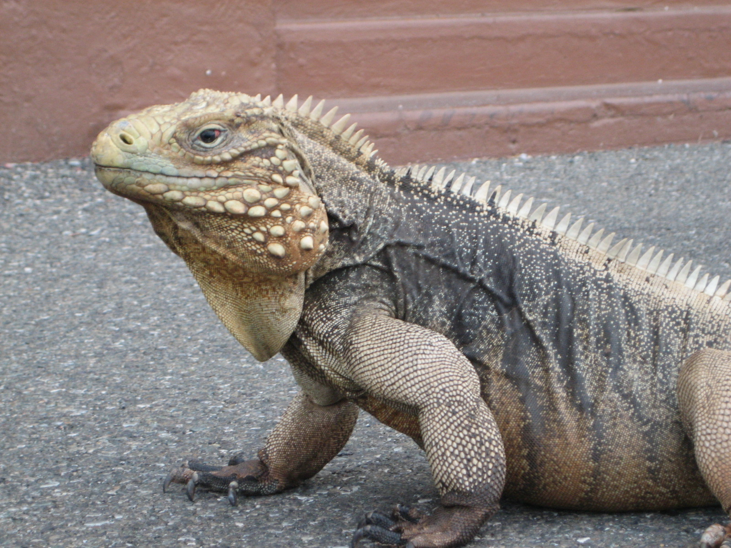
Public Trial

Slide 28
The Media

Slide 29
Public Trial
MCA Compared: IMT/IMTFE and ICT/ICTR markedly the same in practice
Commission court room specially designed to afford public trial.
Media, families of victims, and other observers allowed to watch the proceedings live behind soundproofed, double-paned glass.
Audio on CCTV monitors in viewing room delayed so intelligence agent can blot out any unintentionally disclosed classified information.
Lawyers, in cooperation with judge, work assiduously to declassify as much evidence as possible so public can view.

Slide 30
Speedy Trial
MCA Compared: Worse than IMT/IMTFE and ICT/ICTR
No right to speedy trial
Noor is case in point:
August '02 Noor arrives in Gitmo
May '08 First charges (material support/conspiracy)
July '08 Charges dismissed w/o prejudice
December '08 Recharged (same crimes)
January '09 Arraigned
February '11 Trial

Slide 31
Noor Post-Arraignment Delays
President Obama freeze
Stalled production of classified material
Attempted severance of military counsel
Asset holder refusals (CIA, NSC, FBI)
Article 5 proceedings
Constitutional challenges and other law motions (20 or more)

Slide 32
Compulsory Process
MCA Compared: Better than IMT/IMTFE and ICT/ICTR
Defense counsel afforded "reasonable" but not "equal" opportunity to obtain witnesses and other evidence
Prosecution obligated to disclose exculpatory evidence
Classified evidence allowed in summary form
CIPA protocol established in Noor's case
Brady material not covered (e.g. impeachment evidence)

Slide 33
Trial Proceedings and Jury Selection February 15, 2011

Slide 34
Trial Team

Slide 35
Trial by Impartial Judge
MCA Compared: Better than IMT/IMTFE but worse than ICTY/ICTY
Prohibits unlawful command influence
No adverse actions can be taken against commission members in their performance reviews
Multiple roles assigned to Convening Authority (e.g. initiating charges, allocating resources, assignment of counsel, selection of commission members) create risk of inherent conflicts or perceived unfairness
Limited right of appeal

Slide 36
Exclusion of Testimonial Hearsay
MCA Compared: Better than IMT/IMTFE and ICTY/ICTR
Hearsay evidence permitted on notice and finding of "reliability"
No corroboration required
Burden of persuasion on profferer
No right to confront and cross-examine accusers consistent with Sixth Amendment
Noor's case: Ressam (LAX) and Moussaui (20th highjacker)

Slide 37
Privilege Against Self-Incrimination
MCA Compared: Better than IMT/IMTFE but worse than ICTY/ICTR
No person required to testify against himself
Adverse inferences may be drawn from failure to testify subject to presumption of innocence instruction
Confessions allegedly elicited through coercion or compulsory self-incrimination admissible subject to specific finding of reliability and probative value
Defendants allowed to submit unsworn statements without subjecting themselves to cross-examination

Slide 38
The Plea Agreement
Thirty four (34) month cap on confinement
Participation in interviews (testimony) with government in presence of counsel re contents of stipulated facts and proffer
Ten (10) – fourteen (14) year sentence range for refusal to cooperate with interviews in place of life sentence

Slide 39
Sentencing Trial Themes
Punishment must fit the crime
Noor not the "worst of the worst"
Already endured enough punishment – harsh treatment and 9 years confinement
Poor health – tuberculosis, hepatitis, etc.
Age 45 with life expectancy in Sudan of 53
Different person today than when he left home 17 yrs ago
Support networks

Slide 40
Noor’s Support Networks
Noor
Family
Tribe
Sudanese
Government
Nonprofit
Organizations
Lives
Nearby
Ready
To
Reintegrate
Commitment
To
Reintegration
Empirical
Success
With
Rehabilitation

Slide 41
Post-Trial Obstacles to Enforcement
December 2011 Congress passes law eliminating transfer exception for plea agreements.
May 2012 appeals court declares MCA crime of “material support” invalid for pre-2006 acts.
March 2013 appeals court declares MCA crime of “conspiracy” invalid
As of May 2013 Military Commission refuses to approve sentence per plea agreement
Noor compelled to file motion with court for specific performance of the plea bargain .
Press campaign launched to pressure release.

Slide 42
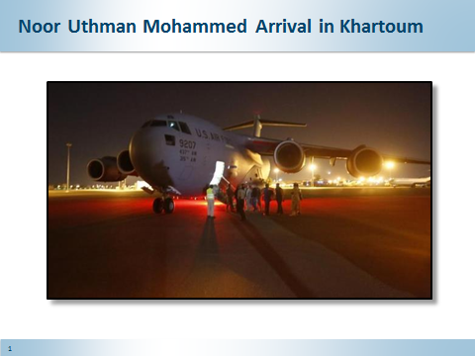

Slide 43
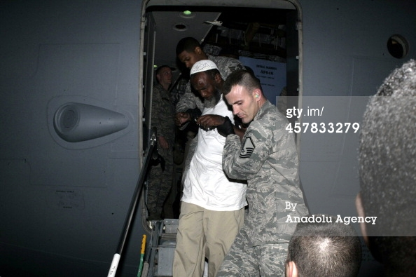
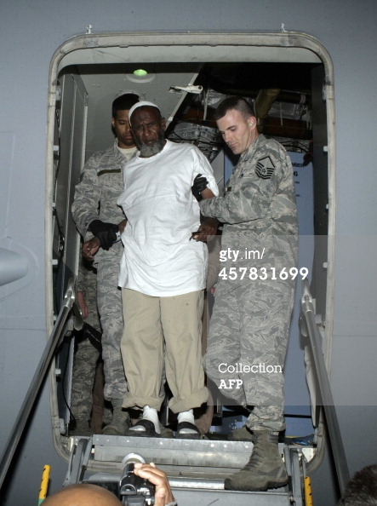
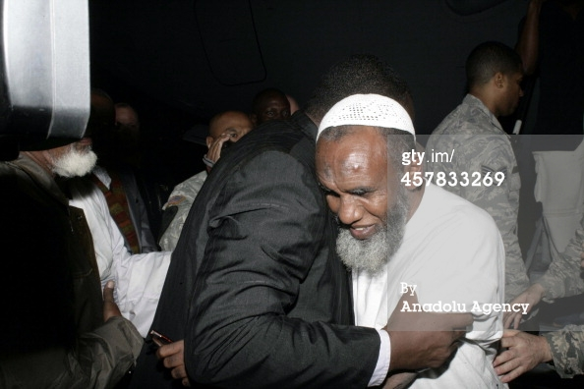

Slide 44
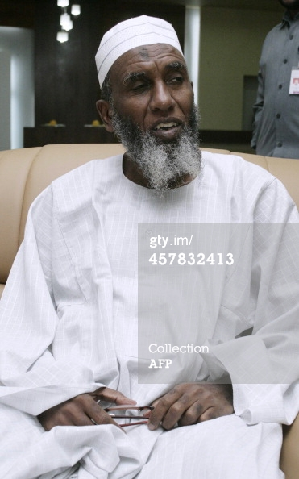
A FREE MAN – December 19, 2014

Slide 45
Impact of Obama Administration on Gitmo
Gitmo remains open despite promise of 2010 closure
Trial of five 9/11 conspirators transferred from civilian court in NY to Gitmo for Commission trial – arraigned in May 2012.
Congress passes legislation in January 2011 and thereafter barring transfer of detainees to US soil for trial, detention or resettlement or generally to countries of origin on list of terrorist nations and allowing for indefinite detention.
Obama administration has repeatedly argued against the US Supreme Court accepting any detainee case for review.

Slide 46
What’s Next at Guantanamo?
Population as of May 2013: 166 detainees out of original 779
Of 166 detainees:
31 referred for prosecution
46 held for indefinite detention
86 approved for release
Following “hunger strike” 2 detainees returned to Algeria, 2 returned to Sudan, 3 ( Ughers) resettled to Slovakia .
157 detainees left
March 2014 Uruguay agrees to take 5 detainees

Slide 47
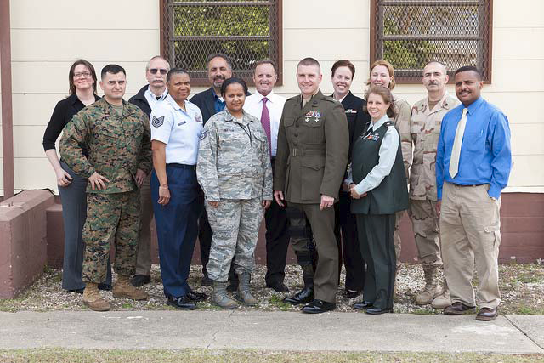

Slide 48
Questions

