Slide 1
Carlill v Carbolic Smoke Ball Co. (1893)
April 23, 2015

Slide 2
Plan for today
1. A task on the essential elements of a valid English contract
2. Get to know the testing of elements
3. Get to know the facts of the Carlill case
4. Come up with defences for the Smoke Ball Co.
5. Come up with arguments which will trump the defences
6. Revise the case

Slide 3
Answers:
offer
consideration
agreement
legal capacity
certainty of terms
acceptance
intention to create legal relations

Slide 4
What constitues a valid offer?
The offer must be communicated from the offeror to the offeree.
The offer must contain language of commitment.
The offer must be made with serious intention by the offeror.
The offer must be reasonably definite, usually containing the names of the parties involved, the subject-matter, the consideration and the time and place for performance.

Slide 5
What consitutes valid acceptance?
The acceptance must be made to the offeror and not to anyone else unless the offeror has authorised it.
The acceptance must be communicated.
The acceptance must be actually heard or received in writing to be effective.
If the offer specifies the method of acceptance you must accept it using a method that is no less effective than the method specified.
A request for more information is not the same as a counter-offer and will not have the effect of rejecting the original offer.

Slide 6
Carlill v Carbolic Smoke Ball Co. (1893)
Carbolic Smoke Ball Co. (D) manufactured and sold The Carbolic Smoke Ball
the company placed ads in various newspapers offering a reward of 100 pounds to any person who used the smoke ball three times per day as directed and contracted influenza, colds, or any other disease
after seeing the ad Carlill (P) purchased a ball and used it as directed
Carlill contracted influenza and made a claim for the reward ☺
Carbolic Smoke Ball Co. refused to pay and Carlill sued for damages arising from breach of contract

Slide 7
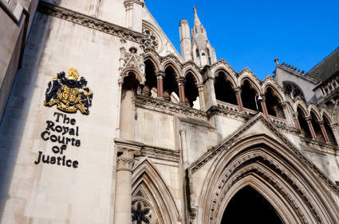
Judgement
judgment for 100 pounds was entered for Carlill
Carbolic Smoke Ball Co. appealed

Slide 8
The defences
The advertisement was „a mere puff” – a sales gimmick with no intention
A contract with the whole world is no contract at all
The wording was too vague
Acceptance was not communicated
Mrs Carlill provided no consideration for CSC’s promise to pay the reward

Slide 9
Court of Appeal (LJs Lindley, Bowen and Smith)
The language of the ad indicating that the CSC had £1,000 in the bank directly contradicts the claim of ”puffery”
It was not a contract with the whole world but with those who fulfill the stipulated conditions
The terms were not vague if read in their plain meaning; entitled to reward (that is, a contract is formed) if one used the ball for two weeks, three times a day and got the flu

Slide 10
4. Performance of the condition of the ad was sufficient acceptance and it was not necessary that CSC be notified of the intention to be bound
- notification of acceptance need not precede performance, in this case acceptance was contemporaneous with performance
5. The inconvenience of Carlill was sufficient consideration

Slide 11
Significance
it provides an excellent study of the basic principles of contract and how they relate to every day life
by running almost every possible defence, the defense forced the court to address all of them
it still binds the lower courts of England and Wales and is cited by judges with approval

Slide 12
Tha faith of Mrs. Carlill and the CSC?
a new company was formed and the owner placed new ads:
"Many thousand Carbolic Smoke Balls were sold on these advertisements, but only three people claimed the reward of £100, thus proving conclusively that this invaluable remedy will prevent and cure the above mentioned diseases. The CARBOLIC SMOKE BALL COMPANY LTD. now offer £200 REWARD to the person who purchases a Carbolic Smoke Ball and afterwards contracts any of the following diseases...„
Mr Roe died in 1899 of tuberculosis aged 57

Slide 13
Mrs Carlill died in 1942 aged 92 of old age

