Slide 1
Comparison and Contrast

Slide 2
Comparison and contrast
In most academic subjects it is often nedded to compare and contrast things
The language of comparison and contrast is frequently needed when studying tables and other statistical information

Slide 3
Comparison- formation
The regular comparative and superlative forms of adjectives and adverbs
the endings -er and –est to words with one syllable
by placing the words more and the most in front of words with more syllables

Slide 4
Irregular comparison
A small group of very frequent adjectives:
good-better-best, bad-worse-worst, far-further-furthest, many-more-most
A small group of adverbs:
badly-worse,worst, little-less-least, much-more-most

Slide 5
Language constructions
Showing equivalence (i.e. the same):
as…as, the same…as, as many…as, as much…as
Showing non-equivalence
not as/so…as, than, more…than, not as many…as, not as much…as
3. Showing one item compared with a number (i.e. the superlative)
She was the tallest of all the girls.
4. Showing parallel increase
The more, the merrier

Slide 6
Similarities
Study the table about various countries and write three sentences expressing similarities between the countries:

Slide 7
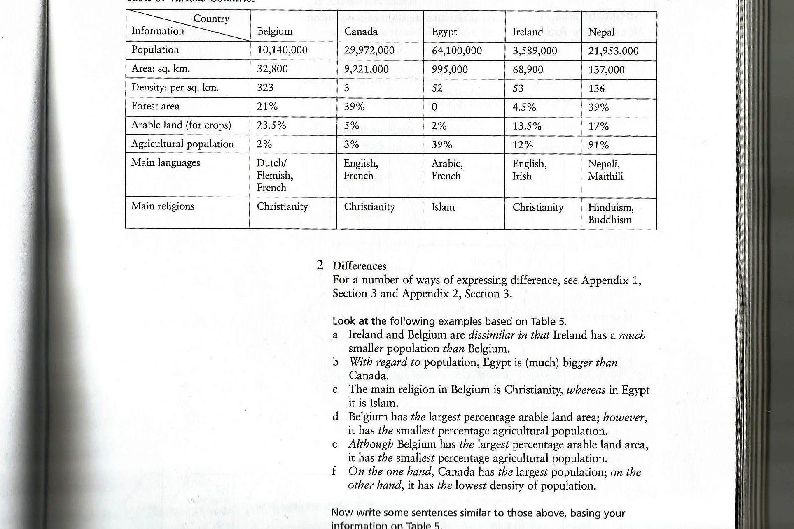
Comparison

Slide 8
Sample sentences
Both Belgium and Canada have small agricultural population / Belgium and Canada are similar in that they both have a small agricultural population / Belgium, like Canada, has a small agricultural population.
Canada is similar to Nepal in its percentage of forrest area.

Slide 9
Extended Comparison
Compare lecturing as a method of teaching with seminar as a way of teaching.
Provide some arguments for and against lecturing as a method of teaching as opposed to seminars.
Use Venn diagram to help you clarify the similarities and differences.

Slide 10
Possible arguments for lecturing
Lectures are an economical way of giving information to a large number of students
The latest information or views can be heard
It is more interesting to hear a person than to read a textbook
A good lecture can stimulate thought or discussion
Students do not have to do anything, just listen

Slide 11
Arguments against lecturing
Lectures are often boring
It is difficult to take notes during a lectures
Lectures can be difficult to understand
Many lecturers just read aloud parts of their books
It is easier to learn from a textbook
Lectures are too long

Slide 12
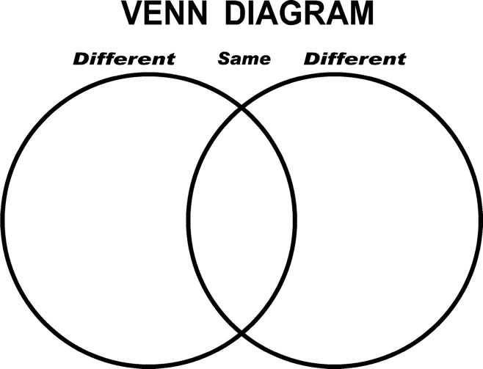

Slide 13
Compare your notes with another student. Check whether you identified the same points.

Slide 14
Comparative adjectives
Complete the sentences with the correct form of the adjective in brackets.
1. Innovation is _____ (risky) creating a me-too product.
Prices for me-too products are not _____ (high) for revolutionary products.
People are often __________ (confident) about buying a new product than buying an established product.
Revolutionary products are _________ (expensive) for many consumers to buy.

Slide 15
Generalisation
Making general comments or generalising about the information
Generalisations can be made more precise by qualifying them
When we make a qualification, we may be giving our own opinion or interpreting the information
If we are giving our opinion or are interpreting the informaton, caution is needed

Slide 16
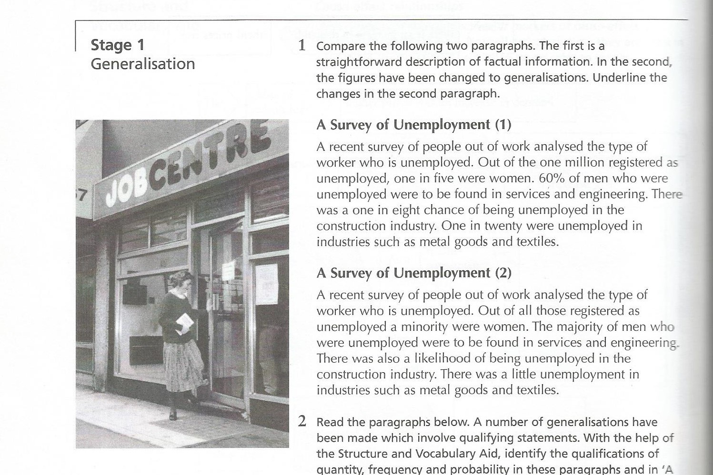
Exercise
Read A Survey of Unemployment and underline generalisations in the second paragraph:

Slide 17
Generalisations
All those registered as unemployed instead of one million
The majority of men instead of 60 % of men
A likelihood of being unemployed instead of a one in eight chance
A little unemployment instead of one in twenty were unemployed

Slide 18
Exercise
Identify the qualifications of quantity, frequency and probability in the text below:
If somebody was unemployed from engineering, mining or chemicals, he could usually find another job. However, an unemployed person from agriculture or construction seldom found a job again. Job chances were generally much better for manual workers than for office workers.
Most of the unemployed had been without jobs for more than two months. A number had been unemployed for more than a year. Undoubtedly the longer a person is out of work, the more likely it is that he will not find another job. In addition, job prospects are definitely worse for older workers.

Slide 19
Answer key
Quantity: most, a number
Frequency: usually, seldom, generally
Probability: likelihood, undoubtedly, more likely, definitely

Slide 20
Caution
A feature of written academic English is the need to be careful or cautious. Thus, unless there is evidence which indicates 100% certainty, statements or conclusions are normally qualified in some way to make them less definite. Therefore words like always and never should be avoided. The purpose is to be accurate and to allow for other possible points of view. That is achieved by using impersonal verb pheases and certain vocabulary.

Slide 21
Vocabulary suggestions
Impersonal verb phrases: it appears that, it seems that, it tends to be, it is said that, some writers say that, it has been suggested that, it is now generally recognised that
Useful nouns: assumption, claim, estimate, possibility, presumption, chance, likelihood
Useful adverbs: apparently, hardly, presumably, relatively, scarcely, seemingly, virtually

Slide 22
Thank you for your attention!

