Slide 1
Cyberspace fraud and abuse

Slide 2
Introduction
Have you ever bought anything through the Internet?
How did you pay for it?
Did you receive the goods you bought safely?
Were the goods of satisfactory quality?
What guarantee did you have that you would get what you paid for?

Slide 3
Reading task
Read the text Cyberspace fraud and abuse and answer the following questions:
What are the main types of investment fraud reported in the text?
How does the text define cyberspace?
How do criminals exploit anonymity on the Internet?
Which organisations could you inform if you were a victim of a scam on the Internet?
Which crime has increased most in the last year or so, according to the text?
Do most victims of fraud use traditional payment methods?

Slide 4
IFW
What does the acronym IFW stand for?
What does IFW recommend to buyers?
How does escrow service work?
What are the most common types of Internet fraud according to IFW?

Slide 5
IFW – Internet Fraud Watch
IFW recommendation: use escrow services
Escrow services hold money in a special account until the buyer has received the goods in satisfactory condition, then they release it to the seller
Web auctions, the sale of general merchandise, Internet services, hardware or software, multi-level marketing or pyramid schemes, franchises, credit ‘repair’ and credit card issuing

Slide 6
Discussion point
Are cyberspace frauds really any different from frauds committed through more traditional communication channels?

Slide 7
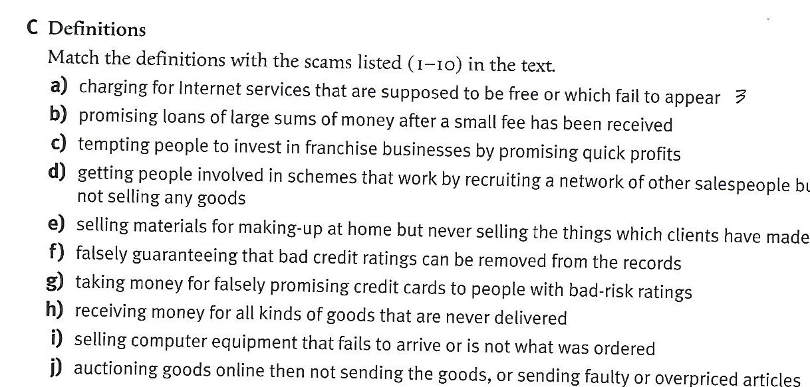
Definitions

Slide 8
Answer key
a) 3 - Internet services
b) 8 - advance for loans
c) 6 - Business opportunities or franchises
d) 5 - multi-level marketing or pyramid schemes
e) 7 - work-at-home plans
f) 9 - credit ‘repair’
g)10 - credit card issuing
h) 2 - Sales of general merchandise
i) 4 - computer equipment (hardware or software)
j) 1 - Web auctions

Slide 9
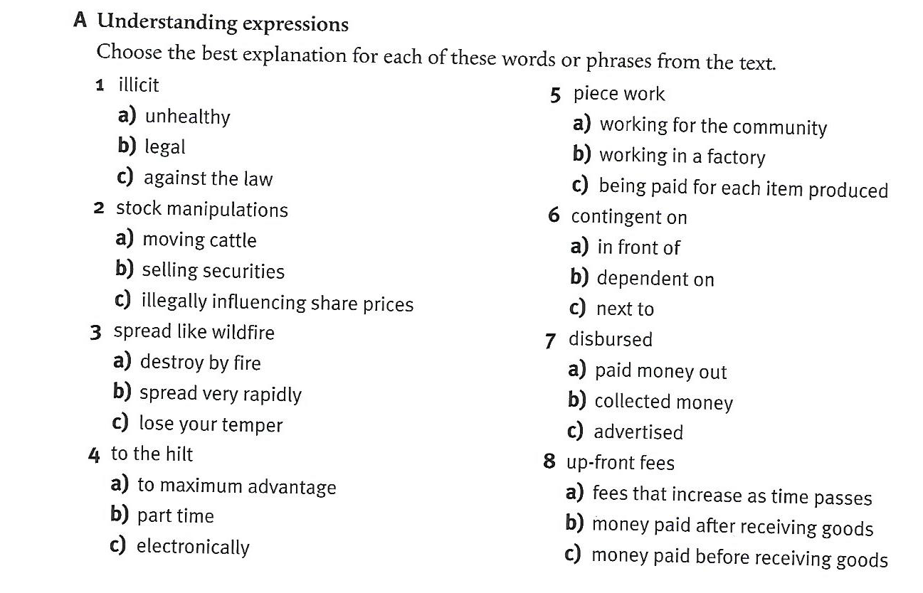
Vocabulary tasks

Slide 10
Answer key
Illicit – against the law
Stock manipulations – illegally influencing share prices
Spread like wildfire – spread very rapidly
To the hilt – to maximum advantage
Piece work – being paid for each item produced
Contingent on – dependent on
Disbursed – paid money out
Up-front fees – money paid before receiving goods
Find Croatian equivalents for the above phrases!

Slide 11
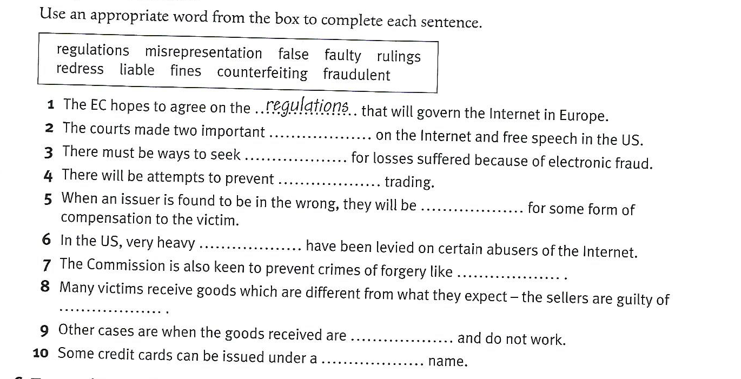
Complete the sentence:

Slide 12
Answer key
The courts made two important rulings on the Internet and free speech in the US.
There most be ways to seek redress for losses suffered because of electronic fraud.
There will be attempts to prevent fraudulent trading.
When an issuer is found to be in the wrong, they will be liable for some form of compensation to the victim.
In the US, very heavy fines have been levied on certain abusers of the Internet.
The Commission is also keen to prevent crimes of forgery like counterfeiting.
Many victims receive goods which are different from what they expect – the sellers are guilty of misrepresentation.
Other cases are when the goods received are faulty and do not work.
Some credit cards can be issued under a false name.
Translate the above sentences!

Slide 13
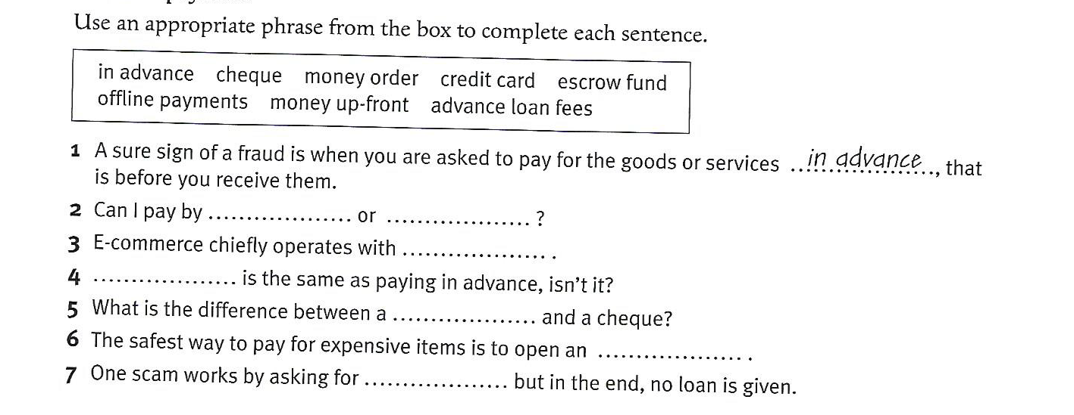
Terms of payment

Slide 14
Answer key
2. Can I pay by credit card or by cheque?
3. E- commerce chiefly operates with offline payments.
4. Money up-front is the same as paying in advance.
5. What is the difference between a money order and a cheque?
6. The safest way to pay for expensive items is to open an escrow fund.
7. One scam works by asking for advance loan fees, but in the end no loan is given.

Slide 15
Discussion
Who can you trust on the Internet?
How can you check on a business or individual?
How careful are you online?
How much should one reveal on social networks?

Slide 16
National Consumers League
Fraud.org is a project of the National Consumers League (NCL), a nonprofit advocacy organization based in Washington, DC. NCL was founded in 1899 to promote the interests of consumers and workers in the United States and abroad.
In 1992, in response to the growth in telemarketing and Internet fraud, NCL launched the National Fraud Information Center.

Slide 17
By contacting www.fraud.org, consumers from all over the world can get tips on how to avoid scams and report fraud
Top 10 scams are published annually

Slide 18
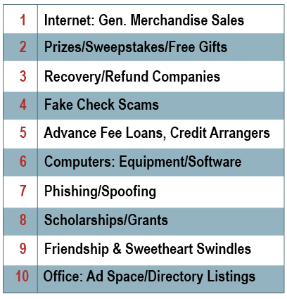
Top ten scams in 2015

Slide 19
Read the text and answer the questions:
http://www.fraud.org/2015_top_ten
What has changed since 1998?
What is phishing/spoofing?
Do you agree with the following statement: Regardless of the type of scam, many instances of fraud can be avoided by remembering the old rule of thumb: if something seems too good to be true, it probably is.

Slide 20
Phishing
Identity thefts
Phishing is defined as pretending to be financial institution or company and sending spam or pop-up messages to get people to reveal personal information
https://www.youtube.com/watch?v=7MtYVSGe1ME
Keyboard spyware

Slide 21
Thank you for your attention!

