Slide 1
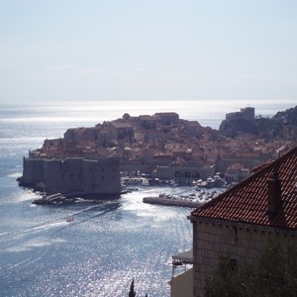
2014: A Year of Critical Issues and Challenges for International Criminal Justice
COURSE CONCLUSIONS
Marta Dragičević Prtenjača
Aleksandar Maršavelski

Slide 2

The Problems of International Criminal Justice
Prof. Farkas:“The project of ICL is both emboldened and weakened by politics”
Are national criminal justice systems influenced by politics?

Slide 3
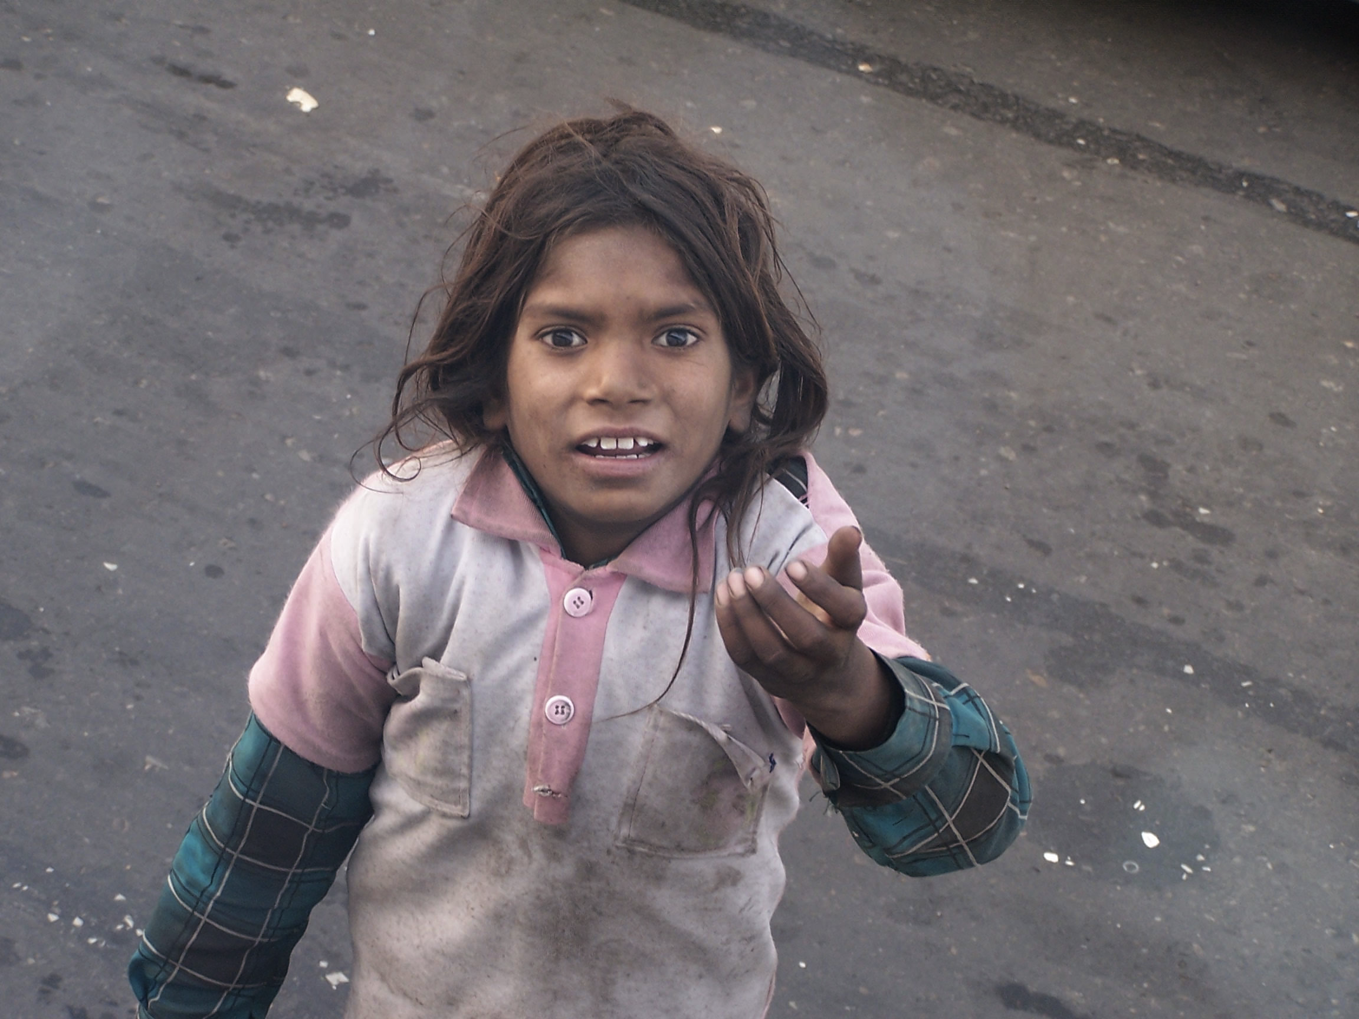
Human trafficking around us?

Slide 4
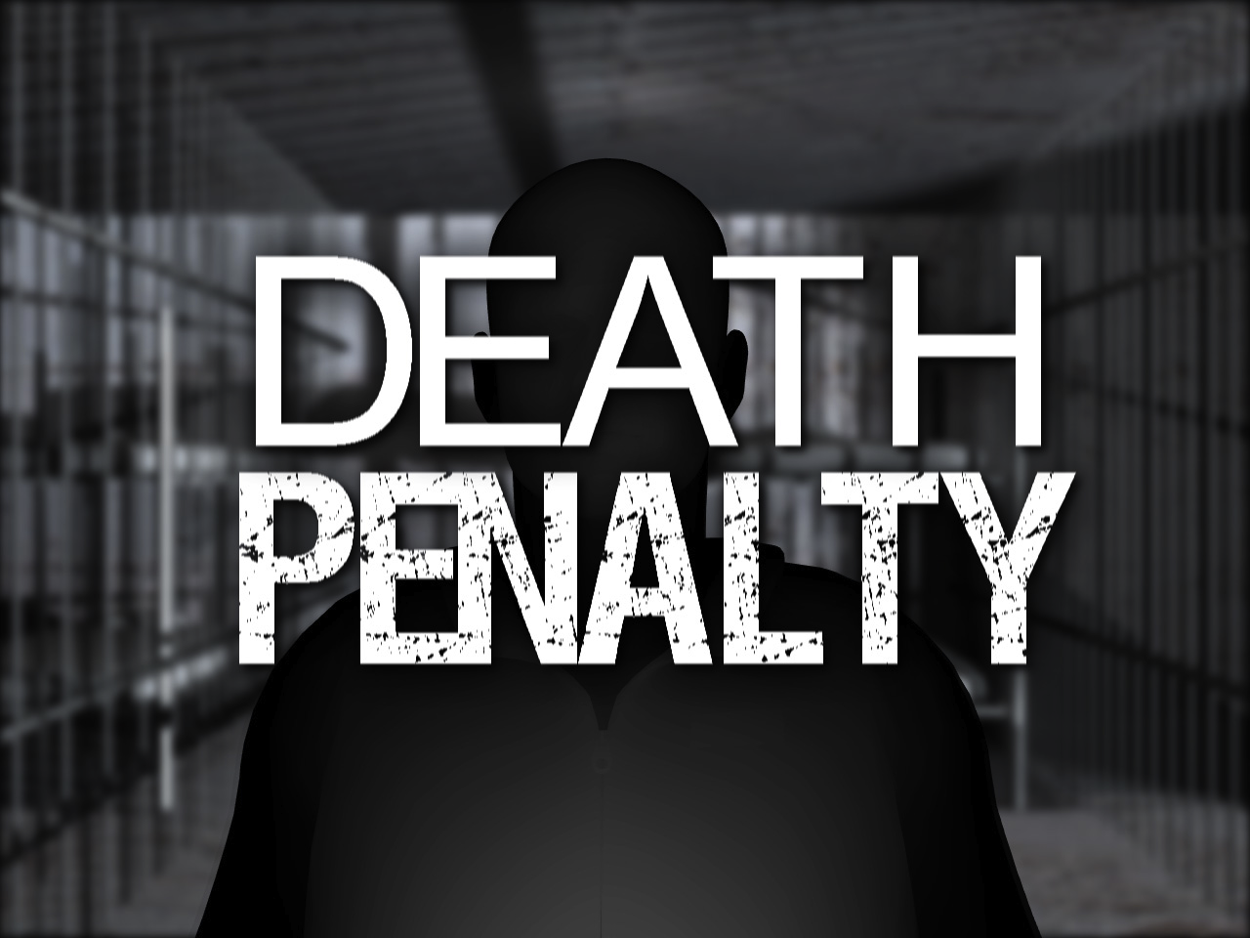
Death Penalty
Is it really a cruel and inhumane punishment?

Slide 5

Cybercrime
Low costs of crime and high costs of prevention?
Education of police, prosecutors and judges?

Slide 6
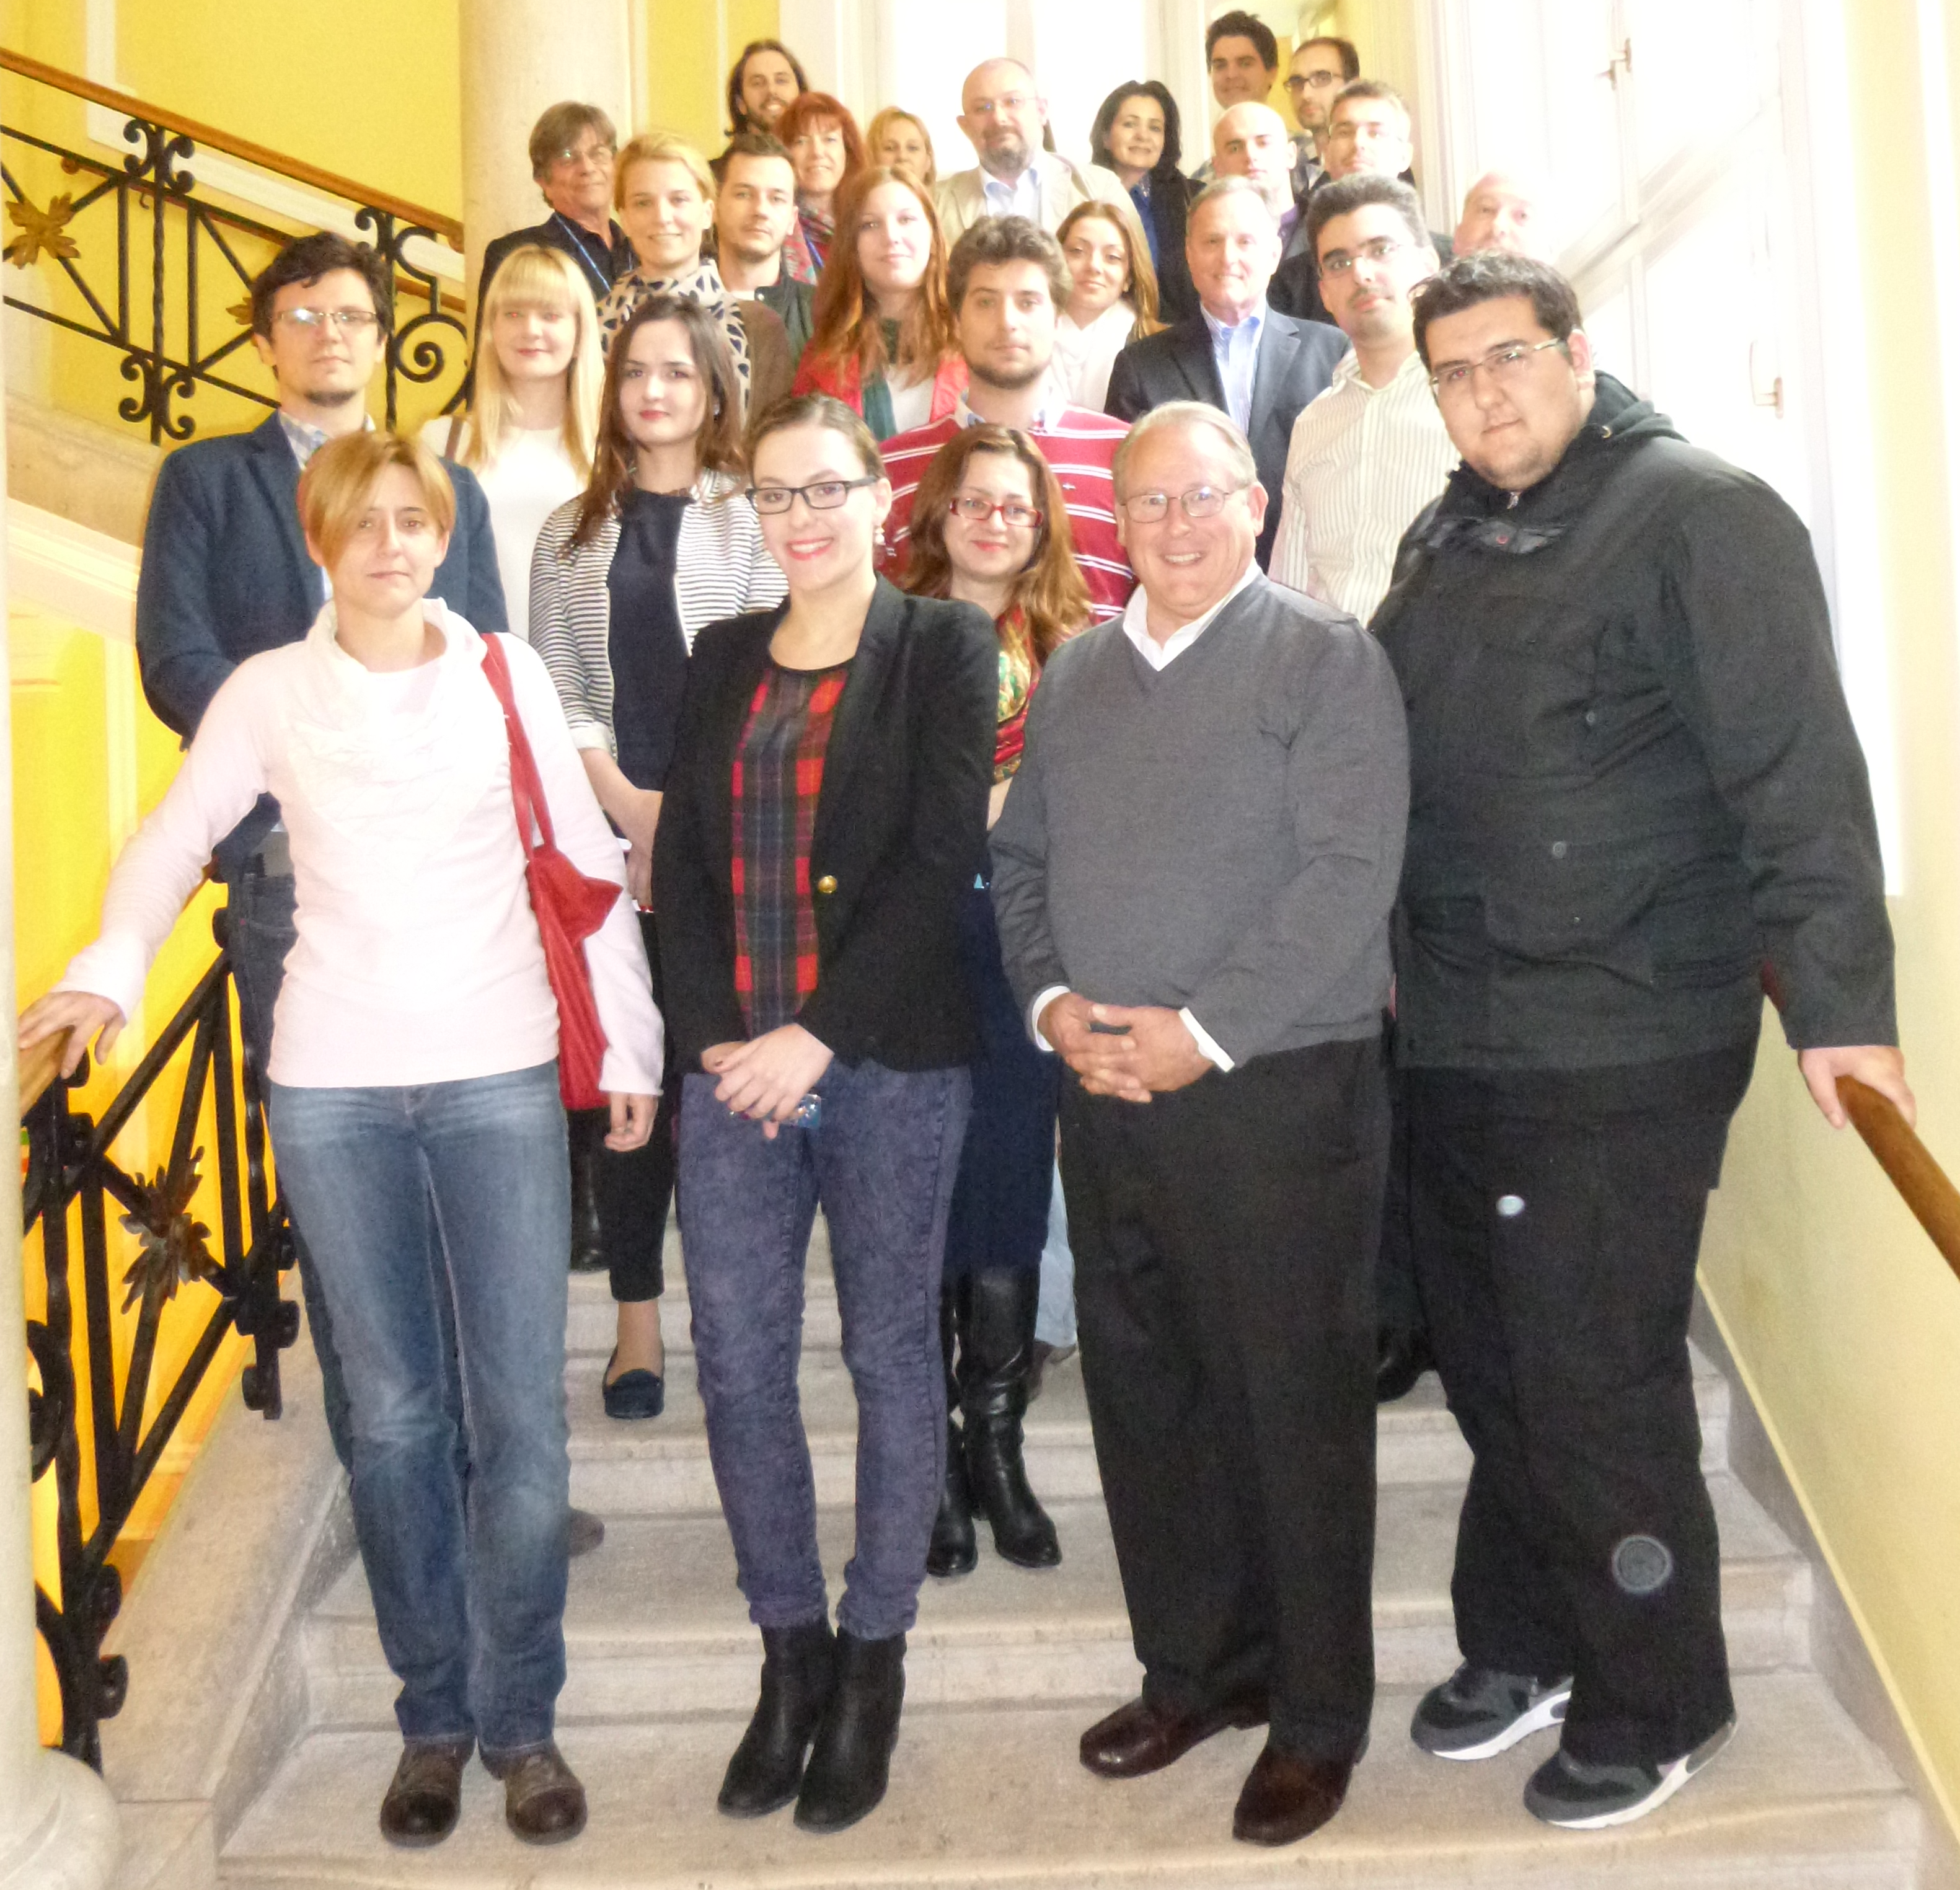
We are the future!

