Slide 1
English for Lawyers 2
Lecturer: Miljen Matijašević
e-mail: miljen.matijasevic@gmail.com
Session 10, 15 May 2018

Slide 2
Revision

Slide 3
Complete the sentences I
The British Parliament has two ___________ (houses). The members of the House Commons are ___________ (chosen by vote), while the members of the House of Lords are ___________ (designated by an authority). The UK has no written ___________ (the supreme legal act).
Common law is based on judicial ___________ (previous court decisions). Those of higher courts are ___________ (must be followed). Those of lower courts are ___________ (do not have to be followed).
Magistrates are ___________ (not professional) judges who are not paid for their work.
There are two types of lawyers in the UK: ___________ and ___________, who have the right of _______ in higher courts.
In the UK serious criminal cases are heard in the ___________ Court, while civil cases are heard in ___________ courts.

Slide 4
Complete the sentences I
The British Parliament has two CHAMBERS. The members of the House Commons are ELECTED, while the members of the House of Lords are APPOINTED. The UK has no written CONSTITUTION.
Common law is based on judicial PRECEDENTS. Those of higher courts are BINDING. Those of lower courts are PERSUASIVE.
Magistrates are LAY judges who are not paid for their work.
There are two types of lawyers in the UK: SOLICITORS and BARRISTERS, who have the right of AUDIENCE in higher courts.
In the UK serious criminal cases are heard in the CROWN Court, while civil cases are heard in COUNTY courts.

Slide 5
Complete the sentences II
US Congress consists of the H______ of ________, which has p________ representation, and the S_______, which has e______ representation, i.e. two ______ per state.
The President of the USA is elected in an indirect electoral system. The people vote in the p_______ vote and choose _______, who in turn vote for the candidates. This vote is called the _______ vote, and the body that casts it called the E_______ C_______.
The US federal court system consists of: _______ courts, which are _______-_______ courts, and the _______ courts, which have _______ jurisdiction, and finally the Supreme Court.

Slide 6
Complete the sentences II
US Congress consists of the HOUSE of REPRESENTATIVES, which has POPULAR representation, and the SENATE, which has EQUAL representation, i.e. two SENATORS per state.
The President of the USA is elected in an indirect electoral system. The people vote in the POPULAR vote and choose ELECTORS, who in turn vote for the candidates. This vote is called the ELECTORAL vote, and the body that casts it is called the ELECTORAL COLLEGE.
The US federal court system consists of: DISTRICT courts, which are FIRST-INSTANCE courts, and the CIRCUIT courts, which have APPELLATE jurisdiction, and finally the Supreme Court.

Slide 7
administrative – advocacy – bill – budget – case – conveyancing debating – delegated – draft – impeachment – instruction instrument – levy – mandate – office – ratio - scrutiny
The binding part of a precedent is called …………… decidendi.
…………… are proposed by the Cabinet and debated in Parliament.
Both levels of government in the US have the power to …………… taxes, while the power to declare war is …………… to the federal government.
A US president can be removed from …………… by …………… .
Solicitors take …………… from lay clients, …………… wills and contracts, and do …………… . They can speak in higher courts if they have a(n) …………… qualification.
The main functions of the British Parliament are government ……………, …………… issues of the day, making and changing laws, and checking and approving the state …………… .
Delegated legislation is passed by …………… bodies, and includes acts such as statutory …………… .
…………… law is a source of law in the common law systems.

Slide 8
Translate into Croatian
The binding part of a precedent is called RATIO decidendi.
BILLS are proposed by the Cabinet and debated in Parliament.
Both levels of government in the US have the power to LEVY taxes, while the power to declare war is DELEGATED to the federal government.
A US president can be removed from OFFICE by IMPEACHMENT.
Solicitors take INSTRUCTIONS from lay clients, DRAFT wills and contracts, and do CONVEYANCING. They can speak in higher courts if they have a(n) ADVOCACY qualification.
The main functions of the British Parliament are government SCRUTINY, DEBATING issues of the day, making and changing laws, and checking and approving the state BUDGET.
Delegated legislation is passed by ADMINISTRATIVE bodies, and includes acts such as statutory INSTRUMENTS.
CASE law is a source of law in the common law systems.

Slide 9
Translate into Croatian
Obvezujući dio presedana naziva se ratio decidendi.
Zakonodavne prijedloge predlaže Vlada, a raspravljaju se u Parlamentu.
Obje razine vlasti u SAD-u imaju ovlast ubiranja poreza, a ovlast objave rata delegirana je na saveznu vladu.
Predsjednika SAD-a može se razriješiti dužnosti postupkom opoziva (odgovornosti).
Solicitore unajmljuju klijenti laici. Bave se sastavljanjem oporuka i ugovora i prijenosom prava vlasništva. Imaju pravo zastupanja u višim sudovima ako imaju dozvolu za zastupanje.
Glavne funkcije Britanskog parlamenta su praćenje rada vlade, raspravljanje o tekućim problemima, donošenje i mijenjanje zakona, te provjera i odobravanje državnog proračuna.
Delegirano zakonodavstvo donose upravna tijela, a uključuje akte kao što su provedbeni propisi (uredbe, pravilnici)
Sudska praksa je izvor prava u common law sustavima.

Slide 10
Explain/translate the following terms
hold judicial office
dissenting opinion
statute law
equity
hear a case
appear in court
reverse the judgment
dissolve Parliament

Slide 11
Explain/translate the following terms
obavljati sudačku dužnost
izdvojeno mišljenje
zakonodavstvo
equity, pravo pravičnosti
voditi postupak, predmet
zastupati stranku u sudu
preinačiti presudu
raspustiti Parlament

Slide 12
The British Parliament
THE LEGISLATURE
The House of Commons | The House of Lords | The Queen
THE EXECUTIVE
The Prime Minister The Cabinet
Compare and discuss the differences between the parts of the British Parliament.
What is the relationship between the executive and the legislature in Britain?

Slide 13
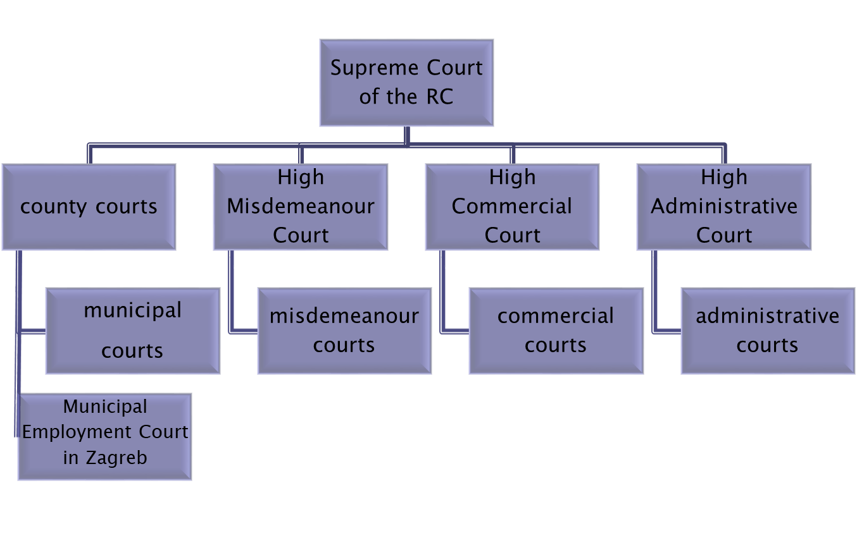
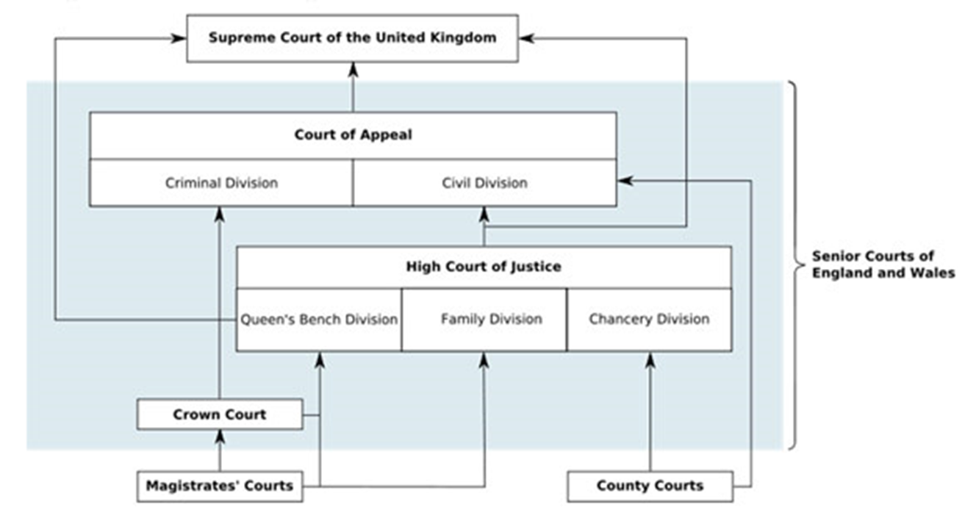
The Court System
List the similarities and differences between English and Croatian court systems

Slide 14
American federalism
Explain the basics of the organisation of government in American federalism.
Consider both the vertical and horizontal divions, i.e.:
National and state levels
The three branches of government (legislative, executive, judicial)

Slide 15
American federalism
 | LEGISLATIVE | EXECUTIVE | JUDICIAL
FEDERAL (NATIONAL) LEVEL
STATE LEVEL

Slide 16
American federalism
 | LEGISLATIVE | EXECUTIVE | JUDICIAL
FEDERAL (NATIONAL) LEVEL | US Congress (HoR + Senate) | President of the US (+ the Cabinet) | US Supreme Court (+ District Courts and Circuit Courts)
STATE LEVEL | state legislative assemblies (x50) | state governors (x50) | state court systems (x50)
Compare the powers of the states and the federation!

Slide 17
The Supreme Court
Compare the jurisdiction of the three Supreme Courts: Croatia, UK and USA
CROATIA | UNITED KINGDOM | USA

Slide 18
The Supreme Court
CROATIA | UNITED KINGDOM | USA
third instance for civil cases second instance for serious criminal cases approx. 40 judges | third or higher instance civil and criminal cases issues of statutory interpretation sets precedents of interpretation of law can refuse to hear cases without explanation 12 judges | third or higher instance civil and criminal cases some original jurisdiction chooses only cases that it wants to hear issues of interpretation of the constitution can abolish state and federal laws 9 judges

Slide 19
Thank you for your attention!

