Slide 1
English for Lawyers 2
Lecturer: Miljen Matijašević
e-mail: miljen.matijasevic@gmail.com
Session 2, 6 Mar 2018

Slide 2
The Sources of
English Law
Unit 7

Slide 3
Introduction
DISCUSS THE FOLLOWING QUESTIONS
How would you define a source of law?
What sources of Croatian law are you aware of?
Is there a hierarchy of the sources?

Slide 4
The Sources of English Law
Discuss the sources of law listed on p. 51 in your coursebook
If you know what they are, discuss their characteristics

Slide 5
England or the UK?
Consider the relationships between the following
Great Britain
The British Isles
Wales
England
The United Kingdom
Ireland
Scotland
Northern Ireland

Slide 6
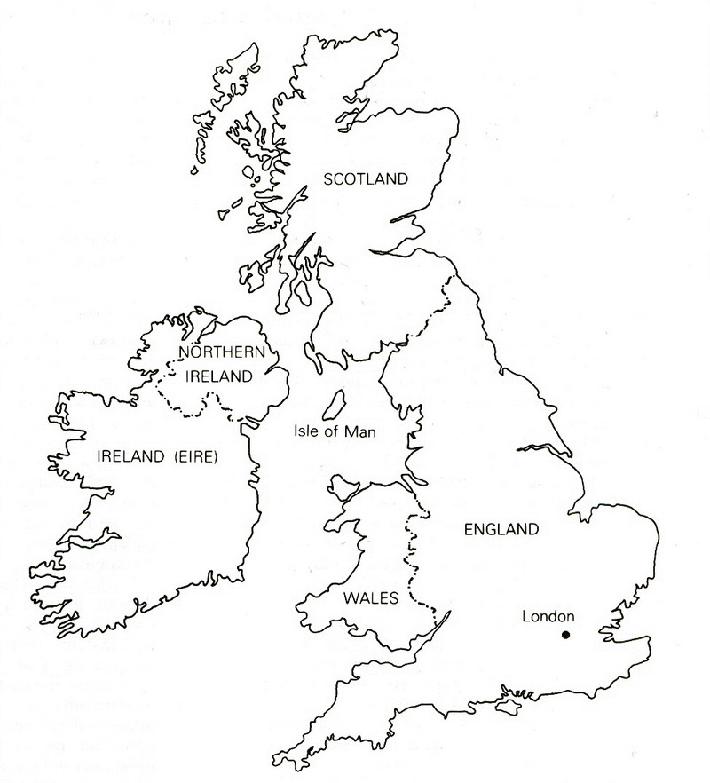
The British Isles

Slide 7
The States and the Countries
The United Kingdom of Great Britain and Northern Ireland
The Republic of Ireland
Great Britain: England, Wales and Scotland
England, Wales, Scotland and Northern Ireland – the four countries of the UK
England and Wales share a common legal system, while Scotland and Northern Ireland have separate legal systems

Slide 8
England or the UK
The United Kingdom of Great Britain and Northern Ireland
a constitutional monarchy
constitution – UNCODIFIED – not a single legal act
multiple sources of constitutional law
collectively referred to as: the Constitution

Slide 9
Sources of constitutional law
statutes:
      Magna Carta 1215
      Bill of Rights 1689
      Parliament Acts 1911, 1949
      European Communities Act 1972
      Human Rights Act 1998
      Constitutional Reform Act 2005, etc.
case law
constitutional/parliamentary conventions
      roles and powers of government authorities (the monarch, the Cabinet, the Prime Minister, Parliament, etc.)
books of authority – works by experts on the British constitution (Bagehot, Dicey)

Slide 10
The Sources of English Law
COMMON LAW
EQUITY
STATUTE LAW
DELEGATED LEGISLATION
ECHR
EU LAW
CUSTOM

Slide 11
Custom
GENERAL CUSTOMS
  served as the basis for common law
  some original court decisions based on customs, accepted practices and values in a community
LOCAL CUSTOMS
  refers to local rights, e.g. the right to use land in a particular way, the right of way
  not part of the law per se, but may be recognized by the courts

Slide 12
Common law
instituted in 12th century after the Norman Conquest (1066)
William the Conqueror – set up the King’s Court (Curia Regis) and appointed judges
judges also travelled around England and Wales to decide cases
cases applied to the king or his judges

Slide 13
Common law
a collection of court rulings (case law) from local Anglo-Saxon courts
collection ordered by Henry II Plantagenet
judges travelled around circuits to decide cases
COMMON LAW – law common to the whole territory of England and Wales, unified law
the term has a historical meaning

Slide 14
Common law
uncodified law, judicial precedents
provide a certain principle derived from a particular case
e.g. A man who is aware that a risk he is taking may result in damage is liable for the damage. If he is unaware of the risk, he is not liable.

Slide 15
Common law and equity
„If there is a remedy, there is a right”
common law had a limited number of „actions” (lawsuits) with very strict formal requirements
citizens paid to take a certain type of action against a defendant
the formal requirements had to be satisfied
minor errors resulted in failure
remedies fixed (usually DAMAGES)
this often resulted in injustice

Slide 16
Common law and equity
substantive law derived from the „actions” and developed over time through precedents
EQUITY – an answer to the rigidity and unfairness of common law
dissatisfied citizens applied to the King for justice
cases referred to the Lord Chancellor (Keeper of the King’s Conscience)
not bound by (common) law, guided by the principles of natural justice and fairness (equity)

Slide 17
Common law and equity
common law referred to as LAW
main sources of law at the time: LAW and EQUITY
equity developed its own principles, precedents and remedies, and a special court
EQUITABLE REMEDIES:
  injunction
  specific performance
  rescission
  rectification

Slide 18
Equity
law was remedy-oriented
if you wanted a common-law remedy, you turned to the court of law
if you wanted an equitable remedy, you turned to the Court of Chancery
the Judicature Acts 1873-75
fused common law and equity
both common-law and equitable remedies available in all courts

Slide 19
Statute law
law passed by Parliament
today the most productive source of law
modern view – laws should be made by elected representatives of the people
statutes also known as Acts of Parliament

Slide 20
Statute law
doctrine of PARLIAMENTARY SUPREMACY
Parliament has supreme law-making power
nothing and nobody is above Parliament
no formal limitations to Parliament’s law-making power
no authority that can abolish laws made by Parliament

Slide 21
Delegated legislation
to DELEGATE – to transfer a power to someone else
Parliament confers (delegates) the law-making powers to other bodies – government ministers, administrative bodies
PURPOSE: to make more detailed rules and regulations
often referred to as STATUTORY INSTRUMENTS (comparable to pravilnici, uredbe, odluke)

Slide 22
Delegated legislation
not made by Parliament – can be challenged in court
the court (Administrative Court) can examine if the makes has gone beyond the powers (ultra vires) conferred by Parliament

Slide 23
European Convention on Human Rights (ECHR)
Convention for the Protection of Human Rights and Fundamental Freedoms (1950)
a treaty of the Council of Europe
the UK one of the first signatories
transposed into English law only in 1998 – Human Rights Act
English courts must take into account judgments and advisory opinions of the European Court of Human Rights
must interpret English law in a way compatible with ECHR

Slide 24
European Union law
the UK a member since 1973
European Communities Act 1972
enabled accession
made EU law applicable in the UK
Brexit – the UK to leave the EU in 2019
EU law will no longer apply

Slide 25
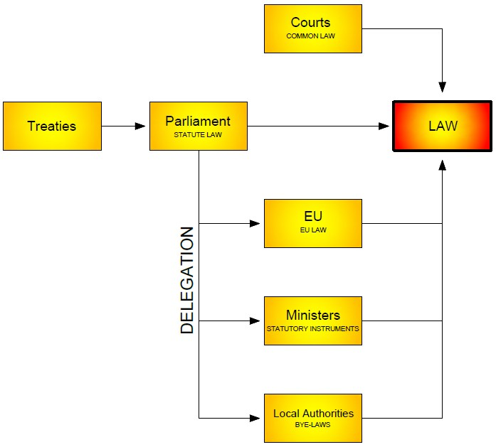
Sources of English law

Slide 26
Exercises
Do exercises III, IV and V (pp. 54-56)

Slide 27
Thank you for your attention!

