Slide 1
English for Lawyers 2
Lecturer: Miljen Matijašević
e-mail: miljen.matijasevic@gmail.com
Session 3, 13 Mar 2018

Slide 2
Revision
The Sources of English Law

Slide 3
The Sources of English Law
Say a sentence about each source of English law:
common law
equity
statute law
delegated legislation
custom
ECHR
EU law

Slide 4
The Sources of English Law
Do exercises 55/IV and 56/V

Slide 5
The Hierarchy of
English Courts
Unit 8

Slide 6
Court Network of the RC

Slide 7
Court Network of the RC
Supreme Court of the RC
county courts
administrative courts
High Misdemeanour Court
misdemeanour courts
Municipal Employment Court in Zagreb
commercial courts
High Commercial Court
High Administrative Court
municipal
courts
Constitutional
Court

Slide 8
The Court System
KEY VOCABULARY:
criminal court, civil court, etc.
general jurisdiction court
specialized court
first-instance court, trial court
second-instance court, appeals court, court of appeal, appellate court
higher, superior court
lower, inferior court

Slide 9
The Court System
KEY VOCABULARY (cont.):
  of a court
  to hear a case
  to have jurisdiction in (civil matters)
  to be competent for (hearing criminal cases)
  to hear appeals from a (lower court)
  to hear appeals on/against (a decision of a lower court)

Slide 10
The Courts of England and Wales
Read the text on pp. 62-63 quickly and draw a chart of the Courts of England and Wales
Pay attention to the line of appeal!

Slide 11
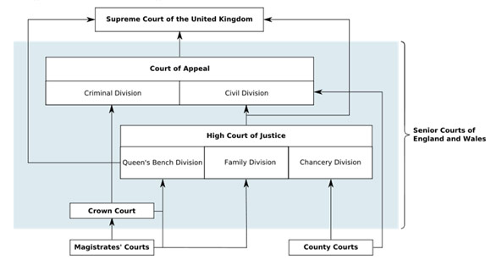
The Courts of England and Wales

Slide 12
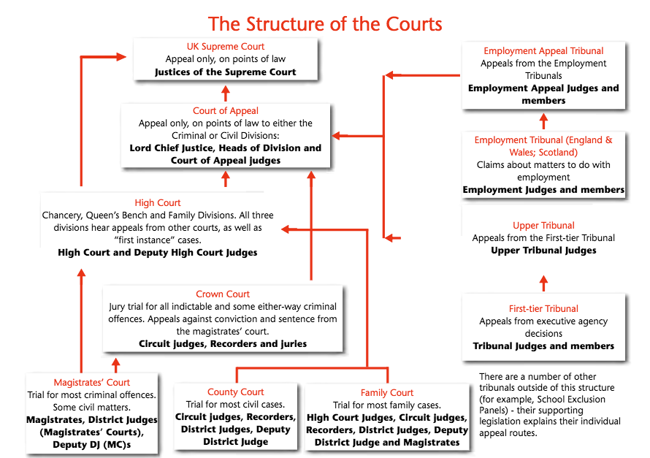

Slide 13
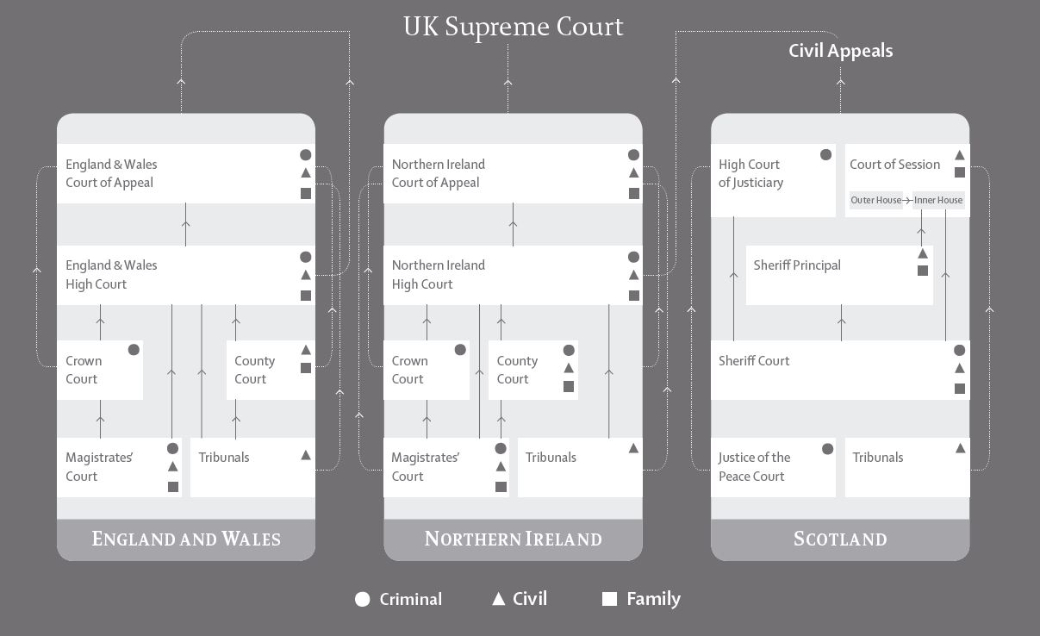
The Courts of the United Kingdom

Slide 14
The Court System
LOWER CIVIL COURTS:
  county courts
LOWER CRIMINAL COURTS:
  magistrates’ courts

Slide 15
The Court System
HIGH COURTS
The Supreme Court of the UK
highest court of appeal (appeals from the CA of exceptionally the HCJ; also appeals from Scotland and Northern Ireland)
The Court of Appeal
Civil and criminal divisions
The High Court of Justice
  Queen’s Bench division
  Chancery Division
  Family Division

Slide 16
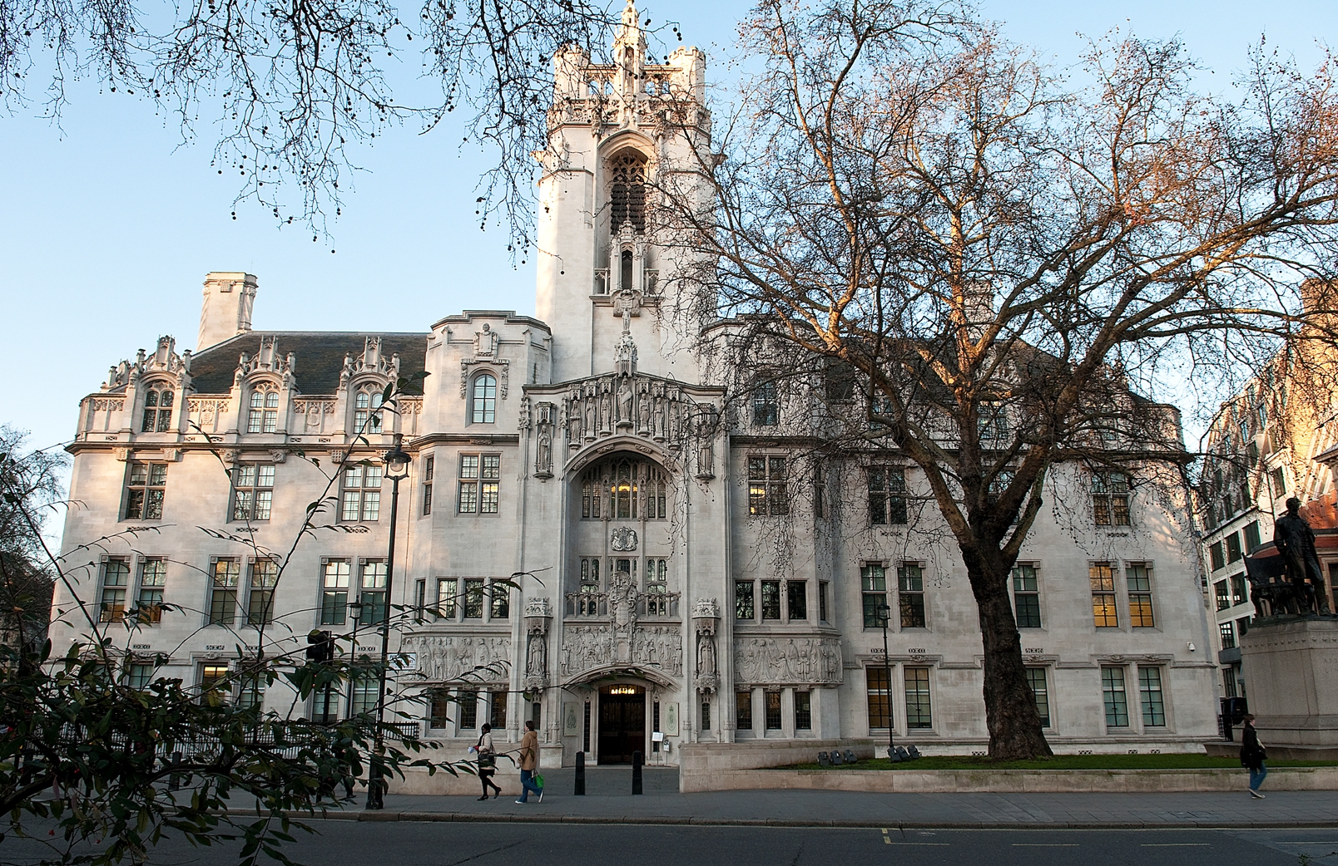
Supreme Court of the UK

Slide 17

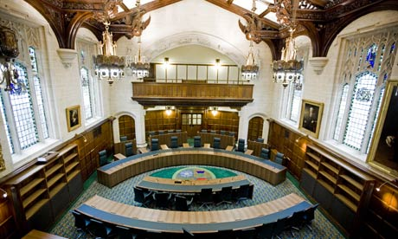
Supreme Court of the UK

Slide 18
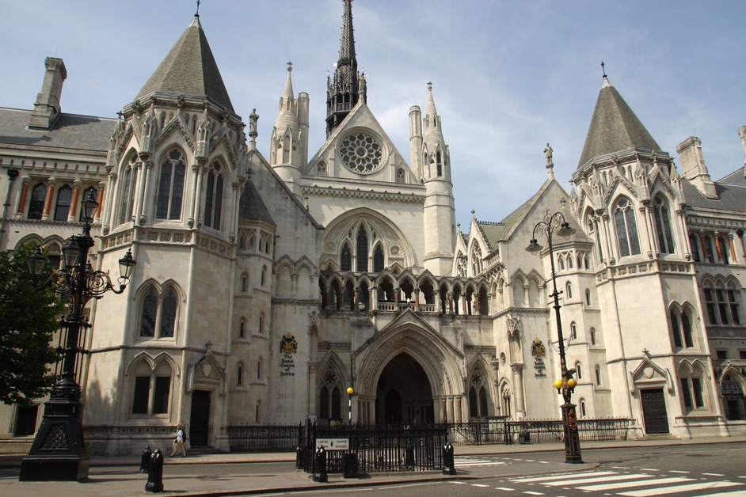
Royal Courts of Justice

Slide 19
Royal Courts of Justice
High Court of Justice
Court of Appeal

Slide 20
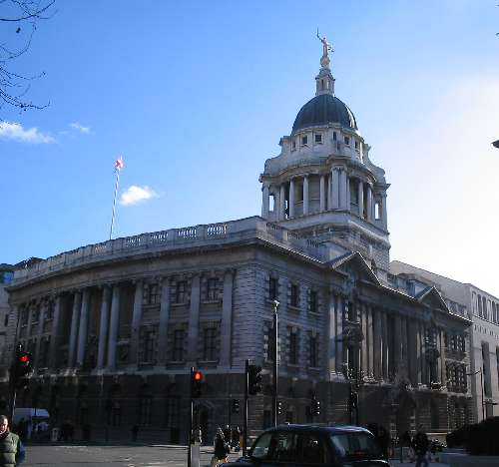
Crown Court
Central Criminal Court in London
A.k.a. The Old Bailey

Slide 21
The Court System
Civil Courts
The Supreme Court of the UK - highest court of appeal (appeals from the CA of exceptionally the HCJ)
The Court of Appeal (civil division) - appeals from the High Court or county courts
The High Court of Justice – first instance for complex cases, specialist divisions (family law, administrative law, commercial law, etc.), also second instance for appeals from county courts
County courts – first-instance court for most civil cases of low or medium complexity

Slide 22
The Court System
Criminal Courts
The Supreme Court of the UK - highest court of appeal
The Court of Appeal (criminal court) - appeals from the Crown Court on points of law or the verdict
Divisional Court of the Queen’s Bench Division (HCJ) – criminal appeals from the Crown Court or magistrates’ courts on points of law
Crown Court – first-instance court for serious crimes
Magistrates’ courts – first-instance court for summary offences (petty crimes)

Slide 23
The Judges
Judges have different titles, according to experience and type of court they sit in
  Justices of the Supreme Court
  Lord Justices of Appeal (CA)
  High court judges
  circuit judges
  recorders
  district judges
  Justices of the Peace (magistrates)

Slide 24
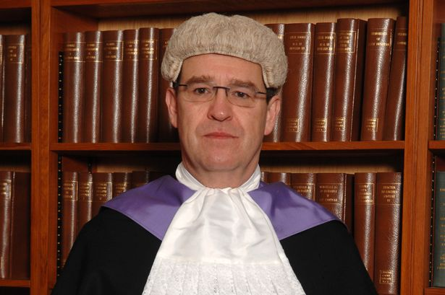
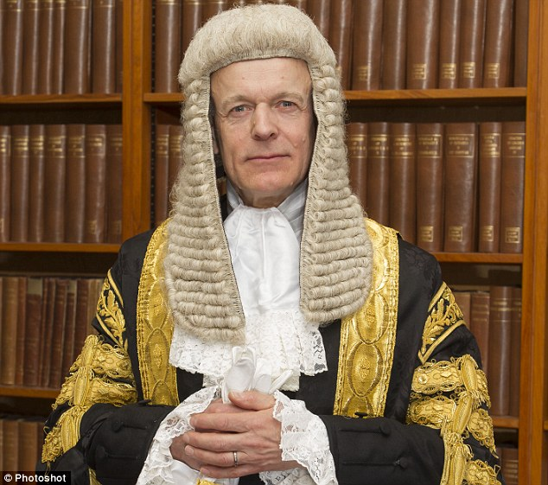
The Judges
                High Court Judge
Circuit judge

Slide 25
The Judges
Justices of the Peace (magistrates)
  lay, unpaid judges – esteemed members of the local community hired part-time
  usually sit in groups of 2 or 3
  advised by a clerk
  TREND: tend to be replaced by district judges (professional judges)

Slide 26
The Court System
The only judicial authorities above the Supreme Court of the UK are:
  the Court of Justice of the European Union, and
  the European Court of Human Rights

Slide 27
Do exercises III, IV, V and VI (pp. 63-65)

Slide 28
The Courts of England and Wales
The Magistrates’ Court
https://www.youtube.com/watch?v=WeNDacwO5NA
More about magistrates:
https://www.youtube.com/watch?v=fCybrBaKj8s
The Crown Court
https://www.youtube.com/watch?v=tZYvv_s5R-s

Slide 29
Thank you for your attention!

