Slide 1
English for Lawyers 2
Lecturer: Miljen Matijašević
e-mail: miljen.matijasevic@gmail.com
Session 4, 20 Mar 2018

Slide 2
Today’s session
Revision – The Courts of England and Wales
The Doctrine of Precedent (Unit 8, Part Three)

Slide 3
Revision
The Courts of
England and Wales

Slide 4
Translate into Croatian
misdemeanour court
commercial court
administrative court
general jurisdiction court
first-instance court
appellate court
to have jurisdiction in civil matters
to hear criminal cases
to hear appeals from municipal courts

Slide 5
Translate into Croatian
misdemeanour court – prekršajni sud
commercial court – trgovački sud
administrative court – upravni sud
general jurisdiction court – sud opće nadležnosti
first-instance court – prvostupanjski sud
appellate court – žalbeni sud
to have jurisdiction in civil matters – imati nadležnost za građanske stvari
to hear criminal cases – rješavati kaznene predmete
to hear appeals from municipal courts – rješavati žalbe na odluke općinskih sudova

Slide 6
The Courts of England and Wales
Read the text on pp. 61-63 and do the tasks:
Enumerate the civil courts from lowest to highest.
Enumerate the criminal courts from lowest to highest
Exercise 63/III – True or false?
Exercises 64/IV, V – Collocations
Exercise 65/VI – Word search

Slide 7
The Doctrine of Precedent
Unit 8, Part Three

Slide 8
The Doctrine of Precedent
The foundation of the common law system
Judge-made law – court rulings that have the force of the law

Slide 9
The Doctrine of Precedent
The principle of precedent is also known as stare decisis (‘to stand by decisions’)
The doctrine determines whose decisions (precedents) are BINDING (i.e. must be followed)
binding precedent, binding authority
In principle – first-instance courts are bound by decisions made by higher courts, but not by their own
Appellate courts normally bound by their own decisions

Slide 10
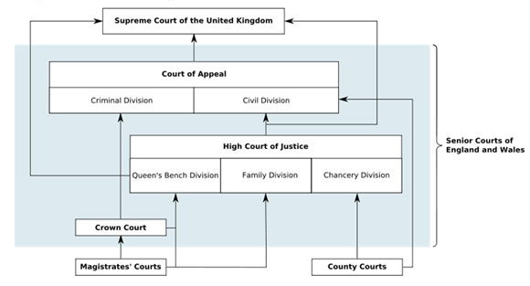
The Courts of England and Wales

Slide 11
The Doctrine of Precedent
Rulings made by lower courts (Magistrates’ Courts, the County Court, the Crown Court) are not binding, but may be considered as PERSUASIVE (having good grounds and possibly helping to reach a decision in the case at hand)
Decisions (precedents) made by courts in other common law countries may also be considered in adjudication, but are only treated as PERSUASIVE

Slide 12
The Doctrine of Precedent
The decisions of the Supreme Court of the UK (or formerly the House of Lords) are BINDING on ALL lower courts, except on the SC itself
Court rulings (both binding and persuasive) are recorded in Law Reports

Slide 13
The Doctrine of Precedent
THE ELEMENTS OF A JUDGMENT:
Findings of facts
Statement of the principles of law (points of law)
Decision (based on 1 and 2)

Slide 14
The Doctrine of Precedent
THE DECISION INCLUDES
Ratio decidendi (reasons for the decision)
the binding part of the decision
Obiter dicta (things said by the way)
remarks, comments explaining the decision
the persuasive (non-binding) part of the decision
It may be difficult to distinguish one from the other!

Slide 15
The Doctrine of Precedent
During trial
Legal representatives CITE precedents to the judge, trying to persuade him to follow them
The judge can decide to FOLLOW a precedent, which means, apply it to the case at hand
Alternatively, the judge may decide to DISTINGUISH THE CASE, i.e. find that the facts of the case are different from the cited precedent and that the same principles, i.e. precedent cannot or should not be applied

Slide 16
The Doctrine of Precedent
An court of appeal can:
APPROVE – accept the choice of precedent
DISAPPROVE – reject the choice precedent in the particular case
OVERRULE (the principle of law) – i.e. find that the reasoning (of a new precedent) was wrong; the precedent may not be cited/applied again
REVERSE (the decision of a lower court)

Slide 17
The Doctrine of Precedent
What, in your opinion, are the advantages and disadvantages of the doctrine of precedent?

Slide 18
The Doctrine of Precedent
ADVANTAGES OF THE DOCTRINE
Consistency in application, which secures predictability of the outcome of cases
Law can change quickly to adapt to new circumstances
Age-long recording of cases provides for a huge amount of details, circumstances, points of law, that enhance precision in the creating of law

Slide 19
The Doctrine of Precedent
DISADVANTAGES OF THE DOCTRINE
It may restrict judicial reasoning and lead to illogical conclusions by judges
It can be difficult to understand what exactly the ratio decidendi was
Increasing complexity and volume of precedents, makes it difficult and impractical do deal with cases

Slide 20
The Doctrine of Precedent
These days, judges generally avoid creating new precedents unless absolutely necessary
It is considered that law-making should predominantely be in the hands of Parliament – the representative body of the people

Slide 21
The Doctrine of Precedent
Do the exercises:
71/III
72/IV and V

Slide 22
Thank you for your attention!

