Slide 1
English for Lawyers 2
Lecturer: Miljen Matijašević
e-mail: miljen.matijasevic@gmail.com
Session 5, 27 Mar 2018

Slide 2
Today’s session
Revision – The Doctrine of Precedent
Parliament and Legislation

Slide 3
Revision
The Doctrine of Precedent

Slide 4
The Doctrine of Precedent
Do the exercises:
  71/III
  72/IV and V

Slide 5
Parliament and Legislation
Unit 9

Slide 6
British Government and Parliament
The Government
The Prime Minister (Premijer)
The Cabinet (Vlada)
Government departments (ministarstva)
Civil service (državni službenici)
The Queen

Slide 7
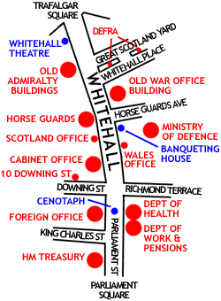
British Government and Parliament
the Cabinet also referred to as Whitehall

Slide 8
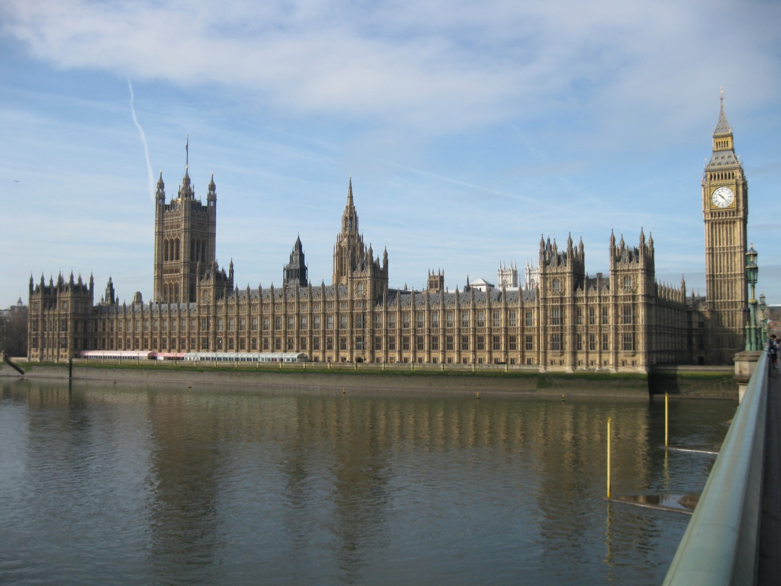
British Parliament
The Palace of Westminster

Slide 9
The British Parliament
The House of Commons
650 MPs
The House of Lords
825 members
The Queen

Slide 10
The House of Commons
650 Members of Parliament (MPs)
salaried
elected in the national election by the people
each MP represents the voters in his constituency
‘first past the post’ electoral system
  the candidate with the most votes in each constituency wins and goes to Parliament, the others lose

Slide 11
The House of Lords
ca. 800 members (most of whom – peers)
non-salaried (may claim expenses)
appointed by the Queen (at the proposal of the Prime Minister)
Lords Spiritual
bishops (max. 26)
Lords Temporal
life peers (no limit)
hereditary peers (max. 92)

Slide 12
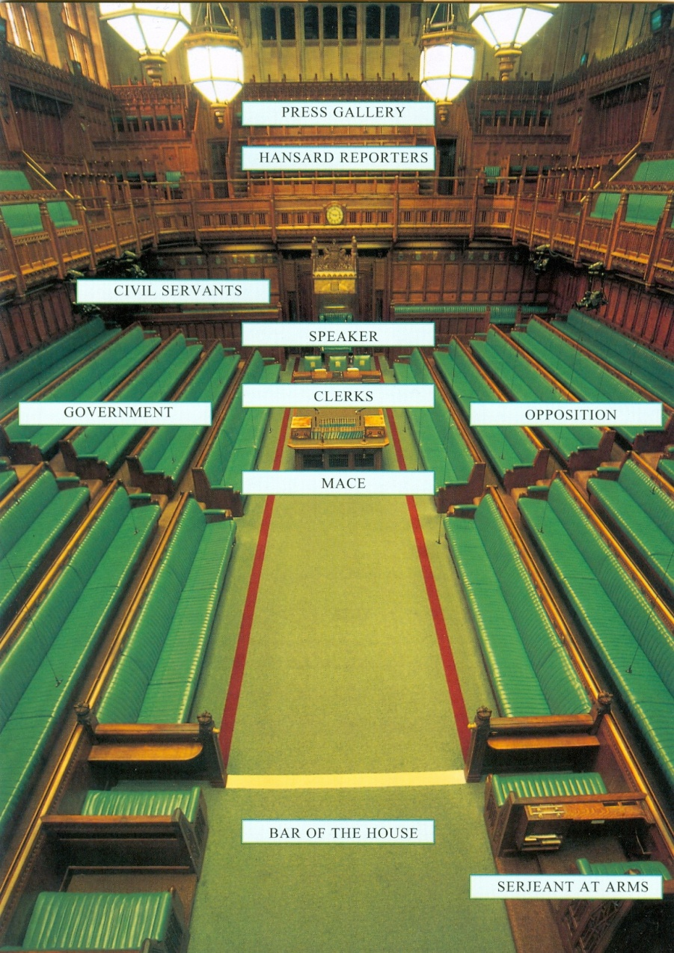
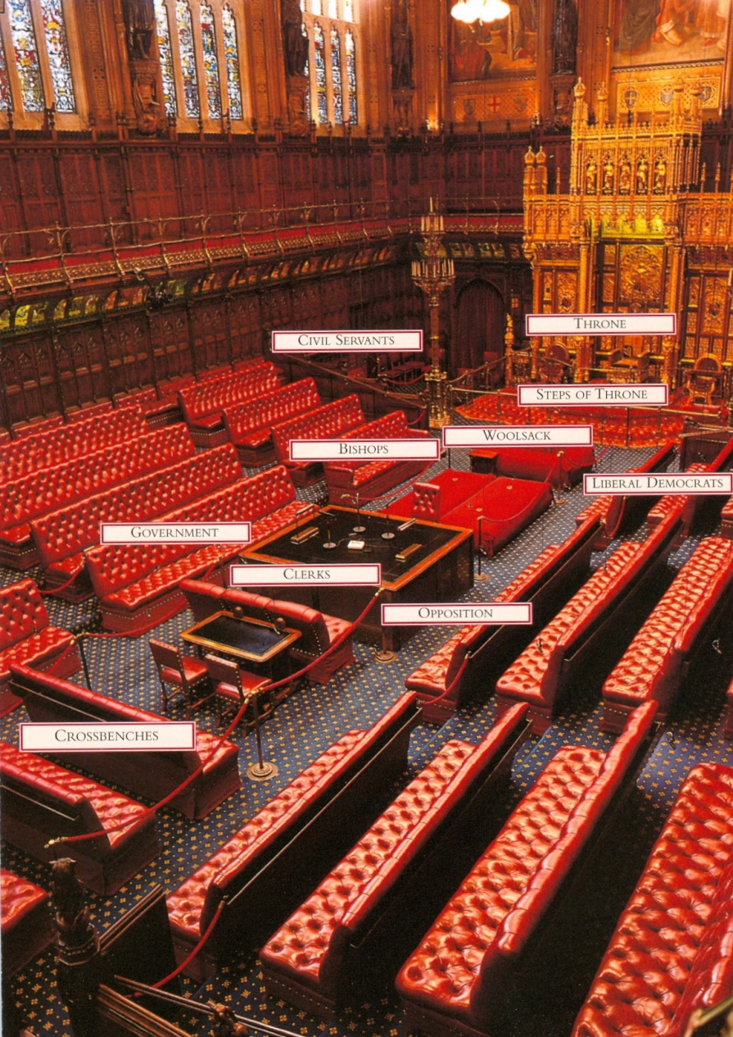
The Commons and the Lords

Slide 13
Some peculiarities
The Commons
Searjant at Arms
the Mace
the Bar of the House
the red lines – two sword lengths
the Speaker of the House of Commons
The Lords
the Throne
the Woolsack
the Lord Speaker (formerly the Lord Chancellor!)

Slide 14
The House of Commons
checks and challenges the work of the Government (government scrutiny)
enacts statute law (legislation)
debate important issues of the day
check and approve Government spending (taxes and state budget)
meet constituents and discuss matters that concern them (surgery)

Slide 15
The House of Lords
gives advice on public policy, representing the British society
revises legislation passed by the Commons
possibility for persons who have contributed to the public life of Britain to participate in government
acts as a constitutional check

Slide 16
More on statute law
PARLIAMENT has supreme law-making power
‘No limits’ to its law-making capacity – an act enacted by Parliament which has undergone the proper procedure may not be overturned! (no constitutional court!)
However, in enacting laws, the following must be taken into account: EU law (not true after Brexit!) and the European Convention on Human Rights (via the Human Rights Act 1998)

Slide 17
Legislative procedure
An Act of Parliament starts as a BILL (a legislative proposal)
There are three main types of Bills, differing in scope and subject matter:
PUBLIC BILLS
PRIVATE BILLS
PRIVATE MEMBERS’ BILLS

Slide 18
Legislative procedure
PUBLIC BILLS – affect the public at large, proposed by the Government (e.g. Domestic Violence Bill)
PRIVATE BILLS – concern a limited section of the population (Local and Personal Bills), may be initiated by associations and companies
PRIVATE MEMBERS’ BILLS – introduced by a ‘back-bencher’, provided there is time and luck! Rarely enacted, but may spark a public debate and indirectly affect legislative trends

Slide 19
Legislative procedure
Bills usually originate in the Commons
There are normally three readings for each bill, including a committee stage and a report stage
The procedure starts in the Commons and a largely similar procedure is followed in the Lords
Bills may be returned to the Commons for revision and amendments and the procedure may be repeated

Slide 20
Legislative procedure
The Lords may not reject a Bill, they can only delay its enactment for up to one year
When the final agreement is reached and the final version of the Bill is approved, the Bill is given the Royal Assent, thus becoming and Act of Parliament (statute)

Slide 21
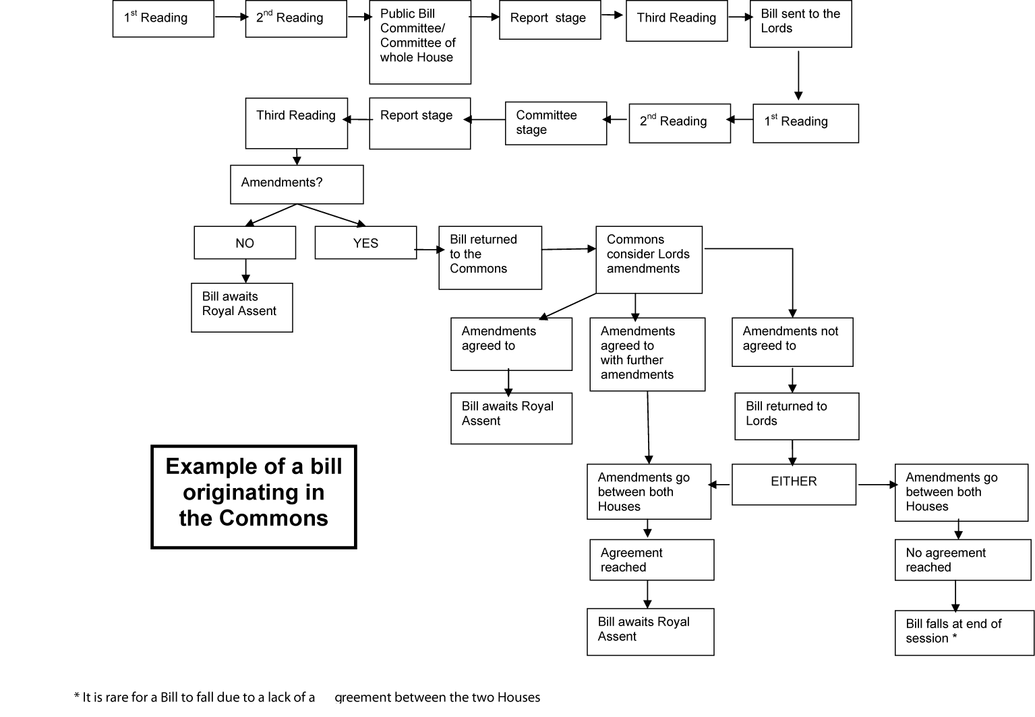
Legislative procedure

Slide 22
The Queen’s role
the monarch summons, prorogues and dissolves Parliament
SUMMON – call Parliament for a session after a general election
PROROGUING –discontinue a session
DISSOLVE –dismiss Parliament, before a general election

Slide 23
The Queen’s role
At the beginning of each session of Parliament (usually November) and after a General Election, the Queen reads a speech outlining legislative proposals for the coming year
This speech is written by the Prime Minister

Slide 24
The Queen’s role
The other role of the Queen is to give the Royal Assent to a Bill in order for it to become an Act of Parliament, i.e. enter into force
Royal Assent has not been refused since 1707 (today the Queen no longer signs bills with her own hand nor is she even consulted)
today: given automatically by clerks representing the Sovereign, the Queen NOT involved or consulted

Slide 25
Watch the video clips
Queen opening Parliament
https://www.youtube.com/watch?v=htJlSC9lXVg
Introduction to Parliament
https://www.youtube.com/watch?v=RAMbIz3Y2JA (8:30)
https://www.youtube.com/watch?v=GbLTwQwXqWc (1:30)
House of Commons
https://www.youtube.com/watch?v=dS_SLF92e5A
House of Lords
https://www.youtube.com/watch?v=-U0LhurGWOc

Slide 26
Thank you for your attention!

