Slide 1

Economic, Social and Cultural Rights

Slide 2

Economic, Social and Cultural Rights
concern the dignity of human beings
ideas of equality and access to essential social and economic goods and opportunities

Slide 3

Economic Rights
economic rights – legal claim on potential property rights
property rights – legal claim on wealth that already exists

Slide 4
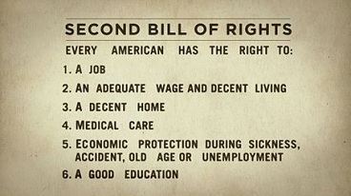
Economic rights
rights that provide people with opportunities for creating wealth
right to an adequate standard of living, housing, pension...

Slide 5
Entrepreneurial freedom
freedom to go into business for yourself
existence of rights = existence of responsibilities
  ensures legal equality in the market

Slide 6

Competition law
antitrust law, antimonopoly law
maintains and promotes market competition
regulates anticompetitive practices

Slide 7

Market competition
rivalry among parties to get a bigger share of a market
changing elements – price, product, promotion...

Slide 8

Anticompetitive pracitce
to prevent competition in the market
dealings with competitors
single firm conduct

Slide 9

Dealings with competitors
price fixing
dividing markets
bid rigging
group boycotts

Slide 10
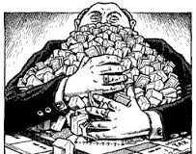
Single firm conduct
monopoly – a situation in which a single company or group owns all or nearly all of the market for a given type of product or service

Slide 11

Social Rights
rights necessary for full participation in the life of society
right to work, found and maintain a family, health care, privacy...

Slide 12
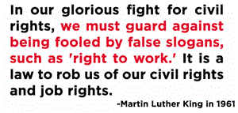
Right to work
belief that everyone has the right to work and can’t be prevented from doing so

Slide 13
In Croatia
everyone has the right to work
salary – should be enough to provide for the individual and their family
right to join trade unions an organized association of workers in a trade, group of trades, or profession, formed to protect and further their rights and interests

Slide 14
Collective bargaining agreement
an agreement between trade unions and employers
determines: salaries, working hours, promotions, benefits...
cannot go against laws

Slide 15

Fixed term employment
for a specified period (or until the job is done)
needs a valid reason
cannot last more than three years

Slide 16

Full-time employment
more secure than fixed term employment
more benefits (annual leave, sick leave, health insurance)
terminating the contract – termination period and severance pay

Slide 17
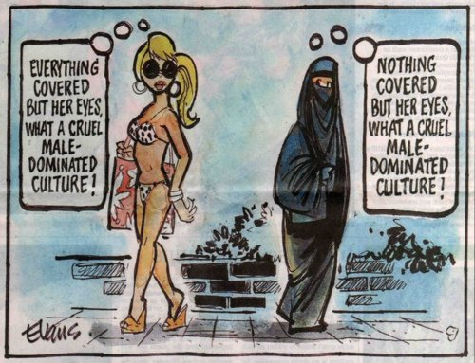
Cultural rights
human rights that aim at assuring the enjoyment of culture and its components in conditions of equality, human dignity and non-discrimination

Slide 18
Universal Declaratin of Human Rights:
”Everyone has the right to education. Education shall be directed to the full development of the human personality and to the strengthening of respect for human rights and fundamental freedom.”

Slide 19

Right to education
a universal entitlement to education
promotes individual freedom and development
free primary and secondary education

Slide 20
Vocabulary
annual leave
anticompetitive practices
antimonopoly law
antitrust law
collective bargaining
competition law
enterpreneurial freedom
fixed term emplyoment
full-time employment
health insurance
market competition
severance pay
sick leave
trade union

Slide 21
Thank you!

