Slide 1
Law of Tort
March 18, 2015

Slide 2
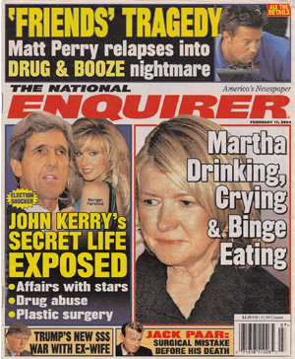


Slide 3
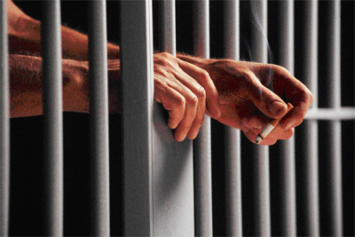
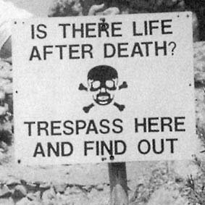

Slide 4
Tort = a civil wrong
A harmful action or inaction that causes harm or damage to another person
DUTY OF CARE BREACH TORT

Slide 5
Duty of care
to owe duty of care to smb.– to make sure one’s conduct doesn’t harm anyone
to be liable for one’s actions and omissions. – tortious liability
harm must be reasonably foreseeable

Slide 6
Breach of duty of care
start proceedings in a civil court for a remedy
grounds: breach of duty of care
the court awards a remedy: damages (compensatory, punitive) injunction
county court – the court of first instance for civil cases
tracks:
small claims track < 5000
fast track < 15000
multi-track > 15000 or injunction

Slide 7
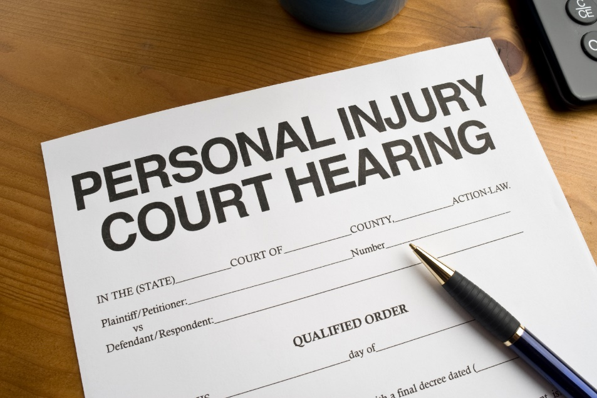
Vocabulary
To sue somebody for something
To bring an action against somebody
To start/bring/institute proceedings against somebody
To file a claim against somebody

Slide 8
Heads of tort
Intentional torts
Negligence torts
torts against property
nuisance
trespass
torts against the person
trespass to the person (assault, battery, false imprisonment)
defamation (libel, slander)
business torts
misrepresentation
contractual interference
unfair business practice
those which arise out of negligence (the ommission to do sth which a reasonable person would do, or doing sth a reasonable person would not do

Slide 9
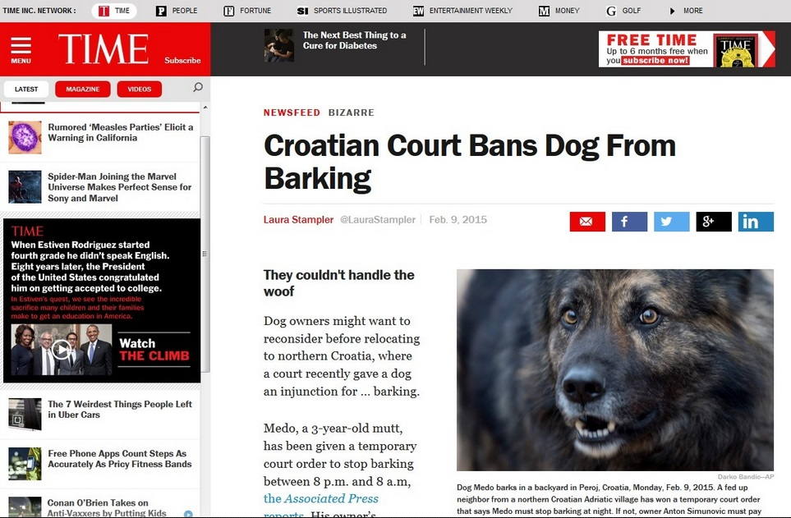
Torts against the property
nuisance
trespass
interferes with the owners enjoyment of the land or property
to land – wrongful interference with one’s possessory rights in real property
to personal property – intentional interference with the possession of personal property…

Slide 10
Torts against the person
trespass
defamation
assault – any act that will cause fear of battery
battery – any intentional contact with the claimant’s person or anything attached to it or identified with it
false imprisonment – unlawful obstruction or deprivation of freedom from restraint of movement
communication of a statement that makes a claim, expressly stated or implied to be factual, that may give an individual, business, product, group, government or a nation a negative image
libel – written, broadcast or otherwise published
slander - spoken

Slide 11
Shaking your fist in anger?
Punching someone in the face?
Locking someone up in a room?
Performing a medical operation without the patient’s consent?
Using abusive language?

Slide 12
Business torts
misrepresentation
a) innocent misrepresentation
representor makes a statement which he reasonably believes to be true
b) negligent misrepresentation
representor makes a statement which he believes is true but has no reasonable grounds
c) fraudulant misrepresentation, fraud
representor does not honestly believe in his statement (KNOWS IT IS NOT TRUE!)

Slide 13
contractual interference
a defendant interferes with the claimant’s contractual relations
Elements:
A valid contract (claimant and third party)
Defendant’s knowledge of this contract
Defendant’s intentional acts to breach it
Actual breach of contract
Resulting damage

Slide 14
unfair business practice
unfair competition
Examples:
trademark infringement
false advertising
use of confidential information by a former employee to solicit customers
theft of trade secrets
trade libel

Slide 15
Negligence torts
personal injuries
clinical/medical negligence
workers negligence
product liability

Slide 16
Establishing negligence
Did the defendant owe the claimant a duty of care?
Was the duty of care breached?
Did the defendant’s breach cause or materially contribute to the damage suffered by the claimant?
Was the chain of causation broken at any time?
Would the harm suffered by the claimant happen anyway?
Even in the case of clear chain of causation, was the damage too remote (not reasonably foreseeable)?

Slide 17
Tortious liability
Liablity
legal responsability
= occupier’s liability = responsability of those who occupy (ownership or lease) real property to people who visit or trespass
= product liability = responsability of those who manufacture a product for the injuries this product causes
manufacturing defect
design defect
duty to warn

Slide 18
Secondary liability
Strict liability
legal responsibility of a party for acts carried out by another party
vicarious liability
contributory liability
responsability of a party without a finding of fault (negligence or intent)
applies to situations which are inherently dangerous
f.e. owner of a tiger centre

Slide 19
vicarious liability
the responsability of a superior for the acts of their subordinate
f.e. employer’s liability, principal’s liability (f.e. car), parental liability
contributory liability
responsability on the part of someone who is not directly infringing, but contributing to the act
f.e. material contributions (enabling), knowledge of the act

Slide 20
Vocabulary
assault
battery
defamation
grounds
libel
negligence
nuisance
slander
tort
trespass

Slide 21
business torts
civil wrong
clinical negligence
compensatory damages
confidential information
contractual interference
contributory liability
false advertising
false imprisonment
fraudulant misrepresentation
innocent misrepresentation
intentional torts
medical negligence
negligence torts
negligent misrepresentation
occupier’s liability

Slide 22
personal injuries
personal property
possessory rights
product liability
punitive damages
real property
reasonable person
reasonably foreseeable
secondary liability
strict liability
trademark infringement
trade libel
trade secrets
tortious liability
unfair business practice
unfair competition
vicarious liability
worker’s negligence

Slide 23
to be liable for one’s actions
to breach chain of causation
to breach duty of care
to bring an action against somebody
to file a claim against somebody
to owe duty of care
to start proceedings against somebody
to sue somebody for something

Slide 24
Thank you!

