Slide 1
Legal english

Slide 2
Preview
Historical development of English
Language contacts in the history of English
The spread of English
Development of legal English

Slide 3
HISTORY OF THE ENGLISH LANGUAGE
OLD ENGLISH (c. 450- c. 1100)
MIDDLE ENGLISH (c. 1100- c.1450)
MODERN ENGLISH (c. 1450 - )

Slide 4
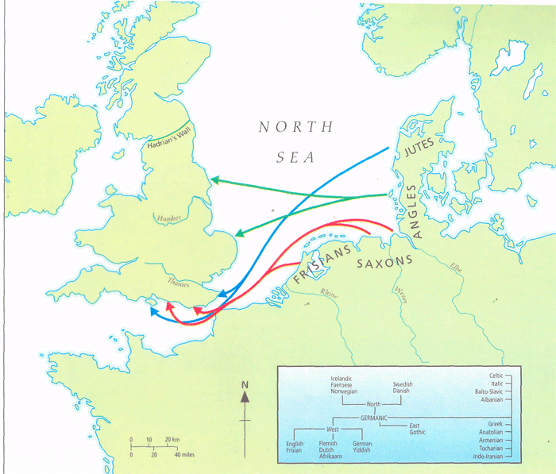
Migrations of Angles, Saxons and Jutes

Slide 5
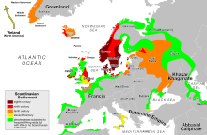
Viking invasions in Europe
(late 8th c.- mid-11th c.)

Slide 6
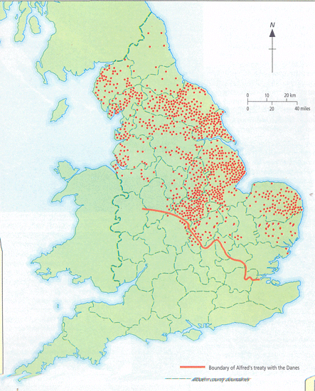
SCANDINAVIAN PLACE NAMES

Slide 7
LATER OLD ENGLISH (c. 850 - c.1100)
Language Contacts
OLD NORSE
Lexical words
Nouns: birth, bull, dirt, egg, fellow, husband, leg, sister, skin, sky, skirt, window
Adjectives: ill, low, odd, rotten, sly, weak
Verbs: call, crawl, die, get, give, lift, raise, scream, take,
Function words
Pronouns: they (their, them)
Conjunctions: though
Determiners: some, any
Auxiliaries: are
Names
Family names: -son: Johnson, Stevenson
Place names: -by 'farm, town': Derby, Rugby, Whitby; -thorp 'village': Althorp, Linthorp

Slide 8
The norman conquest (1066)
The Norman Conquest brought to England a French-speaking upper class
Latin – dominant in law
Normans – used Latin in important contexts
11-12 c. Latin was the language of legal documents in England

Slide 9
Rise of Law French
1st law promulgated in French in 1275
End of 13th c. both Latin and French used as legislative languages
Early 14th c. French used in drafting laws (except in Church matters)

Slide 10
MIDDLE ENGLISH (c. 1100-1450)
French Influence
Administration
Authority, bailiff, baron, chamberlain, chancellor, constable, council, court, crown, duke, empire, exchequer, government, liberty, majesty, mayor, messenger, minister, noble, palace, parliament, prince, realm, reign, revenue, royal, servant, sir, sovereign, statute, tax, traitor, treason, treasurer, treaty
Law
Accuse, advocate, arrest, arson, assault, assize, attorney, bail, bar, blame, convict, crime, decree, depose, estate, evidence, executor, felon, fine, fraud, heir, indictment, inquest, jail, judge, jury, justice, larceny, legacy, libel, pardon, perjury, plaintiff, plea, prison, punishment, sue, summons, trespass, verdict, warrant
Military
Ambush, archer, army, battle, besiege, captain, combat, defend, enemy, garrison, guard, lance, lieutenant, navy, retreat, sergeant, siege, soldier, vanquish

Slide 11
Decline of Law Latin and Law French
1362 Statute of Pleading “All lawsuits shall be conducted in English, because French is much unknown in the said realm” – drafted in French!

Slide 12
Dominance of Latin, French and English
1000 1200 1500 2000
Latin supremacy
Law French supremacy
English supremacy

Slide 13
Latin influence
shortened expressions:
Nisi prius (‘unless before’) = a matter of proceedings at first instance with a jury present
Affidavit (‘he affirmed’) = ‘a written or printed declaration confirmed by an oath’
Habeas corpus (‘you may have the body’) = a judge’s order to bring a prisoner before the court to clarify the legality of detaining him

Slide 14
French influence
Influence on word formation:
Old French past participle: -e or –ee
Doer of the action: -or/-er (for the person obtaining sth or forming the object of an action Employer/employee, trustor/trustee, vendor/vendee
Word order (Accounts payable, attorney general, court martial, fee simple, letters patent)

Slide 15
LeGal language: synonyms
Binary expressions: words with the same meaning existed at the same time in the form of Latin-French variants and Anglo-Saxon variants .
Repetitions ensured that legal messages were understandable in a multilingual society
Acknowledge and confess, act and deed, devise and bequeath, fit and proper, goods and chattels, will and testament
null and void and of no effect, authorized, empowered and entitled to
To tell the truth, the whole truth, and nothing but the truth

Slide 16
Richard Mulcaster (1582)
“The English tongue is of small account, stretching no further than this island of ours, nay not there over all.”

Slide 17
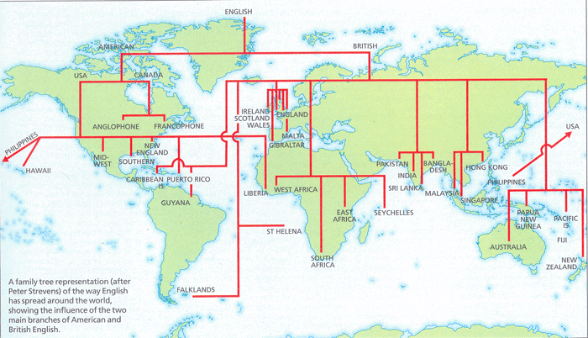
THE SPREAD OF ENGLISH

Slide 18
English as a Global Language:
Some 1,200-1,500 million people in command of English; 670 million native speakers
English – official language in 75 states or administrative territories
85% international organisations use English as one of their languages
Dominance in international trade

Slide 19
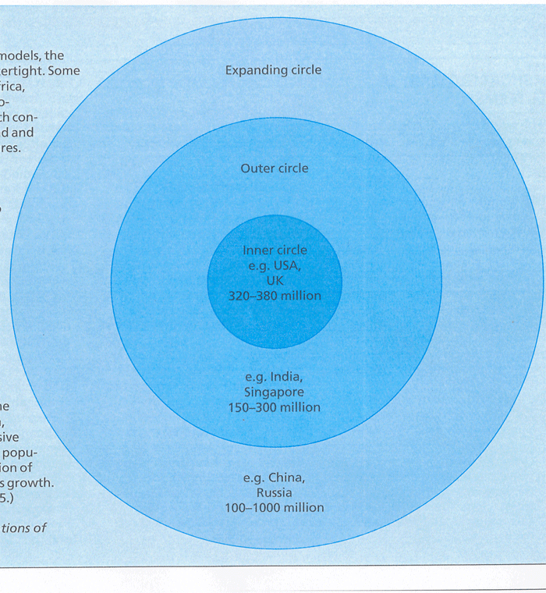
Tripartite model (B. Kachru)

