Slide 1
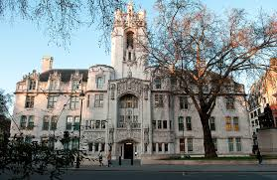
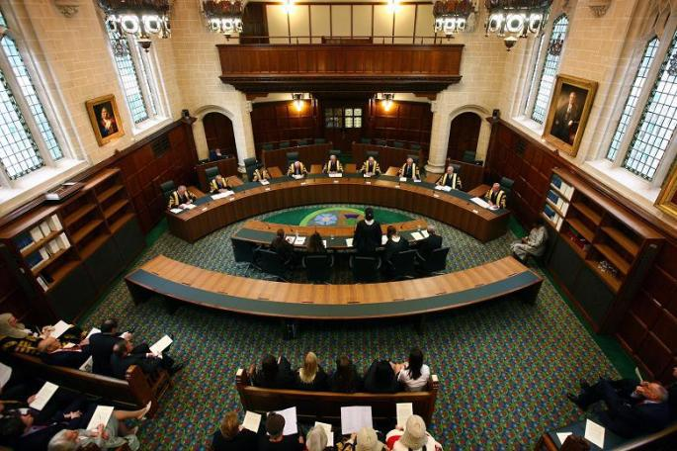
UNIT 8 THE HIERARCHY OF COURTS AND THE DOCTRINE OF PRECEDENT
UK Supreme Court

Slide 2
Hierarchy of courts in the UK
The highest
Court instance
Superior
courts
Inferior courts

Slide 3
Specialised courts outside the court system
e.g. the Employment Tribunal,
Lands Tribunal (resolves a range of disputes about the value of land and buildings, and about their occupation, use or development)
Immigration and Asylum Tribunal, etc.

Slide 4
Inferior courts
Read the text, p. 62 and complete the table with the main information.
CIVIL JURISDICTION | CRIMINAL JURISDICION
County courts | Magistrates’ courts
TYPES OF CASES: Almost all civil matters (torts, contracts, divorce, probate) – the amount of claim!!! Some other family proceedings JUDGES: professional judges | TYPES OF CASES: starting instance for all criminal prosecutions - Tries the category of summary offences (less serious offences) - Indictable offences referred to the Crown court JUDGES: magistrates or justices of peace (lay / part-time judges), two or three sit in benches, assissted by a legal clerk

Slide 5
Superior courts – general features
Unlimited geographical jurisdiction
Unlimited amount of damges (non-criminal cases)
PROFESSIONAL JUDGES
-meet the following conditions:
- legal education
- experience as a solicitor or barrister (10 years)

Slide 6
Superior courts - The Crown Court in the City of London (the main premises)
Two types of jurisdiction:
a) exclusive jurisdiction (court of first instance) for trials on indictment
b) appellate jurisdiction, appeals against rulings of
magistrates’ courts
Composition of the court
a professional judge + a jury of twelve
decides on matters of fact
renders a verdict of guilty or not guilty
passes sentence

Slide 7
Superior courts - The High Court of Justice
Two types of jurisdiction:
a) original jurisdiction (court of first instance) in civil matters (high value / importance of the case)
b) appellate jurisdiction, appeals against judgments of lower courts
THREE DIVISIONS

Slide 8
Superior courts - The High Court of Justice
Read the text, p. 63 and complete the information about the three divisions of the court.
Other specialized courts
- Administrative …
- A…
Co…
Divisional …
The Queen’s …
The … division
The Chancery…

Slide 9
Superior courts - The Court of Appeal
The Court of Appeal
Panels of usually three justices
(hears also appeals from specialised courts)
CRIMINAL
CIVIL
County courts and the High Court
Crown Court
Appeals from

Slide 10
The UK Supreme Court – visit the web page of the court
Since
October
2009
Earlier:
The Judicial
Committee of
the House
of Lords

Slide 11
Explain the appeal jurisdiction of the UK Supreme Court
sits in panels of five,
with panels of
seven or nine
judges for the
revision of
previous
decisions
The UK Supreme Court
The Court of Appeal
The High Court of Justice
appeals may ‘leapfrog
demanding issue of general
public concern’

Slide 12
Appeal jurisdiction for Norther Ireland / Scotland
The UK Supreme Court
The Court of Appeal in Northern Ireland (civil and criminal)
The Court of Session (Scotland: the highes instance civil matters)

Slide 13
Language work
Do the exercises IV to VI in the book, p. 64 -65

Slide 14
Part Two – Who sits in a County Court?
Read the three parts of the text
1. the role of a judge hearing a civil case
2. the way of delivering judgement and deciding on
appropriate remedy
3. costs of the case: different elements

Slide 15
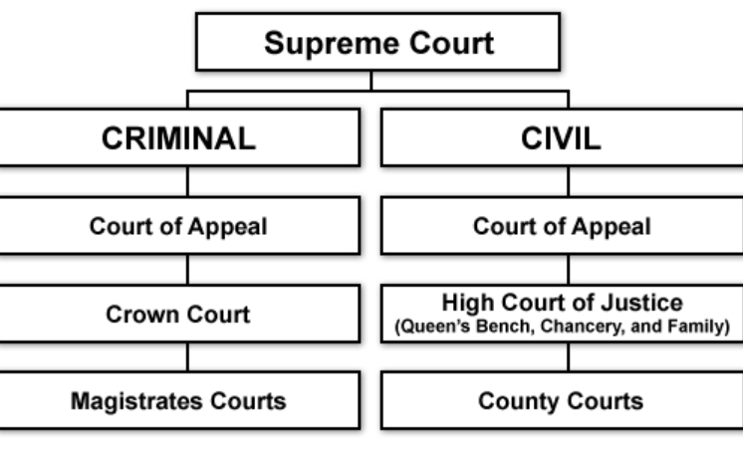
Part III – The doctrine of Precedent
The HIERARCHY OF COURTS
The principle of stare decisis
(ˌstɑːreɪ dɪˈsiːsɪs) = „stand by the decision of past cases”
Court are bound to follow decisions made by courts above them / sometimes their own decisions (e.g. appellate courts)

Slide 16
Part III – The doctrine of Precedent
The HIERARCHY OF COURTS
Read the text p. 70 and mark on the graphical presentation which court is bound by the decision of which other court/courts.

Slide 17
Types of precedents
two types of precedent: binding precedents and persuasive
Type I
A binding precedent obliges a court to follow its decision
This type of precedent is called a ‘mandatory precedent’ in some court systems. A binding precedent requires all inferior courts to follow the ratio decidendi (reasons for deciding) of superior courts. It is also binding for the superior court itself.

Slide 18
Type II
- a persuasive precedent can influence a decision but not compel or restrict it
- Decision of a lower court
Obiter dicta – additional remarks and speculations of judges – in a decision of a higher court
→ provides some insight or explanation into how the judge interpreted the facts and legal principles, in order to reach his or her decision.

Slide 19
Part III – The doctrine of Precedent
ELEMENTS OF A JUDGEMENT
Read the text p. 70 and complete the list of elements.
______ _______ of a certain case
_______ of law applicable in a case
judicial _________ resulting from the other two
Reason for deciding = ratio decidendi must be followed in future cases (not obiter dicta = remarks made incidentally)

Slide 20
Departing from a precedent (ways of avoiding precedents)
REVERSING
Fill in the gaps. Which way of avoiding
precedent is which?
OVERRULING
DISTINGUISHING
I ____________ – a method which can be used by a judge to avoid following a past precedent – facts are sufficiently different – not bound by the previous case
II ____________ – when a higher court decides not to follow a previous decision of a lower court because it thinks it was wrongly decided (a higher court overturns and changes a precedent)
III ___________ – a higher court overturns the DECISION of a lower court on appeal (in the same case) because it disagrees with it (and then it reverses it)

Slide 21
Part III – The doctrine of Precedent
LAW REPORTS
These are records of judicial decisions → it is possible to apply decisions of past cases in new processes
RESPONSIBLE INSTITUTION
Incorporated Council of Law Reporting
TWO SERIES OF RECORDS
Weekly Law Reports, All England Law Reports
PLUS
Official sites on the Internet – the Supreme Court / Court of Appeal

Slide 22
Language work
Do the exercises III, p. 71 and IV and V, p. 72 in your text book.

