Slide 1
Unit 9
Parliament of the United Kingdom
and legislation

Slide 2
Definition of legislation (law-making)
Legislation consists “of the making of determinations which are issued to indicated but unnamed and unspecified persons or situations.” .... it
“affects the rights of individuals in the abstract and must be applied in further proceedings...”

Slide 3
Other functions of the UK Parliament
Scrutiny – control of the work of the Government
Debating - important questions
Budgetary decisions – controlling and approving Government expenditures

Slide 4
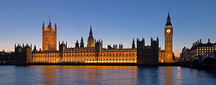
Law-making body
LEGISLATURE / legislative bodies
THE PARLIAMENT of the UK
the Sovereign
= the Monarch
= the Queen
the House of
Commons
the House of
Lords

Slide 5
The House of Commons
Read the text p. 75 and complete the notes.
members elected at ________________
the number of MPs = the number of ___________
- by-election, in case ___________________
elections are held ____________________
the main political parties MPs come from _____
_______________________________________
three types of duties MPs have:
a) ______________ b) _______________
c) ________________

Slide 6
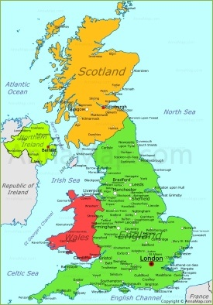
Where do MPs come from?
DEVOLVED POLTICAL BODIES → powers on
regional level
THE PARLIAMENT
of the UK
A Parliament in Scotland
A National Assembly
A National Assembly

Slide 7
Working in the Parliament
Read the text p. 75 - 76 and complete the notes.
(interests of the area the MP come from)
raising issues important for their constituencies
(taking part in discussions)
attending debates
(participating in the process of law-making)
discussing legislative proposals and vorting on new
laws
(member of specialized working bodies)
working as a member of comittees dealing with different topics

Slide 8
Are MPs present in their constituency?
Read the text p. 76 and answer the question.
Describe the activities of the MPS on their regional level.
e. g.
1. ____________________
2. ____________________
3. _____________________

Slide 9
The House of Lords
the second chamber (of the bicameral body)
Independent from the other chamber (HoC)
Role in the law-making & in the control of the executive power (government)
Currently about 825 members

Slide 10
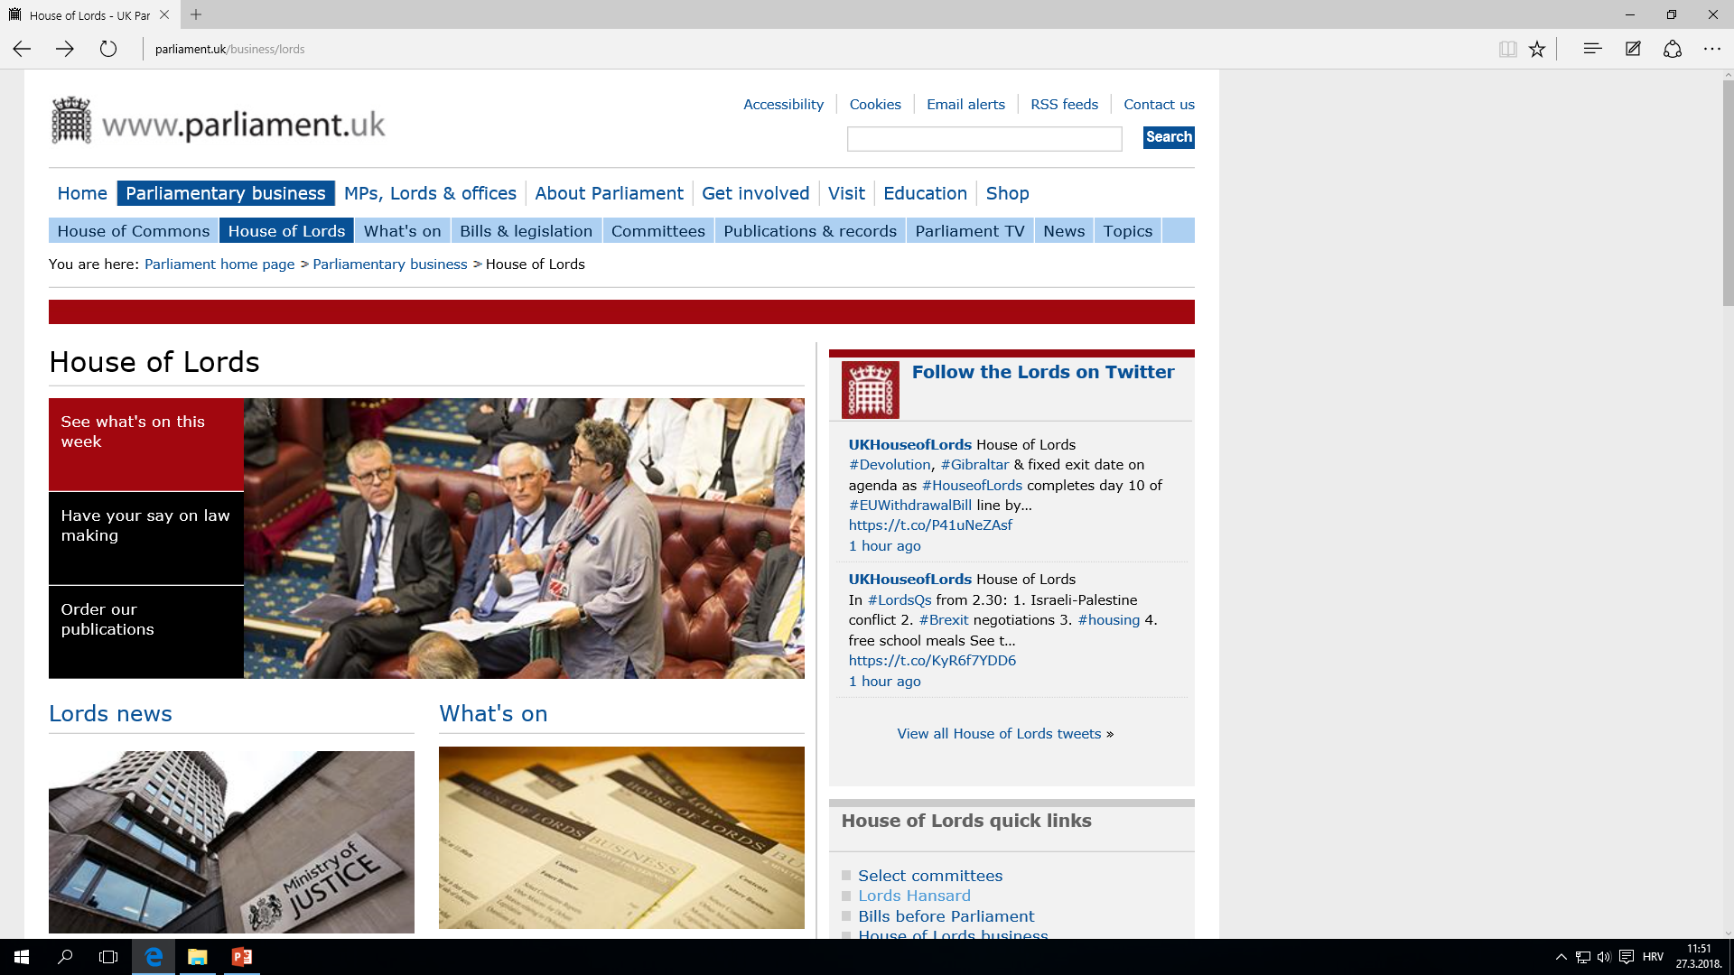
Visit the web page of the House of Lords and find out more about their work. http://www.parliament.uk/business/lords

Slide 11
Members of the House of Lords
Read the text p. 76 and explain the three types of members in the House of Lords.
1. ________________________________
2. ________________________________
3. ________________________________

Slide 12
The role of the Monarch
An integral part of the legislature
The task to:
- summon
- prorogue /prəʊˈrəʊɡ/ OR dissolve
the Parliament
Giving royal assent in the law-making procedure

Slide 13
Parliamentary sovereignty/supremacy
the major characteristic of the United Kingdom constitution
Historically speaking - a result of the struggle between the king and the parliament (the bill of 1689 established the supremacy of parliament over the crown)
Parliament can legislate in any matter where there are no limitations → courts cannot declare it as null and void

Slide 14
The UK constitution
Read the text p. 77 and
explain the main feature of the UK constitution.
explain the which laws have affected the concept of parliamentary sovereignty

Slide 15
Language work
Do the exercises p.78, exercise IV – VI.

Slide 16
A bill
a legislative proposal = a bill
TWO TYPES
The beginning of the procedure in any of the two houses
HOWEVER, bills on new taxation in the House of
Commons
PUBLIC BILLS
Introduced by a government minister
(most common)
PRIVATE MEMBER΄S BILLS
Introduced by any MP

Slide 17
Making of statutes
no constitutional restrictions on the
subject-matter (as long as it is acceptable by law)
paying regard to the common law already in existence
the proper procedure in the two Houses of Parliament is required for the passing of any statutes + signing of the Queen
after being passed a new statute is added to the
statute book

Slide 18
Stages of the legislative procedure
- The 1. stage – the first reading, information about the proposed measure
The 2. stage – the second reading, debate about the bill → voting to recject the bill / to pass the motion
The 3. stage – the bill sent to committees in both houses , they consider the bill clause by clause (amending the bill) → report the bill to the house
The 4. stage – third reading (HoC may not further amend it, HoL can make further amendments to the bill) – final draft of the bill
The 5. stage – presentation for the Sovereign’s Assent (if passed in identical form; in case of disagreements that houses can not resolve the bill can fail).
!!!! The HoC may direct the bill for Sovereigns Assent disregarding the rejection of the bill in the HoL.

Slide 19
“BE IT ENACTED”
The last stage -The Sovereign may either grant the Royal Assent (make the bill a law) or withold it (the last refusal in 1708, Queen Anne, “the settling of Militia in Scotland”)
Enacting formula: “BE IT ENACTED by the Qeens’s (King’s) most Excellent Majesty, by and with the advice and consent of the Lords spiritual and Temporal and Commons, in the present parliament assembled, and by the authority of the same, as follows…”
2. version - …of the Commons in this present Parliament assembled, in accordance with the provisions of the Parliament Act 1911 and 1949, and …

Slide 20
An example of an Act of Parliament from 2015
Read the text p. 81 – 82
Do the exercises p. 83
Make a further research into the reasons for proposing such a new Act…
One of the possible pages is the following:
https://www.opendemocracy.net/beyondslavery/msaoh/michael-dottridge/path-to-modern-slavery-act

