Slide 1
Separation of Powers

Slide 2
Introduction
Starting from Aristotle, scholars have been concerned that if legislative, executive and judicial functions were concentrated in the same person or body, that body would become too powerful and would abuse its power.

Slide 3
John Locke
John Locke (1632-1704) studied the bloody civil wars in 17th-century England, and concluded that what was needed was a division among political institutions. It was a mistake to entrust government functions to a single department: it may be too great a temptation to seize power, for the same persons who have the power to make laws to have also in their hands the power to execute them.

Slide 4
Separation of powers
The great political philosopher Montesquieu (1689-1755) coined the phrase the ‘separation of powers’ in the 18th century
“Government should be set so that no man need be afraid of another”
Three branches of power:
the executive, the legislative and the judicial branch

Slide 5
Elements of a state
Three individual elements of the state:
the executive, the legislature and the judiciary
The executive: Government (Government executes the law)
The legislative: Parliament as the highest legislative body (Parliament makes the law)
The judiciary: the system of courts (courts enforce the law)
https://www.youtube.com/watch?v=BXXv3QrH4qs

Slide 6
The legislative branch
carried out by a legislature, which may bear a name such as parliament or assembly;
a legislature typically consists of a varying number of representatives elected by the citizens of the state.
unicameral or bicameral legislatures, i.e. one or two legislative chambers. The lower chamber is commonly the directly elected one, while the upper chamber may be elected by the lower, it may represent different administrative or geographical regions of the state, or have an entirely different setup.

Slide 7
The executive branch
The executive branch is the one that directly governs the country. It carries out this task by designing and implementing policies in the various areas of life of a state.
The executive draws up and implements development strategies, which involve allocating state budget funds to certain activities.
The highest executive body in terms of power is usually a group of persons known collectively as the government in the narrow sense

Slide 8
The judicial branch
The judicial power is embodied in the system of courts.
This branch enforces the law in court and its independence from the other two branches is seen as paramount.
Judges are often prohibited from engaging in political activity as their impartiality in adjudication is a prerequisite for fair and consistent application of the law.

Slide 9
US Constitution 1789
The oldest Constitution still in force
Sets the basic form of government: three separate branches, each one having powers (“checks and balances”) over the others
Specifies the powers and duties of each federal branch of government
The ultimate power is given to the people

Slide 10
Checks and balances
A government in which no person or branch of government could become all-powerful
Powers are divided among the legislative, executive and judicial branches of government
Even though the powers may seem to be distinct and perfectly separate, in most systems they overlap
Each group can balance and check other’s powers

Slide 11
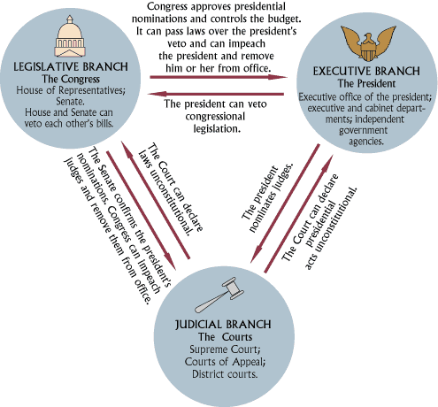

Slide 12
http://www.youtube.com/watch?v=J0XNgH1RmIU
Complete the following:
The legislative branch _________ the law.
The executive branch _________ the law.
The judicial branch __________ the law.

Slide 13
The doctrine of the separation of powers
According to the doctrine of the separation of powers, each branch of government has different functions but each uses its power to control the limits of the others. Conversely, within the limits of its powers, each branch should be independent of the others.

Slide 14
Translate the following:
The division between the three branches aims to ensure that those who make the laws are distinct from those entrusted with their interpretation, application, and enforcement. In this way, lawmakers are subject to the same laws and have an incentive to avoid self-interested legislation and to frame it in general terms that will be equally applicable to all.

Slide 15
Read the text carefully and answer the following questions:
1. Why should the legislative, executive and judicial functions be separated?
2. Who were the main proponents of the doctrine of the separation of powers?
3. What is the aim of the division between the three branches of government?

Slide 16
Fill in the missing words: balances, government, personnel, powers, values.
Today, the separation of ______________can mean:
1. Separation of functions between units of ______________;
2. Separation of _________________between different units of government
3. Checks and ____________________between different units of government.
As with the rule of law, the separation of powers is no more than an underlying set of _______________.

Slide 17
Match the verbs with the appropriate nouns:
VERB | NOUN
settle | sanction
impose | the law
break | ground
lose | dispute
exercise | laws
make | power

Slide 18
Thank you for your attention!

