Slide 1
English for social workers II session 2, 13 oct 2014
Miljen Matijašević
E-mail: miljen.matijasevic@gmail.com
Office: G10, room 6 (1st floor)
Tue, 15:30-16:30

Slide 2
Today’s session
Crime
Case studies
Social workers in criminal justice

Slide 3
Crime
Unit 19

Slide 4
Crime
How can we define crime?
CRIME is
an offence against the community
punishable by the state
a severe breach of public law
Croatian equivalents of the word:
kazneno djelo; kriminal (criminal activity)

Slide 5
Crime in English law
there is no single criminal code in English law
  COMMON-LAW CRIMES
  STATUTORY CRIMES

Slide 6
Classification of Crimes
ACCORDING TO SERIOUSNESS
until 1967:
  treason (punishable by death)
  felonies (more serious)
  misdemeanours (less serious)

Slide 7
Classification of Crimes
the death penalty
  abolished in the UK in 1998 after the ratification of the 6th Protocol of the Europan Convention on Human Rights

Slide 8
Classification of Crimes
TREASON
FELONIES
  murder, manslaughter, rape, arson, burglary, theft, bigamy, etc.
MISDEMEANOURS
  minor assault, conspiracy, fraud, perjury, blasphemy, road traffic offences, etc.

Slide 9
Classification of Crimes
CRIMINAL LAW ACT 1967 – reclassification
INDICTABLE OFFENCES
  treason
  arrestable offences
  other indictable offences
SUMMARY OFFENCES

Slide 10
Classification of Crimes
ARRESTABLE OFFENCES (as per CLA 1967)
  sentence fixed by the law
  maximum punishment at least five years imprisonment
  arrest can be made without a warrant
    by the police
    by any citizen (citizen’s arrest)

Slide 11
Power of arrest
Citizen’s arrest – certain conditions for any citizen to arrest another, such as:
  if the perpetrator is actually committing or has, without a doubt, just committed an offence
  it is not ‘reasonably practical’ for a police constable to make the arrest
  the arrest is made to prevent physical injury, loss or damage to property, escape from the police, etc.
a police constable can, in addition, arrest persons about to commit an offence or persons who might have committed a suspected offence

Slide 12
Classification of Crimes
Serious Organised Crime and Police Act 2006
category of arrestable offence ceased to exist
a constable’s power of arrest extended to all indictable offences

Slide 13
Classification of Crimes
ACCORDING TO METHOD OF TRIAL:
indictable offences
(triable in the Crown Court)
summary offences
(triable in magistrates’ courts)
offences triable either way
(defendant chooses the mode of trial)

Slide 14
Modes of trial
magistrate’s court
  trial by 2-3 lay or stipendiary magistrates
  may impose fines of up to £10,000
  highest prison sentence: 12 months

Slide 15
Modes of trial
the Crown Court
  trial by a judge and jury
  a jury of 12 – 10 needed for a verdict
  more severe sentences available

Slide 16
Classification of Crimes
ACCORDING TO THE OBJECT OF CRIME
Crimes against:
the State and public peace and order
the person
property
other crimes

Slide 17
Crimes against the State, public peace and order
treason
conspiracy
incitement to racial hatred
obstruction of justice
perjury
riot
sedition
unlawful assembly

Slide 18
Crimes against the person
murder
manslaughter
involuntary manslaughter
  by gross negligence
  constructive manslaughter
infanticide
rape
stalking
domestic violence
assault and battery

Slide 19
Crimes against property
arson
blackmail
burglary
embezzlement
extortion
fraud
forgery
handling stolen goods
malicious damage
robbery
shoplifting
theft
larceny
money laundering
tax evasion

Slide 20
Other crimes
traffic offences
bigamy
etc.

Slide 21
Criminal liability
most crimes require two elements:
  actus reus (the prohibited act)
  mens rea (‘guilty mind’, intention)

Slide 22
Criminal liability
ACTUS REUS
  a physical act
  words
  omission (inaction)
  possession
  a state of affairs (being found somewhere unlawfully)

Slide 23
Criminal liability
MENS REA
  intention
    the person acts on purpose in order to cause the event
  recklessness
    takes an unreasonable risk, knowing that his conduct may cause the event

Slide 24
Criminal liability
CASES IN WHICH MENS REA IS NOT REQUIRED
  negligence
  strict liability (e.g. food and drugs, road traffic, consumer protection, etc.)
  vicarious liability (one person acting on behalf of another)
  corporate liability (corporation liable for the conduct of a responsible person in the course of corporate duties)

Slide 25
Exemption from criminal liability
  a person deprived of free will or self-control
    insanity
    coercion
    necessity (avoiding greater damage, injury or death; self-defense)
    automatism (rarely pleaded)
  a person belonging to a class of persons with special rules
    the Sovereign
    foreign sovereigns and diplomats
    children under the age of 10

Slide 26
Case studies

Slide 27
Chief Constable of Avon & Somerset v Shimmen 1987
Criminal damage
An expert in Korean self-defence was charged with criminal damage having unintentionally broken a window. The court accepted that he was not reckless because, relying on his skill, he had decided that the window would not break.
Key principle: A defendant who considers whether a risk exists and genuinely decides that there is no risk is not reckless.

Slide 28
Chief Constable of Avon & Somerset v Shimmen 1987
Criminal damage
(DC) Prosecution appeal allowed. Defendants are not reckless if they consider the risk and decide that there is none. However, this defendant had realised that there was some risk but had thought that he could avoid it. Thus he was reckless in the sense of realising a risk and going on to take it.

Slide 29
R. v Lamb 1967
Involuntary manslaughter: constructive liability
The defendant was convicted of manslaughter, having shot and killed a friend. Misunderstaning how the gun worked, neither the defendant nor the victim anticipated injury.
Key Principle: The defendant must commit an unlawful and dangerous act which causes death.

Slide 30
R. v Lamb 1967
Involuntary manslaughter: constructive liability
(CA) Defendant’s appeal allowed due to a misdirection. There was no unlawful act (assault) without proof of the actus reus and mens rea. Since the latter was missing, the offence was incomplete.

Slide 31
Children who kill
Chase the intruder!
lawyer, evidence, defendant, judge
murder, fine, assault, manslaughter
adult, minor, infant, adolescent
witness, criminal, suspect, offender
parole, release, sentence, pardon

Slide 32
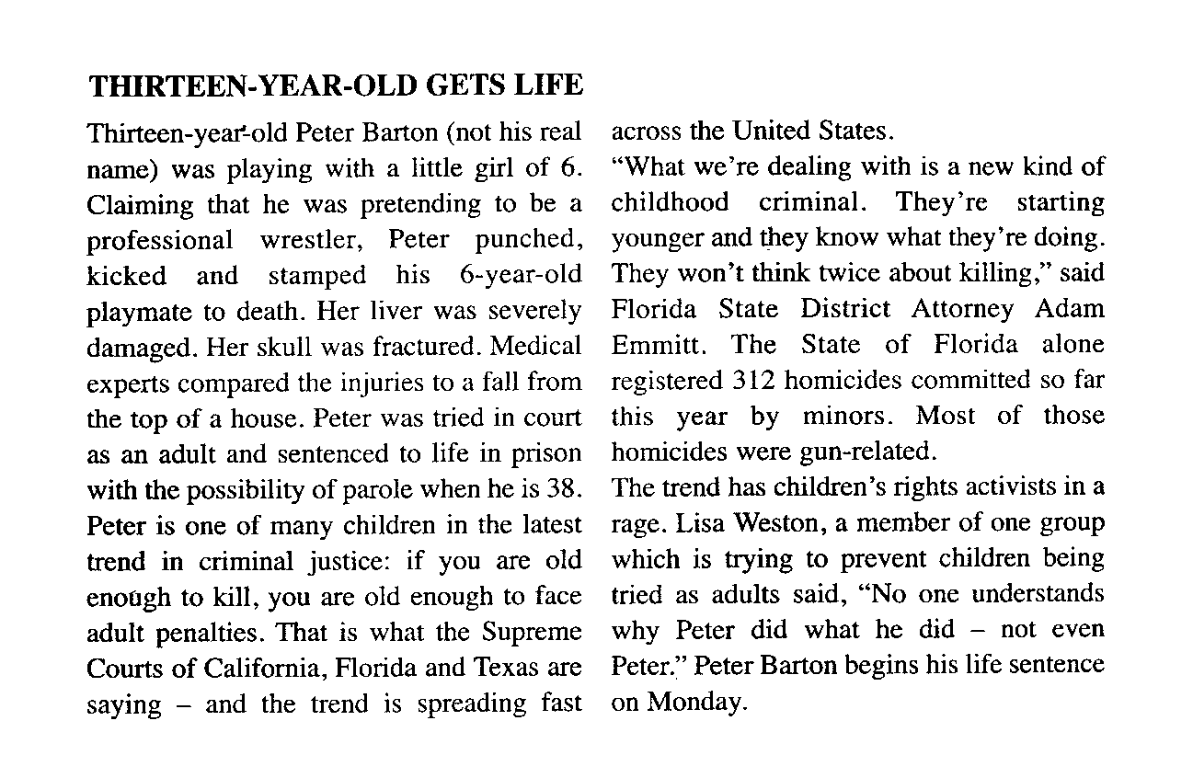

Slide 33
Social workers in criminal justice
Additional reading

Slide 34
Social workers in criminal justice
What is the place of social workers in the criminal justice system? Try to think of possible functions of social workers in the system and of reasons why social workers should be part of it!

Slide 35
Social workers key players in criminal justice system
by Paul R. Pace, News staff, NASW 2012
Along with attorneys, judges and juries, social workers are critical players in the nation’s criminal justice system.
In district attorneys’ offices, social workers help crime victims maneuver through complex legal processes and offer a helping hand on the road to recovery.
On the other side of the scale, social workers in public defenders’ offices ensure defendants have a right to explain their story, and they promote the benefits of rehabilitation.

Slide 36
Social workers in criminal justice
What do you think a forensic social worker does? What sort of information does (s)he collect?
Who is this information intended for and why should they here it?

Slide 37
Betsy Biben, chief of the Office of Rehabilitation and Development in the Public Defender Service for the District of Columbia oversees a staff of forensic social workers whose duties include drafting profile reports of defendants. Such information may identify impairment in the defendant’s decision-making process. Reports include information about the person’s community, medical and mental health, education, court records, research findings and test results.
The work by these social workers ensures the attorney, judge and jury have an opportunity to hear about the defendant’s mental health, substance abuse, brain development, medical conditions, social development and age. The report not only provides a comprehensive assessment of the client, but also a plan of action for successful rehabilitation and re-entry, Biben said, should a defendant be convicted.

Slide 38
Social workers in criminal justice
What is the purpose of the intervention by a forensic social worker?
How can forensic social workers make the system of criminal justice better?
Why do you think this might be a very difficult job?

Slide 39
The information can also help suggest a sentence that allows the person the opportunity to be a productive member of society.
Biben said being a social worker for a public defender’s office is rewarding but also challenging. She said she was inspired to enter the field as a way to address the inequality of treatment and sentences for defendants lacking privilege and money.
Forensic social work is not for everyone, she noted. “Few professionals can sit without judgment and listen and learn from people arrested for serious charges,” she explained. “To help that person share the worst experiences of his life with you is both challenging and a gift.”

Slide 40
Social workers in criminal justice
How would you feel about working in the criminal justice system?
Would you prefer to work with victims of crime or with offenders? Justify your choice.

Slide 41
Thank you for your attention!

