Slide 1
English for social workers II session 4, 27 oct 2014
Miljen Matijašević
E-mail: miljen.matijasevic@gmail.com
Office: G10, room 6 (1st floor)
Tue, 15:30-16:30

Slide 2
Today’s session
Revision of the last session (Death and the Law)
Marriage
Divorce

Slide 3
Revision of the last session
Death and the Law / The Death Penalty

Slide 4
Answer the questions
What does the Suicide Act 1961 criminalise / decriminalise?
What is the difference between euthanasia and assisted suicide?
Explain the difference between active and passive euthanasia!
In what situations can non-voluntary euthanasia be practised?
What is the legislative situation regarding euthanasia in the UK and the USA?
What do you know about the Dutch and Swiss regulations?

Slide 5
Answer the questions
What are the two opposing views on the death penalty?
What methods of execution are still used today?
What are the 6th and 13th Protocols to the European Convention on Human Rights? Who are their signatories?

Slide 6
Marriage
Unit 22

Slide 7
Marriage proverbs
Love is blind (English proverb)
Marry in haste. Repent at leisure. (English proverb)
When a girl marries, she exchanges the attention of many men for the inattention of one. (Helen Rowland, American writer)
Marriage is like a dull meal with the dessert at the beginning. (Toulouse-Lautrec)

Slide 8
Marriage
How would you define marriage?
What are the reasons why people get married nowadays?
Was this different in the past? Why?

Slide 9
Marriage
in English law, marriage is defined as ‘the voluntary union for life of one man and one woman to the exclusion of all others (Hyde v Hyde, 1866)’ (Lord Penzance)
What does this definition say about the essence of marriage? What kind of marriages should be void, according to this definition?

Slide 10
Marriage
‘...the voluntary union for life of one man and one woman to the exclusion of all others’
genuine consent of the partners necessary

Slide 11
Marriage
‘...the voluntary union for life of one man and one woman to the exclusion of all others’
What about divorce? Divorce already legal at the time
CA: at the initiation of the marriage, the intention of the parties must be union for life

Slide 12
Marriage
‘...the voluntary union for life of one man and one woman to the exclusion of all others’
excludes same-sex marriages

Slide 13
Marriage
‘...the voluntary union for life of one man and one woman to the exclusion of all others’
prohibits bigamy

Slide 14
Civil marriage
introduced as an alternative to church marriage in England and Wales by the Marriage Act 1836

Slide 15
Common-law marriage
a.k.a. informal marriage, consensual marriage
marriage not solemnized in a ceremony
recognized in some jurisdictions
requires cohabitation and mutual and publicly expressed intention to act as spouses
recognized in some common-law jurisdictions

Slide 16
Marriage under English law
MARRIAGE – a contract between two persons
imposes rights and obligations (such as rights to visit the spouse in hospital/prison, responsibility for their debts, control over their affairs when they are incapacitated, community property, etc.)
free and voluntary consent of the parties essential

Slide 17
Capacity to marry
an English or Welsh resident wishing to marry must NOT be:
  under 16 years old
  already married
  certified of unsound mind
  within the ‘prohibited degrees’ of consanguinity (a close blood relation)

Slide 18
Capacity to marry
a person of 18 or above can marry independently
a person between 16 and 18 needs the consent of a parent
if unable to get this, they may get it from the court

Slide 19
Marriage under English law
a marriage can be solemnized either:
  according to the rites of the Church of England
  under a certificate of a Superintendent Registrar
the certificate valid for marriages in a register office, the Church of England, and other buildings registered for that purpose

Slide 20
Void marriages
A marriage will be declared null and void ab initio by the court in the following cases:
  the parties are within the ‘prohibited degrees’
  either party is under 16
  procedure was not followed (e.g. marriage took place in an unregistered place)
  either party is already legally married
  the parties are not a man and a woman

Slide 21
Voidable marriages
A marriage valid until declared void by the court in the following cases:
  marriage not consummated because of incapacity of either party or either party willfully refuses to consummate the marriage
  the consent was invalid (e.g. duress, mistake, unsound mind)
  the respondent was suffering from a sexually transmitted disease at the time of the marriage
  the respondent was pregnant by another man at the time of the marriage

Slide 22
Civil partnership (UK)
Civil Partnership Act 2004
a legal relationship between two people of the same sex
can end in death, dissolution or annulment

Slide 23
Civil partnership (UK)
bars to a civil partnership:
  the partners are not of the same sex
  either of them is a civil partner or is already married
  either is under the age of 16
  they are within the ‘prohibited degrees’ of consanguinity

Slide 24
Same-sex marriage (UK)
Available as of April 2014 [Marriage (Same Sex Couples) Act
Civil partnerships formed before the law entered into force can convert to marriage
Parliament for a long time reluctant to give civil partnerships the name ‘marriage’ but finally succumbed
Public polls increasingly in favour of equal marriage rights

Slide 25
Same-sex marriages (USA)
a.k.a. gay marriages
granted in 32 states and the District of Columbia
some states recognize same-sex marriages, but do not perform them

Slide 26
Same-sex marriages (USA)
Definition of marriage is within the competence of individual states
No federal definition of marriage before 1996
Until 1967 some states banned interracial marriages
States recognized marriages from other states on the basis of reciprocity

Slide 27
Same-sex marriages (USA)
Defense of Marriage Act (DOMA) 1996
Section 2 removes the obligation of reciprocal recognition of marriage between states
Section 3 defines marriage as a union between a man and a woman

Slide 28
Same-sex marriages (USA)
Since 2010 challenged before federal courts – contrary to equal protection under the law and protection against unfair treatment
Section 3 found te be unconstitutional by several federal courts and finally by the US Supreme Court
As a result, support for same-sex marriages growing rapidly; some states still have initiatives to try to combat this trend

Slide 29
Key terms
consent
consanguinity
(certified of) unsound mind
bigamy
cohabitation
common-law marriage
void marriage
voidable marriage
civil partnership
same-sex marriage

Slide 30
Discussion
What do you know about he popularity of marriage in Croatia at the moment? What do you think the statistics suggest?
What about the divorce rate?
Look at the statistics of marriage and divorce in Croatia. What do the trends show?

Slide 31
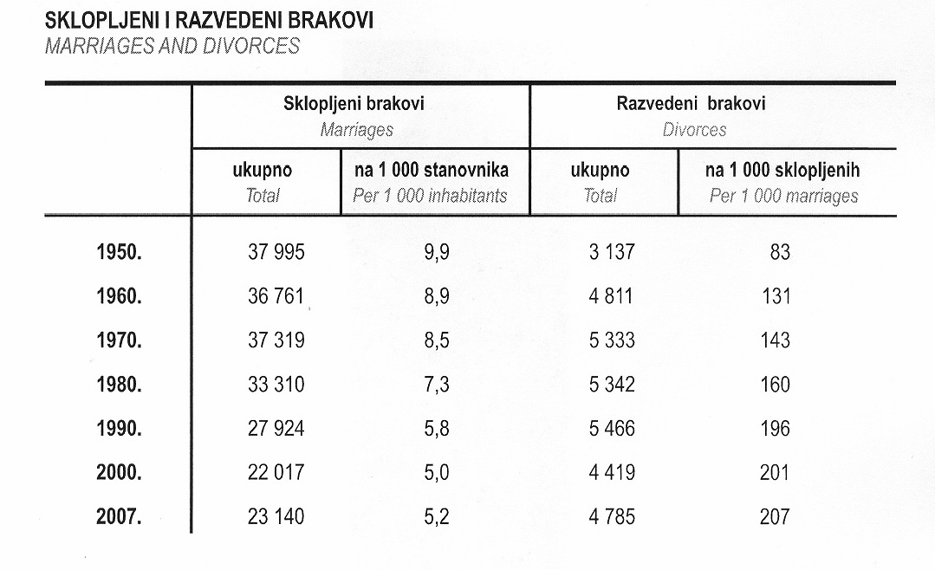

Slide 32
Discussion
What are the main reasons for which you think the institution of marriage is important still today?
What is your opinion of same-sex partnerships? A recent law in Croatia granted same-sex couples equal rights as heterosexual married couples except for the right to adopt children. What is your opinion on this law, i.e. exception?

Slide 33
Divorce
Unit 23

Slide 34
Divorce
Do you think that it is necessary these days to give grounds for divorce?
Should the law make divorce as easy as possible?

Slide 35
Divorce
marriage – a contract
however – the terms of the contract dictated by the law, not negotiable by the parties

Slide 36
Divorce
until 1969, divorce law based on the doctrine of matrimonial offence
the ‘guilty party’ and the ‘innocent party’
the innocent party could ask for a divorce based on the grounds of wrongful conduct of the other party – adultery, cruelty or desertion

Slide 37
Divorce
Family Law Act 1996 (Section 1)
The institution of marriage is to be supported;
The parties to a marriage which may have broken down are encouraged to take steps to save the marriage;
A marriage which has irretrievably broken down should be brought to an end with minimum distress to the parties and any children, in a manner to promote a good continuing relationship and to stop unreasonable costs from the process. Any risk from domestic violence to one of the parties should be removed or diminished.

Slide 38
Divorce
the law encourages reconciliation
the court may make a divorce order or a separation order
JUDICIAL SEPARATION – a nine month period before a divorce application may be made
the partners no longer required to live together
purpose: to rethink the idea of divorce and possibly reconcile

Slide 39
Divorce
the petitioner must prove that the marriage has ‘broken down irretrievably’ on the following grounds:
  adultery
  unreasonable behaviour
  desertion (for 2 years)
  living apart for 2 years (consent of respondent necessary)
  living apart for 5 years

Slide 40
Divorce
a divorce petition cannot normally be presented within the first three years of marriage
absolute ban within the first year

Slide 41
Divorce
UNCONTESTED DIVORCE
a divorce where the parties agree on all terms, including the distribution of property, custody of children, etc.
NO-FAULT DIVORCE
a divorce where the dissolution of marriage does not require a fault by either party

Slide 42
Key vocabulary
divorce petition
petitioner
respondent
dissolution
to dissolve
to contest a divorce
uncontested divorce

Slide 43
Complete the sentences
Persons between 16 and 18 need to obtain the ........ from a parent in order to get married.
A marriage between close blood relations is ........ for reasons of ........ .
If neither party ......... the divorce, i.e. disagree about the terms of the divorce, this is referred to as ......... divorce.
In order to obtain a divorce order, the ........ must prove that the marriage has broken down irretrievably.
Under a separation order, ........ of the spouses is no longer required, i.e. they do not have to live together.
In some jurisdictions a marriage can be ........ by mutual consent of the parties, without either party being at fault.

Slide 44
Complete the sentences
Persons between 16 and 18 need to obtain the CONSENT from a parent in order to get married.
A marriage between close blood relations is VOID for reasons of CONSANGUINITY.
If neither party CONTESTS the divorce, i.e. disagree about the terms of the divorce, this is referred to as UNCONTESTED divorce.
In order to obtain a divorce order, the PETITIONER must prove that the marriage has broken down irretrievably.
Under a separation order, COHABITATION of the spouses is no longer required, i.e. they do not have to live together.
In some jurisdictions a marriage can be DISSOLVED by mutual consent of the parties, without either party being at fault.

