Slide 1

The European Central Bank

Slide 2
ECB
The European Central Bank (ECB) is the central bank for the euro and it administers the monetary policy of the Eurozone, which consists of 19 EU member states and is one of the largest currency areas in the world.

Slide 3
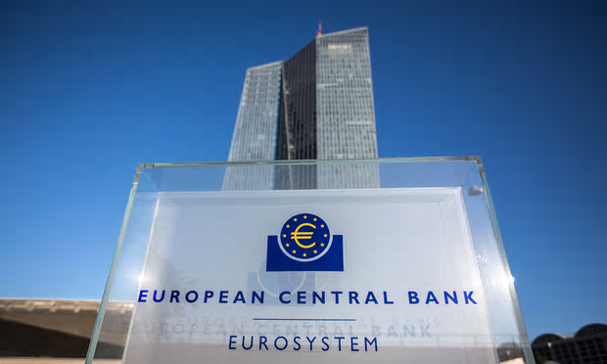
EU institution
It is one of the world's most important central banks and is one of the seven institutions of the European Union (EU) listed in the Treaty on European Union (TEU).

Slide 4
Establishment
The bank was established by the Treaty of Amsterdam in 1998, and is headquartered in Frankfurt, Germany.
https://www.youtube.com/watch?v=Aijn_4TFF_8
Write a short summary about the history of ECB!
1957
1968
1970
1979
1986
1992...

Slide 5
Owners
The capital stock of the bank is owned by the central banks of all 28 EU member states.
The owners and shareholders of the European Central Bank are the central banks of the 28 member states of the EU.

Slide 6
Transparency of ECB
The central bank provides the general public and the markets with all relevant information on its strategy, assessments and policy decisions as well as its procedures in an open, clear and timely manner.

Slide 7

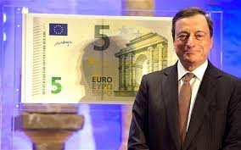
President
As of 2013 the President of the ECB is Mario Draghi, former governor of the Bank of Italy.

Slide 8
The Governing Council
The main decision-making body is the Governing Council, which consists of the six members of the Executive Board plus the governors of the central banks of the 19 euro area countries.

Slide 9
ECB and the Eurosystem explained in 3 min.
http://www.youtube.com/watch?v=TAlcFwGIQBg
Who looks after the euro?
What is the main task of the Eurosystem?
What is inflation? What is the inflation rate?

Slide 10
Eurosystem
The European Central Bank and the national central banks together constitute the Eurosystem, the central banking system of the euro area. The main objective of the Eurosystem is to maintain price stability: safeguarding the value of the euro.
The Eurosystem is responsible for:
defining and implementing monetary policy
conducting foreign exchange operations
holding and managing the euro area’s foreign currency reserves
promoting the smooth operation of payment systems.

Slide 11
Inflation
Inflation is the rate at which the general level of prices for goods and services is rising and, consequently, the purchasing power of currency is falling. Central banks attempt to limit inflation — and avoid deflation — in order to keep the economy running smoothly.
It is a sustained increase in the general price level of goods and services in an economy over a period of time
The inflation rate is a measure of changing prices, typically calculated on a month-to-month and year-to-year basis and expressed as a percentage.

Slide 12
Answer the following questions:
1. What is the European Central Bank?
2. Where is it situated?
3. What is the Eurosystem?
4. What is the European Central Bank responsible for?
5. Who owns the capital stock of the European Central Bank?

Slide 13
Complete the text with the words provided below:
payment stability policy area currency exchange
The Eurosystem is the central banking system of the euro __________. The main objective of the Eurosystem is to maintain price _________. It is responsible for defining and implementing monetary ___________, conducting foreign _______________
operations, holding and managing the euro area’s foreign ______________ reserves and promoting the smooth operation of __________ systems.

Slide 14
Translate into Croatian:
The ECB is the central bank for Europe's single currency, the euro. The ECB’s main task is to maintain the euro's purchasing power and thus price stability in the euro area. The euro area comprises the 19 European Union countries that have introduced the euro since 1999.
Single currency – jedinstvena valuta
Purchasing power – kupovna moć

Slide 15
ESB je središnja banka za jedinstvenu europsku valutu, euro. Glavna je zadaća ESB-a održavati njegovu kupovnu moć i time stabilnost cijena u europodručju (eurozoni). Europodručje obuhvaća 19 država članica Europske unije koje su nakon 1999. uvele euro.

Slide 16
Translate into English:
ESB javno najavljuje strategiju svoje monetarne politike i priopćuje o redovitim ocjenama gospodarskih kretanja. Time tržištima pomaže u razumijevanju uzorka sustavnog odgovora monetarne politike na gospodarska kretanja i udare. Na taj način tržišta mogu lakše predvidjeti srednjoročne poteze politike te učinkovitije i točnije oblikovati svoja očekivanja.
ocjena gospodarskih kretanja – assessment of economic developments
gospodarski udari – economic shocks

Slide 17
The ECB publicly announces its monetary policy strategy and communicates its regular assessment of economic developments. This helps the markets to understand the systematic response pattern of monetary policy to economic developments and shocks. It makes policy moves more predictable for the markets over the medium term. Market expectations can thus be formed more efficiently and accurately.

Slide 18
Part Two
Read the text “European Central Bank Signals End of Cheap Money Era is Coming” and find synonyms for the following underlined expressions:
The European Central Bank said on Thursday that it had pondered how to wind down its easy money policies.
The bank’s Governing Council has been exceedingly cautious about ending the emergency measures.
The emergency measures helped prevent the euro from self-destructing after the global financial meltdown in 2008.
The European Central Bank continues to flood the 19-nation eurozone with cash as a way to reduce interest rates, stimulate growth and nudge inflation from levels considered to be dangerously low.
The benefits have far outweighed any negative effects.
The European Central Bank has been under pressure to shift its policy.

Slide 19
Thank you for your attention!

