Slide 1
Unit 5
LEGAL SYSTEMS OF THE WORLD
Snježana Husinec, PhD; E-mail: shusinec@pravo.hr

Slide 2
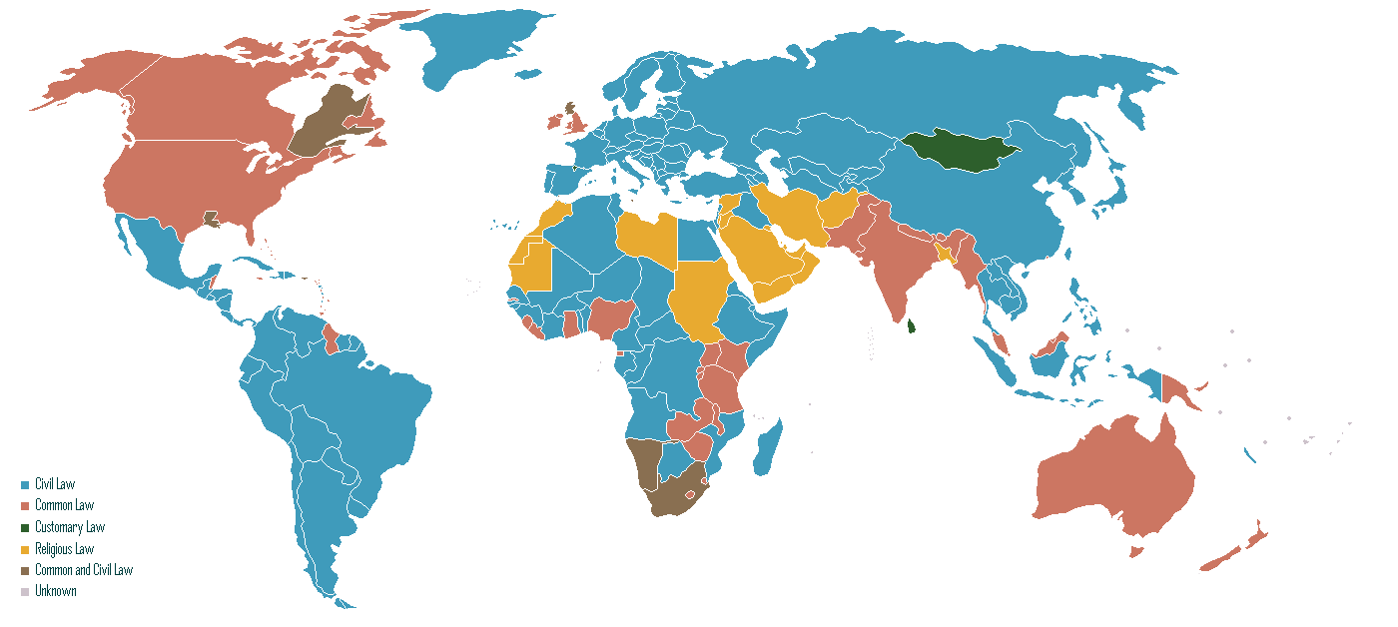

Slide 3
Legal systems
What constitutes a legal system of a state? Which factors, do you think, need to co-exist to form a legal system?
Read the text and find the 5 factors.
Translate the terms in bold into Croatian.

Slide 4
National legal systems
= How significant is a constitution for some legal system?
= How would you define a constitution?

Slide 5
National legal systems - Constitution
CONSTITUTION = the body of fundamental doctrines and rules of a nation from which stem
a) the duties and powers of the government and All other laws are based on it and have to
b) the duties and rights of the people conform to / comply with it.
WRITTEN CONSTITUTION = the constitution where the provisions are all contained in a single document formulated and adopted by a constituent assembly or a council or a legislature
UNWRITTEN (uncodified) CONSTITUTION = the constitution found in several historical charters, laws and conventions; a product of slow and gradual evolution (the UK constitution consists of Acts of Parliament, court judgments, conventions)

Slide 6
Classification of legal systems
= Based on what characteristics would you classify legal systems?
= What types of legal systems do you know of?

Slide 7
Classification of legal systems
The basic distinguishing elements which are used for the purpose of classification are:
1. Sources of the law (What can be the sources of law?)
2. Legal concepts and terminology (Do you know of any typical concepts of our / civil law legal system?)
3. Historical development (Which legal traditions do the present-day legal systems stem from?)
Answer the questions in brackets.
Read the paragraph entitled Classification of legal systems and check your answers.

Slide 8
The main sources of law
Sources of law = the origin of law or the methods for development of law
CUSTOMS
______________________
______________________
______________________
______________________
Etc.

Slide 9
The main sources of law
Sources of law = the origin of law or the methods for development of law
CUSTOMS
JUDICIAL DECISIONS (PRECEDENTS)
LEGAL PRINCIPLES
OPINIONS OF JURISTS
STATUTORY LAW / LEGISLATION
Etc

Slide 10
Civil law vs. Common law
The common-law legal system contrasts strongly with the civil-law legal system of continental
countries. Read the following facts and decide which type of legal system they apply to.
A central importance of enacted law/central importance of precedent
B principles develop in individual cases/general enacted principles are applied to individual cases
C based on decisions of judges (precedents) / based on codes
Civil law Common law
A Basic characteristics of
the system
B Style of legal reasoning
C Legal principles

Slide 11
Civil law vs. Common law
Read the text and find the basic characteristic of civil and common law.
 | Sources | Law-making body | Style of legal reasoning | Role of judiciary | Historical development | Area
Civil law |  | legislative body (parliament or assembly) |  | Interprets and enforces the law
Common law |  |  | From individual cases to general rules (inductive)

Slide 12
Civil law vs. Common law
Read the text and find the basic characteristic of civil and common law.
 | Main source of law | Law-making body | Style of legal reasoning | Role of judiciary | Historical development | Area
Civil law | legislation / statutes / codified law | legislative body (parliament or assembly) | from general rules to particular cases (deductive) | interprets and enforces the law | Roman law
Common law | case law / judicial precedents | courts | from individual cases to general rules (inductive) | creates and develops the law | customs, judicial precedents / case law

Slide 13
Vocabulary practice
Do ex IV on p. 35.
Define the following legal terms and find their Croatian equivalents.
1. Case law
2. Code
3. Precedent
4. Enactment
5. Codification
6. Statute

Slide 14
Other Legal Traditions
Which other legal traditions do you know of? What are their characteristics?
Scan the text on p. 37 and 38 and find different legal traditions presented in it.
1.
2.
3.
4.
5.
6.
Complete the table on p. 39 providing basic information about each of them.
Which of them are religious and which secular?

