Slide 1
Unit 6
STATE GOVERNANCE AND THE ADMINISTRATION OF JUSTICE

Slide 2
State governance
1. What do you understand by STATE GOVERNANCE?
2. What do you understand by the term state government?
3. Is there a difference between government and the Government?
4. Which institution of government has the most power in Croatia?
5. Are the powers and areas of responsibility of different government institutions strictly defined and divided between them? Why?

Slide 3
Separation of powers
- the state power is divided into branches; each branch has separate and independent powers and areas of responsibility
- Read the 1st paragraph of the text and fill in the chart. Find the aim of the separation of powers.
AIM = _____________________________________________________
STATE POWER
_________________
POWER
=ENACTS the LAW
________________
POWER
= IMPLEMENTS / ENFORCES the LAW
________________
POWER
=ADJUDICATES
=ADMINISTERS JUSTICE

Slide 4
Separation of powers
Read the rest of the text and single out
A) the principal bodies of each branch of state power,
B) all the powers of each of the branches.
1) LEGISLATIVE - exercised by ___________________________
Powers: ______________________________________________________________________
_____________________________________________________________________________
2) EXECUTIVE - exercised by ___________________________
Powers: ______________________________________________________________________
_____________________________________________________________________________
3) JUDICIAL - exercised by ___________________________
Powers: ______________________________________________________________________

Slide 5
Checks and balances
Does the separation of powers work perfectly in practice?
What are the reasons for the overlap?
Find examples of such mechanisms in the text.
How do different state branches control one another?
= a system that allows each branch of a government to amend or veto acts of another branch so as to prevent any one branch from exerting too much power

Slide 6
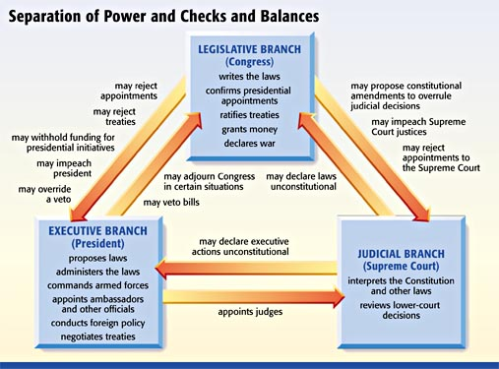
Separation of Power and Checks and Balances – USA

Slide 7
Vocabulary practice
Do exercises III do VII on p. 42 and 43.
Read the text in Part One once again and find the English equivalents for the following English terms and expressions:
1. vršiti/obnašati vlast = 9. vlada =
2. dvodomno zakonodavno tijelo = 10. predsjednik vlade =
3. donošenje zakona = 11. ministarstvo =
4. primjenjivati zakon = 12. sudbena vlast =
5. zakonodavni postupak = 13. provoditi zakon =
6. provoditi razvojne strategije = 14. imenovanje sudaca =
7. ratificirati međunarodni ugovor = 15. držati se zakona =
8. upravljati državom = 16. izricanje presude / suđenje =

Slide 8
Vocabulary practice – English equivalents - Key
1. to exercise / carry out power 9. the government / the cabinet
2. bicameral legislature / legislative body 10. the prime minister
3. enacting / laying down law 11. a ministry / government department
4. to apply a/ the law 12. judicial power
5. legislative procedure 13. to enforce law
6. to implement development strategies 14. judicial appointment
7. to ratify a treaty 15. to adhere to the law / laws
8. to govern a state 16. adjudication

Slide 9
Resolving disputes
What is the main power of the judicial branch of government?
What in particular does it do to administer justice?
Do all courts deal with all kinds of cases?
What is the difference between civil and criminal courts?
What do civil courts and what criminal deal with ?

Slide 10
Resolving disputes
Read the text entitled ¨Resolvin disputes¨ and coplete the following sentences:
Criminal courts deal with ________________________________________________ .
Civil courts deal with ____________________________________________________ .
Civil justice in the broader sense includes ____________________________________.
Civil justice in the narrow sense deals with ___________________________________ .
Family justice refers to ___________________________________________________ .
The purpose of the administrative justice system is to __________________________ .
Do ex. III and IV on p. 45.

