Slide 1
Unit 9
Parliament and Legislation
English for Lawyers II
Snježana Husinec, PhD., shusinec@pravo.hr

Slide 2
The British Parliament
Remember the sources of English law. Which of them is conncted to parliaments? Which of the three state powers do parliaments exercise?
Think in pairs what you know about parliament and add it to the diagram (structure; powers …)?
passes laws (Acts of Parliament)
PARLIAMENT

Slide 3
Parliament structure explained
Watch the video at the following link https://www.youtube.com/watch?v=SlPSAOa4vR4
and take notes on:
1st watching:
The structure of the Parliament
The composition of each part of the Parliament
1.
2.
3.
2nd watching:
The functions of each part

Slide 4
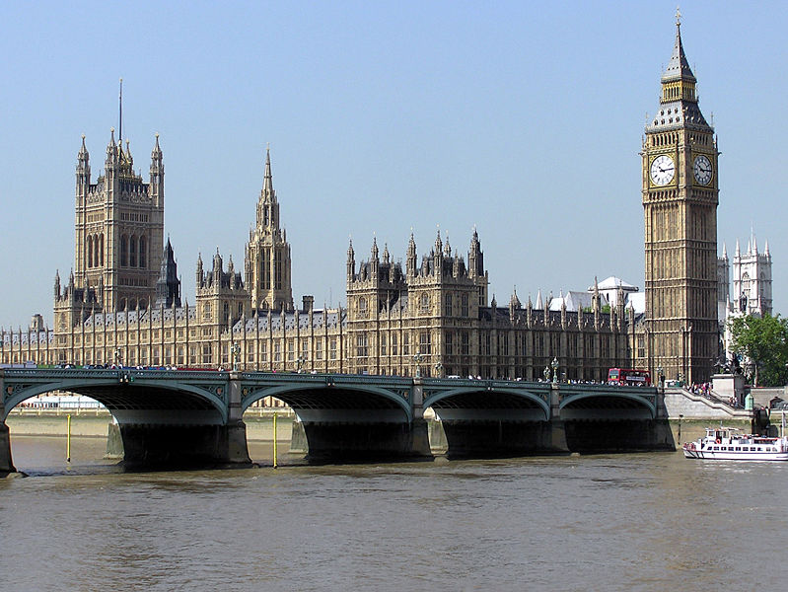

Slide 5
Structure of the UK Parliament
BICAMERAL
The Monarch
UPPER HOUSE
The House of Lord
(used to be hereditary body)
Members of the House of Lords
Life Peers (about 700)
Bishops (26)
Hereditary Peers (92-since
House of Lords Act 1999)
(currently around 825 Members –
appointed by the Queen and
recommenden by the Prime Minister )
LOWER HOUSE
The House of Commons
elected and
representative body
MPs – Members
of the Parliament
(650 Members – elected by
the population at large)

Slide 6
Functions of UK Parliament
Read the 1st paragraph of the text and find the main functions of the UK Parliament.

Slide 7
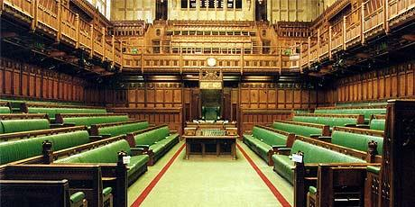
I House of Commons
Read about the House of Commons and find the following:
How does one become an MP?
What happens when an MP dies or retires?
Which political parties do most MPs belong to?

Slide 8
UK-wide representation and devolved Parliaments and Assemblies
What is a devolved legislature?
= a subnational legislature to which powers are statutory granted by the main/national legislative body (zakonodavno tijelo s prenesenom nadležnošću)
Read the section on UK-wide representations and find the devolved legislatures in the UK. Complete the table. What additional information are mentioned about the UK Parliament?
UK Parliament
 | a devolved parliament with power to make legislation in Wales; - 60 members known as Assembly Members (AMs); created by the Government of Wales Act 1998; since the referendum in 2011, it can legislate without having to consult the UK parliament or the Secretary of State for Wales in the 20 areas that are devolved
 | unicameral legislature in Edinburgh; 129 elected members known as members of the Scottish Parliament (MSPs); - has the power to legislate in all areas that are not explicitly reserved to the UK Paliament (according to Scotland Act 1998)
 | unicameral legislature in Belfast; 90 members known as Members of the Legislative Assembly (MLAs) has power to legislate in a wide range of areas that are not explicitly reserved to the UK Parliament

Slide 9
Working in Parliament and constituencies
Find in the text the tasks of MPs in the Parliament and their constituencies.
In PARLIAMENT
In CONSTITUENCIES

Slide 10
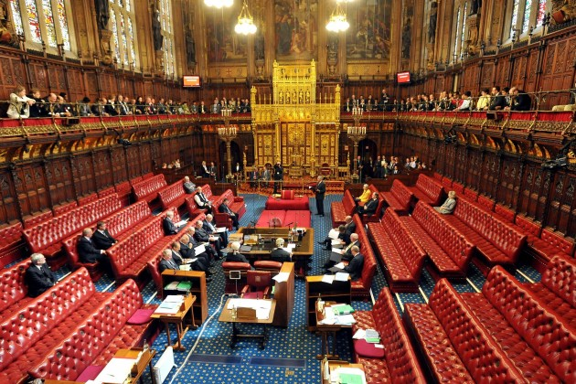
II House of Lords
Find in the text:
The main tasks of the Lords
-
-
-
Who are the members of the House of Lords and how are they appointed:
_____________________ -
_____________________ -
_____________________ -

Slide 11
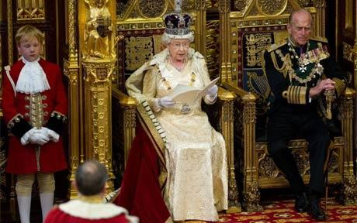
III The Monarch
The rights of the Queen:
The right to be consulted by the Prime Minister
To encourage certain courses of action
To warn against others
Read the paragraph entitles The Monarch and complete the list of
powers of the UK Monarch:
Powers of the Monarch are:
The power to appoint and dismiss the Prime Minister
The power to appoint and dismiss other ministers.
The power to ____________________________ Parliament
The power to make war and peace
The power to command the armed forces of the United Kingdom
The power to ratify treaties
The power to issue passports
The power to appoint bishops and archbishops of the Church of England
The power to create peers (both life peers and hereditary peers)
The power to give ____________________ .

Slide 12
Parliamentary sovereignty and the UK constitution
Explain the terms:
PARLIAMENTARY SOVEREIGNTY
UNWRITTEN CONSTITUTION

Slide 13
Parliamentary sovereignty
= the doctrine that states that the Parliament or a legislature, acting within its jurisdiction, may enact or repeal any law it chooses, and that the UK courts have no power to declare laws duly passed by Parliament invalid
According to A.V. Dicey (Law of the Constitution, 1885), "In theory Parliament has total power. It is sovereign." Dicey's view of parliamentary sovereignty consisted of four factors:
1. Parliament is competent to pass laws on any subject;
2. Parliament's laws can regulate the activities of anyone, anywhere;
3. Parliament cannot bind its successors as to the content, manner and form of subsequent legislation; and
4. Laws passed by Parliament cannot be challenged by the courts.

Slide 14
Written constitution vs. unwritten constitution
--------------------------------------------------------------------------------------------------------------
WRITTEN CONSTITUTION = the constitution where the provisions are all contained in a single document formulated and adopted by a constituent assembly or a council or a legislature
UNWRITTEN (uncodified) CONSTITUTION = the constitution found in several historical charters, laws and conventions; a product of slow and gradual evolution (the UK constitution consists of Acts of Parliament, court judgments, conventions)
--------------------------------------------------------------------------------------------------------------
ENACTED CONSTITUTION = the constitution that was created through a constitutional convention; this convention is called to be able to draft the constitution.
EVOLVED CONSTITUTION = the constitution that is developed as a part of the history of a particular nation; it was not created through a national convention
--------------------------------------------------------------------------------------------------------------
Is the UK constitution an enacted or evolved constitution?

Slide 15
Vocabulary practice
Answer the questions in ex. III.
Do ex. IV, V and VI.

Slide 16
LEGISLATIVE PROCEDURE
IN THE UK PARLIAMENT

Slide 17
Legislative Procedure
ACT OF PARLIAMENT – starts as a BILL
Bill = a proposal for a new law, or
= a proposal to change an existing law,
presented for debate before Parliament
Bill = can start in the House of Commons or the House of Lords
= must be approved in the same form by both Houses before becoming an Act (law)
Who can propose / introduce a Bill?
The government
Individual MPs or Lords
Private individuals or organisations

Slide 18
Legislative Procedure – Types of bills
PUBLIC BILLS – the most common type of bills, proposed mostly by the Government, apply to the general population (eg. Change to the national speed limit on motorways)
PRIVATE MEMBERS’ BILLS – Public Bills introduced by MPs and Lords who aren’t government ministers; only minority become law; may affect legislation indirectly by drawing attention to specific issues
PRIVATE BILLS - usually promoted by organisations (e.g. local authorities or private companies) to give themselves powers beyond the general law; change the law as it applies to specific individuals or organisations
HYBRID BILLS - mix the characteristics of Public and Private Bills; changes to the law proposed by a Hybrid Bill are of national importance but affect one part of the UK or a significant for a particular group or individual (eg. Channel Tunnel Bills)

Slide 19
Legislative Procedure - Stages
I HOUSE OF COMMONS
BILLS usually originate in the Commons (taxation bills must start in the Commons)
-goes through several stages (readings and debates)
II HOUSE OF LORDS
- debate, vote on passage
may return a Bill to the Commons for revision and amendments (cannot reject a Bill)
RESTRICTED POWERS - cannot delay the passage of Money Bills; certain bills can become laws without the consent of the Lords
III THE MONARCH
- if passed in identical form by both Houses – presented to the Queen for the ROYAL ASSENT – approval of the Queen - a formal role
BILL LAW (Act of Parliament)

Slide 20
Legislative Procedure - Stages
First Reading Second Reading Committee Stage Report Stage Third Reading Repeat of process in the House of Lords Royal Assent | Formal introduction of Bill into the House of Commons Main debate on Bill’s principles (voted, amendments can be added,can be defeated) Clause by clause consideration of the Bill by a select committee (called standing committee), amendments can be added Committee reports suggested amendments back to the House of Commons, only amendments are discussed, new amendments may be added Final draft of the Bill is reviewed, final debate on the Bill All stages are repeated BUT if the House of Lords votes against the Bill, it can go back to the House of Commons and become law if the House of Commons passes it for the second time (rare occurrence) A formality - normally Acts of Parliament come into force at midnight after receiving the Royal Assent

Slide 21
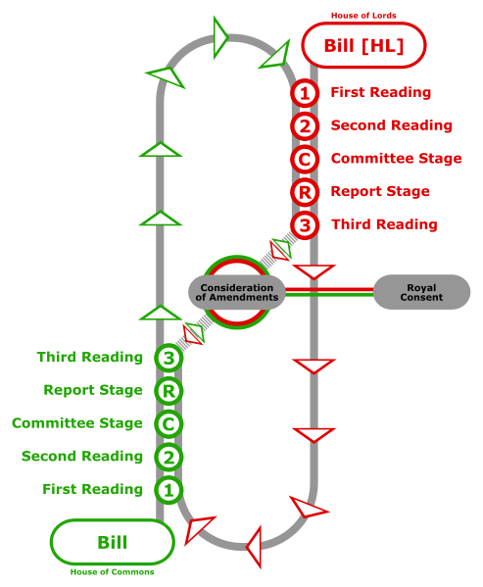

Slide 22
The Royal Assent
the formal method by which a Monarch in many constitutional monarchies completes the process of the enactment of legislation, by formally assenting to an Act of Parliament
Three formal options:
Grant the Royal Assent = sign a bill into a law
Withhold the Royal Assent = veto the Bill
Reserve the Royal Assent = neither veto nor confirm it, just leave it in limbo for an unspecified period
- in practice no British monarch since 1707 has withheld the Royal Assent

Slide 23
Legislative procedure
Read the text entitled Legislative procedure and answer the questions on p. 79.

Slide 24
Vocabulary practice
Find the Croatian equivalents.
= statute / statutory law = = statutory laws = = statutory book = = an Act of Parliament = = to pass/enact a law = = to repeal a law = = overrule a law = = a bill = = to introduce a bill = = to defeat a bill = = to vote ON a bill = = to cast a vote in a constituency = = devolved legislature = = to hold a by-election = | = to summon, prorogue parliament = = to dissolve Parliament = = sovereignty = = to grant royal assent = = to withhold royal assent = to approve (approval) = = to appoint = = appointment = = to amend (a bill or a law) = = House of Lords = = House of Commons = = bicameral =

Slide 25
Vocabulary practice - Key
= statute / statutory law = kodificirano (pisano) pravo = statutory laws = zakonski propisi (koje donosi parlament) = statutory book = zbirka zakona/zakonik = an Act of Parliament = zakon (koji donosi parlament) = to pass/enact a law = donijeti zakon = to repeal a law = opozvati zakon = overrule a law = poništiti zakon = a bill = nacrt zakona, prijedlog zakona = to introduce a bill = podnijeti prijedlog zakona = to defeat a bill = poništiti prijedlog zakona = to vote ON a bill = glasovati o prijedlogu zakona = to cast a vote in a constituency = glasovati u izbornoj jedinici = devolved legislature = zakonodavno tijelo s prenesenom nadležnošću = to hold a by-election = održati izvandredne izbore | = to summon, prorogue parliament = sazvati sjednicu, završiti zasjedanje Parlamenta = to dissolve Parliament = raspustiti parlament prije izbora = sovereignty = suverenitet, nezavisnost (sovereign = suveren, nezavisan) = to grant royal assent = dati kraljevsku potvrdu zakona = to withhold royal assent = uskratiti kraljvesku potvrdu zakona = to approve (approval) = odobriti (odobrenje) = to appoint = imenovati; = appointment = imenovanje = to amend (a bill or a law)= dopuniti = amendment = amandman, dopuna = House of Lords = Gornji dom britanskog parlamenta = House of Commons = Donji dom britanskog parlamenta = bicameral = dvodomni

Slide 26
Vocabulary practice II
I Fill in the gaps with the following words:
legislate repeal delegated bye-laws enact amend statutes enforce Bills
The predominant sources of law in the UK are: primary legislation, known as Acts
of Parliament or ___________, which begin life as drafts called __________; and
secondary or ____________ legislation, such as statutory instruments, _________,
and professional regulations.
A new Act is usually passed in order to update or __________existing legislation or
to ___________ for new circumstances and enforce government policies.
Parliament can ___________ any law it chooses or _________ obsolete laws which
are no longer relevant, and the courts must ___________ it. The exception to this is
EU law.

Slide 27
Vocabulary practice II - Key
The predominant sources of law in the UK are: Primary legislation, known as Acts of
Parliament or statutes, which begin life as drafts called Bills; and secondary or
Delegated legislation, such as statutory instruments, bye-laws, and professional
regulations. A new Act is usually passed in order to update or amend existing
legislation or to legislate for new circumstances and enforce government policies.
Parliament can enact any law it chooses or repeal obsolete laws which are no
longer relevant, and the courts must enforce it. The exception to this is EU law.
II Translate the above text into Croatian.

